Slide 1
CLARA Simplified Planning Tool
http://clara.boku.ac.at
Günter Langergraber
Institute of Sanitary Engineering,
BOKU University, Vienna, Austria

Slide 2
Copy it, adapt it, use it – but acknowledge the source!
Copyright & Disclaimer
Copyright
Included in the SSWM Toolbox are materials from various organisations and sources. Those materials are open source. Following the open-source concept for capacity building and non-profit use, copying and adapting is allowed provided proper acknowledgement of the source is made (see below). The publication of these materials in the SSWM Toolbox does not alter any existing copyrights. Material published in the SSWM Toolbox for the first time follows the same open-source concept, with all rights remaining with the original authors or producing organisations.
To view an official copy of the the Creative Commons Attribution Works 3.0 Unported License we build upon, visit http://creativecommons.org/licenses/by/3.0. This agreement officially states that:
You are free to:
Share - to copy, distribute and transmit this document
Remix - to adapt this document. We would appreciate receiving a copy of any changes that you have made to improve this document.
Under the following conditions:
Attribution: You must always give the original authors or publishing agencies credit for the document or picture you are using.
Disclaimer
The contents of the SSWM Toolbox reflect the opinions of the respective authors and not necessarily the official opinion of the funding or supporting partner organisations.
Depending on the initial situations and respective local circumstances, there is no guarantee that single measures described in the toolbox will make the local water and sanitation system more sustainable. The main aim of the SSWM Toolbox is to be a reference tool to provide ideas for improving the local water and sanitation situation in a sustainable manner. Results depend largely on the respective situation and the implementation and combination of the measures described. An in-depth analysis of respective advantages and disadvantages and the suitability of the measure is necessary in every single case. We do not assume any responsibility for and make no warranty with respect to the results that may be obtained from the use of the information provided.

Slide 3
Contents
1. Rationale
2. Purpose
3. Advantages / disadvantages
4. Example
5. Summary

Slide 4
1. Rationale
Systemic decisions in water supply and sanitation usually have a long term impact due to the lifespan of the related investments.
If therefore investments in one particular water supply and sanitation system (or a combination thereof) have been made it is unlikely that this decision is revoked for a long term, at least the lifespan of the system.
It makes therefore sense to thoroughly analyse different water supply and sanitation systems at a very early stage of the planning process for water and sanitation infrastructure and select the most appropriate system for future investments

Slide 5
1. Rationale (cont'd)
Frequently planning approaches limit themselves to consider relatively small planning areas, say parts of a town or village, which neglects that certain systems are requiring a minimum size to become effective and efficient.
Or systemic decisions, e.g. centralised or decentralised, water-borne or dry, etc., are already taken before the planning process starts and set as a pre-condition for this very planning process.

Slide 6
2. Purpose
Purpose of the CLARA Simplified Planning Tool is to provide planners with a software tool which not only allows but even encourages the comparison of fundamentally different water and sanitation systems at a very early planning stage, requiring a limited amount of effort from the side of the planner, respectively creating minimal cost for the client.
The tool shall - for given framework conditions - identify the most appropriate water and sanitation system, appropriate being defined as legally compliant, fulfilling clients’ requirements and having the lowest NPV. This means that the identified solution fulfils all pre-defined criteria in the most cost effective way.

Slide 7
3. Advantages / disadvantages
Advantages:
Full costs of different alternative system solutions can be compared
Resources-oriented watsan systems included
Only limited amount of input data required and thus applicably in the early phase of the planning process
Costs based on data from 5 African countries
Cost functions can be changed
Adaptation to other (African) countries possible
Disadvantages:
Software implemented in MSExcel® and thus requires MSExcel® (version higher than 2010) to be used
Limited amount of technologies implemented
Mass flow balance check not yet implemented, i.e. comparison of systems with different performance is possible
Cost functions based on BoQs and not real cost
Adaptation to other countries requires some efforts

Slide 8
Community with 10'000 inhabitants Assumptions:
4. Example
Alternative 1: water borne sanitation system
house connections
sewer
wastewater treatment plant (SBR)
sludge thickener
belt filter press
composing (de-watered sludge)
Alternative 2: dry sanitation system
urine-diverting dry toilets
collection of urine and faeces
struvite production from urine
+ VF CW
co-composing of faeces
Length: 25 km
Nitrification
Sludge = 0.008 * PE = 80 m³/d
Sludge = 0.002 * PE = 20 m³/d
Sludge = 0.128 * PE = 1280 m³/y
Urine collection interval: 14 days
Distance to treatment site: 10 km
size 170 PE w. 1.5 m²/PE

Slide 9
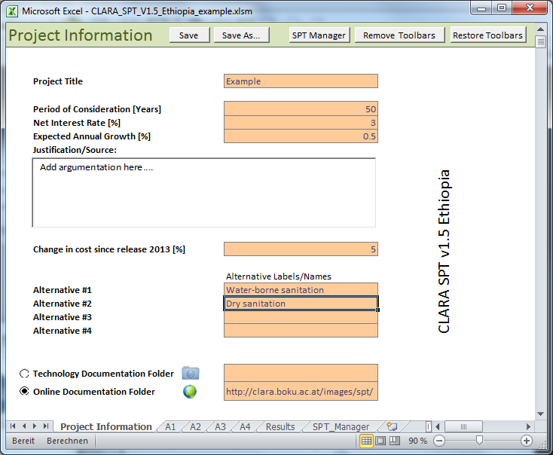
4. Example
"Project information" sheet

Slide 10
4. Example
Example of input data and technology specific results for technology "Sanitary sewer".

Slide 11
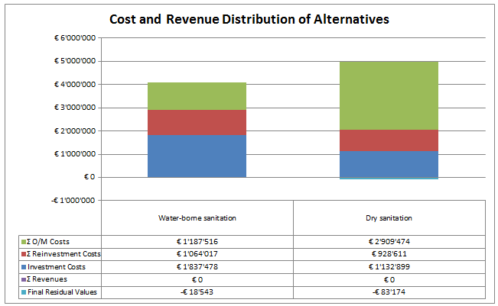
4. Example
Results 1 - Accumulated costs over the whole duration of consideration.

Slide 12
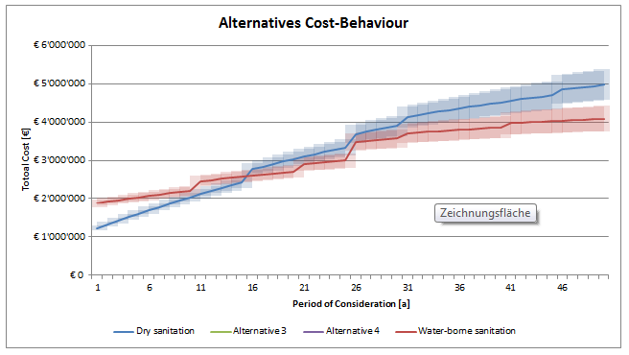
4. Example
Results 2 - Development of total costs over time.

Slide 13
CLARA Simplified Planning Tool (SPT)
5. Summary
for comparing SYSTEM alternatives during pre-planning
only alternatives that fulfil the legal requirements can be considered → cost comparison
based on cost data from Burkina Faso, Ethiopia, Kenya, Morocco and South Africa.
Burkina Faso and Moroccan version of SPT available in French.
The CLARA SPT is available for download for free from
the CLARA website (http://clara.boku.ac.at/) and
within the SSWM toolbox (http://www.sswm.info/home)
by the end of February 2014 (latest)
Other results from CLARA: see special issue of the SSP journal (http://www.ecosan.at/ssp) in April 2014

Slide 14
Acknowledgements
The work was carried out within the project CLARA (Capacity-Linked water supply and sanitation improvement for Africa’s peri-urban and Rural Areas; Contract # 265676; duration: 1.3.2011 – 28.2.2014), a Collaborative Project funded within the EC 7th Framework Programme, Theme "Environment (including Climate Change)". The CLARA team is grateful for the support.
Contact
Dr. Guenter Langergraber
Coordinator CLARA project
Institute of Sanitary Engineering, BOKU University
Vienna, Austria
Tel.: +43 (0)1 47654-5814
Fax: +43 (0)1 47654-5803
Email: guenter.langergraber@boku.ac.at
http://clara.boku.ac.at/

Slide 15
“Linking up Sustainable Sanitation, Water Management & Agriculture”
SSWM is an initiative supported by:
Created by:

