Slide 1
Module 5 – Synthesis & Perspectives
Updated Summary text for the module
Ppt and Video link for lecture
Literature for references, further readings, case studies, weblinks, etc.
List of SSWM factsheets that should be linked into this module or that should be adapted from existing factsheets. (Currently nothing has been identified.)
Inputs on other content that needs to be developed.

Slide 2
Summary and perspectives
The Arctic region is stretching over 14 million km² from 66 ºN latitude to the North Pole. Within this vast region, distributed among the eight Arctic nations, only 13 Million people are living permanently mainly in coast-near settlements and roughly half are settled within the Russian Arctic. The scattered distribution of the settlements poses considerable challenges for the establishing of modern water management. Drinking water supply as well as waste water handling in Arctic settlements are characterised by decentralised infrastructures and minimum cleaning technologies for drinking water and sewage.
Currently only in large settlements (>2000 inhabitants) are central water supply and basic waste water/ sewage treatment facilities installed. Most small settlements (< 2000 inhabitants) are still depended on individual water supply systems as well as individual wastewater and sewage treatment facilities (i.e. Honey Bucket collection systems).
The lack of suitable water supply and treatment facilities in many regions and settlements is today identified as a considerable risk for spreading of infectious diseases, pathogens and anthropogenic pollutants both among the human populations as well as into the environment.
In addition, the currently observed rapid environmental changes in the Arctic regions pose additional stress on infrastructure and requires new routines and updates in water treatment and handling infrastructures. The continuous effects on the Arctic cryosphere (permafrost, icecap reduction, decrease in sea ice coverage) has direct documented effects on the integrity of the available infrastructures as well as the functionality of current treatment routines in the settlements.. Thus in the near future considerable changes are expected in technological solution, treatment strategies and awareness of the individual Arctic inhabitants.

Slide 3
Water management in Arctic communities (Supply and sewage)
Synthesis and Perspectives
Presenter: Roland Kallenborn
With contribution from Nick Ashbolt, Rhonda Johnsen, Cheryl Rosa
Norwegian University of Life Sciences (NMBU) & University Centre in Svalbard (UNIS)
Contact info: roland.kallenborn@nmbu.no; tel.: +47 67232497

Slide 4
Basic requirements of water managements
Water supply: Providing safe and high quality water for consumption and other needed use in households and other public as well as industrial facilities.
Used water/ sewage: used water and aqueous wastes are removed under safe conditions and treated in a way that minimum risk is posed to humans and environments.

Slide 5
The importance of water in our daily life and the environment
70% of the earth is covered by water
Most important consumer liquid for human populations.
The human body consists of >60% water
Important for maintaing hygiene and sanitary standards
Important for agricultural purposes
Important as habitat for wildlife
Important as carrier of nutrients
.
.
.

Slide 6
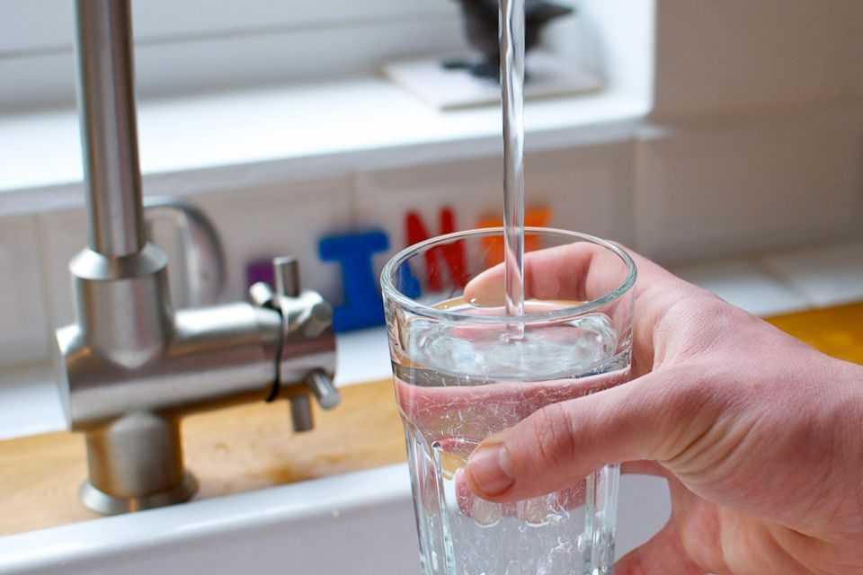
Technological requirements
Technological requirements/ Technical standards are regulated via national guidelines and international agreements
Potable water: Clean Water Act (CWA; US-EPA), Drinking water guidelines (Canada); Drinking water directive (EU), ...
Sewage treatment: CWA (US-EPA); Wastewater Systems Effluent Regulations (Canada); Waste water treatment directive (EU).
Environmental regulations: Water frame work directive (EU), Canadian Environmental Protection Act )Canada), CWA (US-EPA).
WHO (2011) 4th edition drinking water guideline (used to undermine EU and EPA standards)
WHO (2006) Guidelines for the Safe Use of Wastewater, Excreta and Greywater

Slide 7
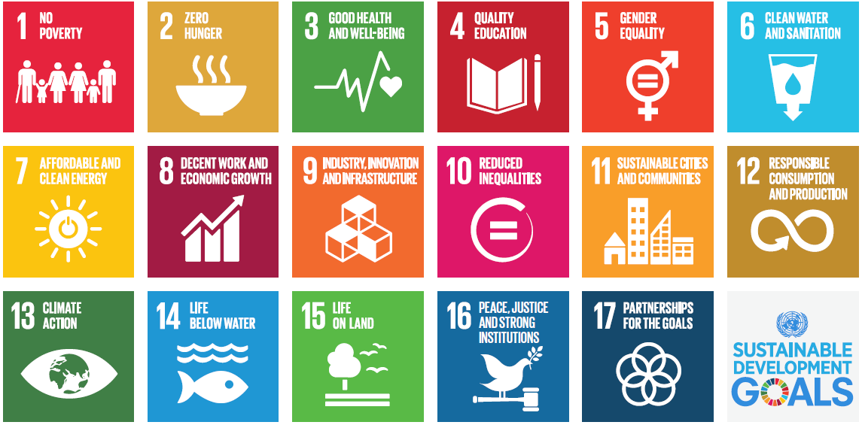
Societal expectations and priorities

Slide 8
Situation in the cold North
Scattered populations over vast distances
Individual houshold based solutions
Minimum drinking water cleaning and controll
Minimal decentralised Sewage handling systems
Adopting risk-based performance standards
Environmental change will add to the already challenging situation – loss of permafrost, erosion, ambient temperatures

Slide 9
Challenges in the North
Not up-dated infrastructure
Quality control of potable water supply
Basic or not existing sewage facilities
Inadequate storage of wastes and sewage
Climate change: Erosion – infrastructure damages – extreme events predicted
Loss of Cryosphere
Demography and Accessibility: industry, tourism, Transportation

Slide 10
Health related aspects in Arctic water management
Water quality is important to health, but, in some regions, water QUANTITY is a/the major issue. The cost in $ and time to haul water and sewer often results in WATER RATIONING in Alaskan villages.
There are direct health impacts of water rationing. The inability to wash hand and body leads to increased prevalence of “water WASHED” diseases: skin and respiratory diseases. It can also lead to a host of indirect impacts (i.e., illness leads to missed school which leads to lower economic status, poorer health for life or illness leads to missed work and subsistence opportunities).
Water conservation strategies:
· Pre-prepared food that doesn’t require water (i.e. microwavable)
· Paper plates, cups, utensils – in order to conserve water
· Reusing water in washbasins, washing machines
· Reduced hygiene (bathing, laundry, dishes, etc.)
· Reduce water used for cooking
· May or may not treat water from traditional sources
· Emigration

Slide 11
Water security and drinking water quality
Household water security: The ability to access and benefit from affordable, adequate, reliable and safe water to meet all domestic, health, and cultural needs.
Household water insecurity: “when at least one of these variables is reduced or unattainable”.
Water insecurity is an involuntary condition.
It means uncertainty: Water insecurity means not knowing where or how much water you will be able to benefit from for a prolonged period of time.I t is something beyond the immediate control of the household.
Dynamic household water insecurity in AK will likely grow due to
-Climate change
-Reduced funding for infrastructure
-Aging infrastructure…
References: Jepson, Wutich, Collins, et al (2017), Adapted from L. Eichelberger presentation

Slide 12
Requirements in the Northern/ Arctic communities
Adjusted dimensjons to local population size
Technological solutions fit for Arctic conditions and infrastructures
Logistical and maintenance demands in accordance with available local resource.
Social and traditional considerations
Economy
Others?

Slide 13
Discussion on challenges and expections for Water management in Cold environments
Questions (Sewage)
What are the requirements for modern solutions for sewage treatments in Arctic condition?
What are the major restrictions and challenges for adequate sewage handling in the Arctic
How are social and traditional aspects considered in technology adjustments
Considering resource-recovery based systems in Arctic communities

Slide 14
Discussions: Perspectives and synthesis
Questions (drinking water)
What are the most significant challenges drinking water management (cleaning and distribution) in cold environments must face today?
Are modern technological solutions suitable and available and meeting the requirements of infrastructures in cold environments
What are the major restrictions challenges for introducing better technological solutions for Arctic communities

Slide 15
Thank you for an exciting and inspiring summer school on
«Water Management in cold Regions»

