Slide 1

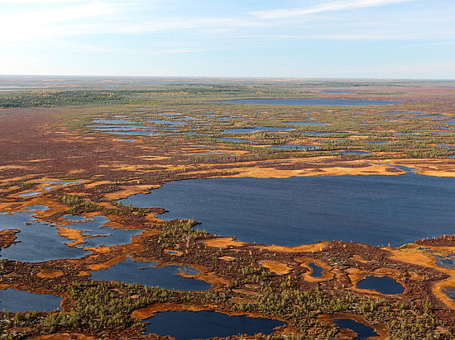
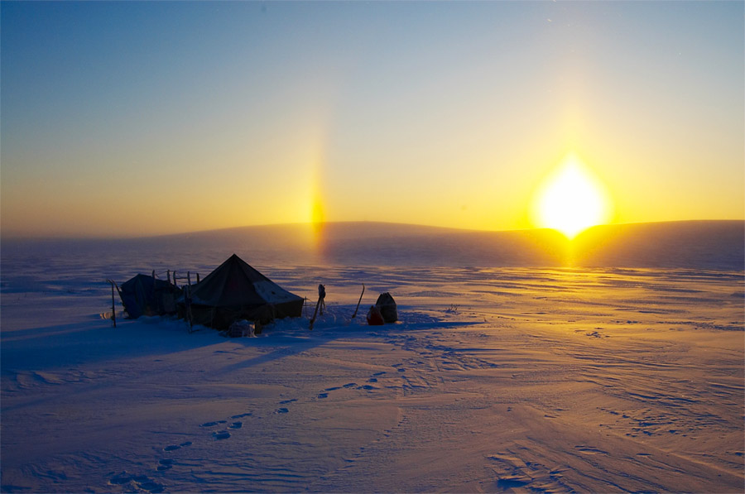
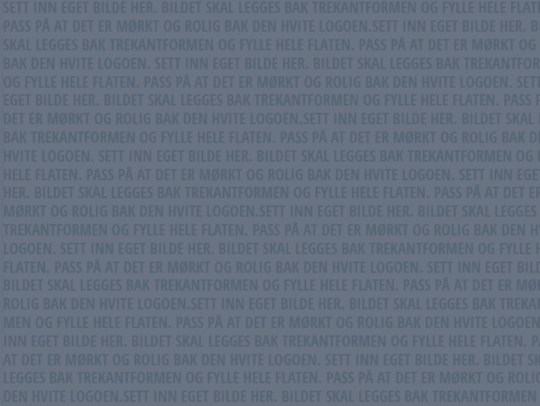
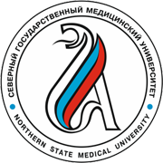
WATER, FOOD AND INDIGENOUS CULTURE
Yury Sumarokov, MD, PhD
Northern State Medical University,
Arkhangelsk

Slide 2
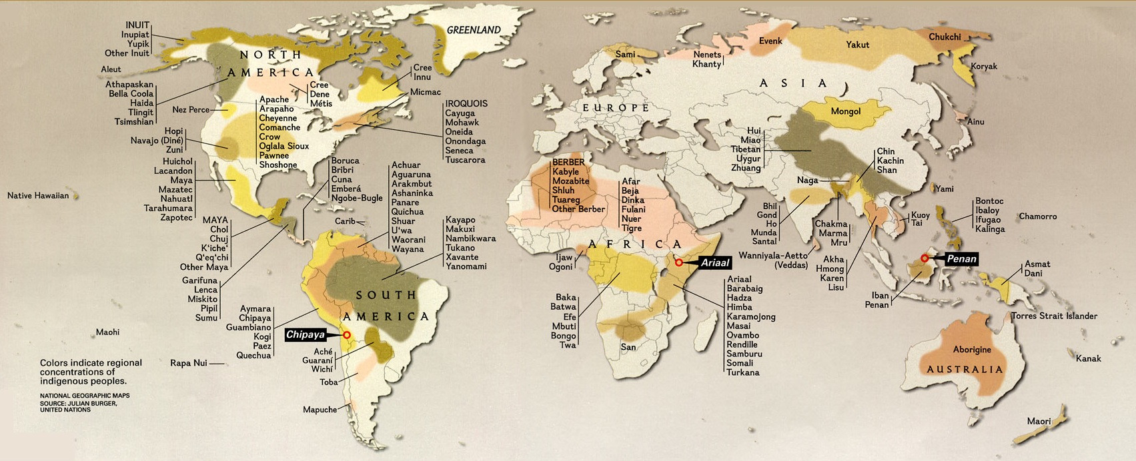
Indigenous peoples of the World
5000 groups, 370 million people
Notes:
There are approximately 370 million Indigenous people in the world, belonging to 5,000 different groups, in 90 countries worldwide, 70% - in Asia. Indigenous suicide rates aggregated across
whole nations or geographical regions are remarkably high, suicide rates actually vary dramatically when examined at the level of Indigenous tribes or communities.

Slide 3
Indigenous people (UN definition)
Self- identification as indigenous peoples at the individual level and accepted by the community as their member
Historical continuity with pre-colonial and/or pre-settler societies
Strong link to territories and surrounding natural resources
Distinct social, economic or political systems
Distinct language, culture and beliefs
Form non-dominant groups of society
Resolve to maintain and reproduce their ancestral environments and systems as distinctive peoples and communities.
Source: http://www.un.org/esa/socdev/unpfii/documents/5session_factsheet1.pdf
Notes:
Considering the diversity of indigenous peoples, an official definition of “indigenous” has not been adopted by any UN-system body.
Instead the system has developed a modern understanding of this term based on the following:
Self- identification as indigenous peoples at the individual level and accepted by the community as their member
Historical continuity with pre-colonial and/or pre-settler societies
Strong link to territories and surrounding natural resources
Distinct social, economic or political systems
Distinct language, culture and beliefs
Form non-dominant groups of society
Resolve to maintain and reproduce their ancestral environments and systems as distinctive peoples and communities.

Slide 4
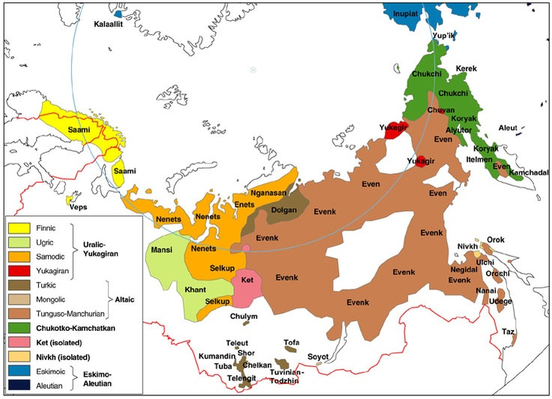
Indigenous people of the Russian Arctic
Source: www.landofmaps.com
Notes:
In the Russian Federation, indigenous nations are defined according to Federal Law. There are about 40 indigenous groups that reside in the Russian Arctic, Siberia, and the Russian Far East. A governmental decree officially defines their status as “Indigenous small-numbered people of the North, Siberia and Far East”. In the Russian Arctic, almost half of these ethnic groups coexist.

Slide 5
Cultural values of indigenous people
Indigenous | Western
Harmony with nature Soul and body united Feelings are important Education from the elders Leaders serve the people To be > to have | Domination of nature Soul and body are divided Feelings must be rationalized Educations from the professionals People serve the leaders To have > to be
Source: Mulvad G. Circumpolar Mental Wellness Symposium. Igualuit, Canada. 2015.
Notes:
G. Mulvad [62] concluded that indigenous peoples use multifactorial processes to define and understand the circumstances of their life, rather than taking a problem-specific approach. Many behavioral differences between indigenous and non-indigenous populations are based on their different cultural values.
Any damage to or pressure on the cultural values of indigenous peoples may lead to an increase in depression, violence, addiction problems, and suicides.
You can not get or demand a culturally competent health care system from the government, the only way is to build it yourself (in Greenland, Northern Canada, Russia))
The health situation among the indigenous people is the end of a historical process that has fostered dependency, loss of identity and marginalization.

Slide 6
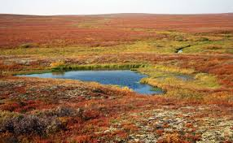
Sources of water in the Arctic
Rivers
Lakes
Snow and ice
Rains

Slide 7
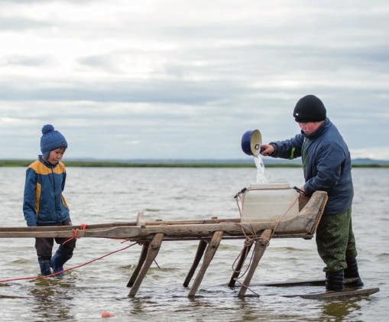
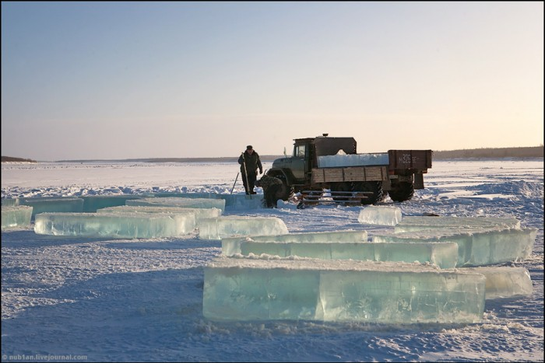
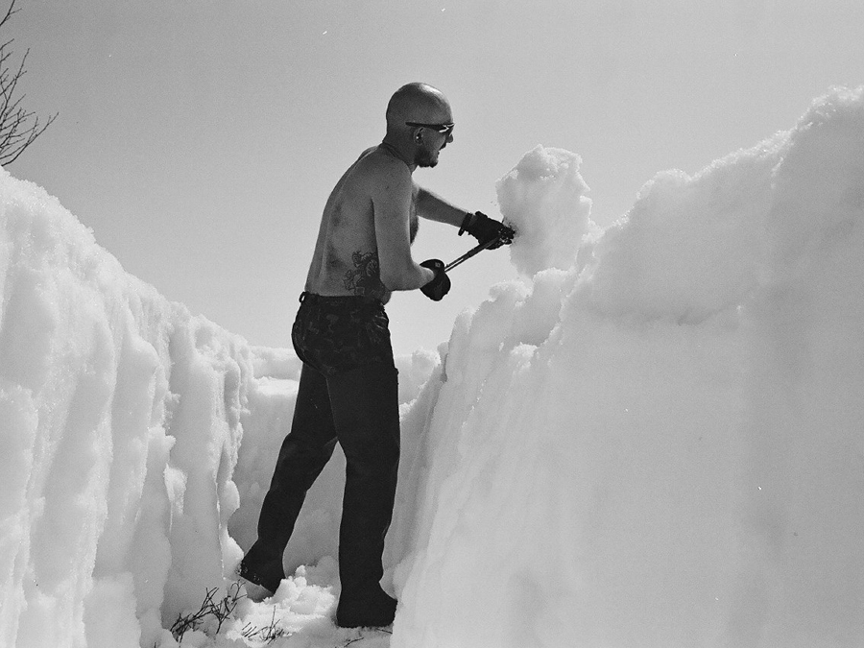
Sources of drinking water in the Arctic

Slide 8
Indigenous values of water
Water is source of life and food
Water is health
Water is communication (logistics)
Water is home of spirits (religion and spiritual value)

Slide 9
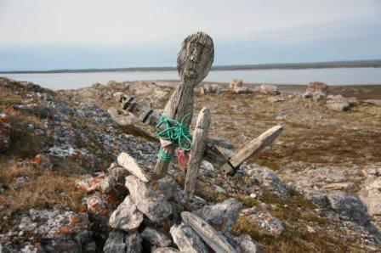
Role of sacred places
1) Places of sacrifice to the gods near the settlements
2) Revered hills
3) The revered islands, including temporary ones (with a decrease in the water level in the river)
4) Sacred sites of rivers (a whirlpool where the “spirits-owners” live)
5) Forbidden territories (where “spirits dangerous for people” live), incl. water reservoirs. There you can not walk, harvest, make noise, fish and hunt, go ashore.
We know 718 sacred places in Arctic Russia, including 87 burial places,
177 places are protected by the state.
Notes:
Indigenous people’s traditional knowledge in management and conservation on natural water resources.
Vital role of indigenous people in sustaining the land, forests and watersheds.
Prevention the destruction of natural ecosystems and habitats, pollution in land and waters, depletion of water sources due to the extractive industries.
Programs on health and sanitation of local indigenous communities.

Slide 10
Food values of Arctic indigenous people
Indigenous | Western
High animal proteins and fat (non-processed) High consumption of fish, low – carbohydrates (< 30%) Food security is low Berries, mushrooms, plants – sources of vitamins and minerals Food is a source of life Spiritual value of food | Refined sugars, fat and processed meat High consumption of carbohydrates (> 60%) Food security is high Food supplements (artificial) Food is energy and health Food is pleasure
Notes:
G. Mulvad [62] concluded that indigenous peoples use multifactorial processes to define and understand the circumstances of their life, rather than taking a problem-specific approach. Many behavioral differences between indigenous and non-indigenous populations are based on their different cultural values.
Any damage to or pressure on the cultural values of indigenous peoples may lead to an increase in depression, violence, addiction problems, and suicides.
You can not get or demand a culturally competent health care system from the government, the only way is to build it yourself (in Greenland, Northern Canada, Russia))
The health situation among the indigenous people is the end of a historical process that has fostered dependency, loss of identity and marginalization.

Slide 11
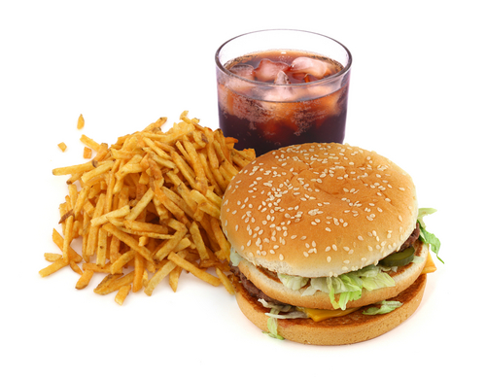
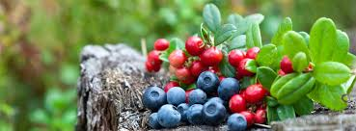
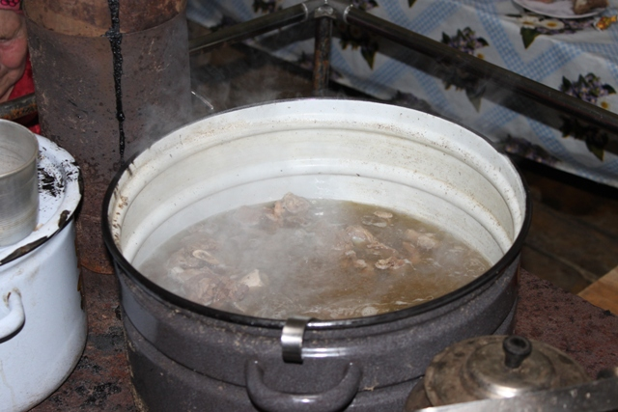
Two types of diet
European (carbohydrate type 1:1,2:4 with 55-60% of CH)
Polar (protein – fat type with 60 and more% of fat and proteins).
Notes:
Reindeer meat is also the most important part of the Nenets’ diet. It is eaten raw, frozen or boiled, together with the blood of a freshly slaughtered reindeer, which is rich in vitamins.
The Nenets also eat fish such as white salmon and muksun, a silvery-coloured whitefish and gather mountain cranberry during the summer months.

Slide 12
Use of natural plants
Traditional Plant Foods of Indigenous Peoples of Canada and Neighboring Areas
Major Plant Grouping | Approximate Number of Species Documented as of 1990
Seaweeds (Marine Algae) | 20
Lichens | 10
Mushrooms and other Fungi | 20
Ferns and Fern-allies | 15
Conifers (Gymnosperms) | 25
Flowering Plants - Monocotyledons | 60
Flowering Plants - Dicotyledons | 400
TOTAL | 550
Source: Kuhnlein HV, Turner NJ

Slide 13
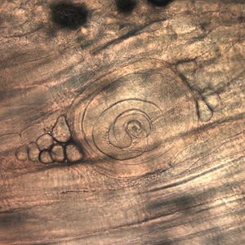
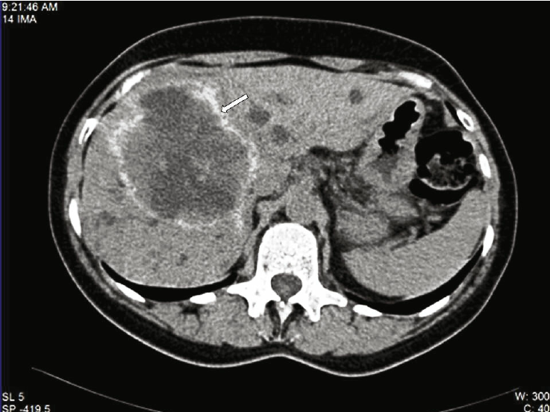
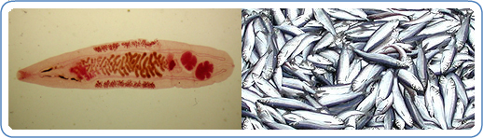
Risks of infectious and parasitic diseases
Opisthorchiasis (raw fish infection)
Brucellosis (undercooked land and marine mammals’ meat infection)
Alveococcosis (animal contact prior intake of food)
Trichinosis (wild predators meat)
Source: https://www.cdc.gov
Notes:
Infectious and parasitic diseases are important source of pathology in the Far North. The close relationship of the indigenous populations with the environment leads to a high prevalence of zoonotic diseases . Opisthorchiasis is endemic in KhantyMansiysky and Yamalo-Nenets Okrugs. Brucellosis is endemic in Magadansky Oblast, Chukotka and Taymyr. Alveococcosis is endemic in Koryakia and Yakutia. In recent years, due to the influence of anthropogenic factors as well as climate change, a significant transformation in zoonotic infectious diseases in the Far North has been underway, evidenced by major outbreaks of certain zoonoses. International experts predict that as a result of global warming and the melting of permafrost, there is a high probability that new disease vectors are expanding northwards, introducing new diseases .

Slide 14
Exotic and unsafe examples of Arctic indigenous food (“calorizators”)
NENETS:
FRESH REINDEER MEAT AND BLOOD (“AIBURDAT”)
STROGANINA
KOPALHEM (KOPALHEN, KOPALHYN, KOPALGYN, KOPALHA, IGUNAK)
Chukchi
VENISON – DRIED REINDEER MEAT
DEER BRAINS
PREREM – frozen reindeer meat (after cooking)
RILKYN
MONTAK / MANTAK (FIRST CHEWING GUM)
RILKEIL
KOLOBKI OR TOLKUSHA
KIVIAK
SECRET DISH “FOOD FOR LOVERS”
Notes:
VENISON
Boiled venison, venison broth, thinly sliced ​​frozen meat with salt –these are the main dishes made of deer. Venison has amazing properties (which could be easily verified, if you tried it). Venison was never fried, and when boiling it they tried not to overdo it too, so that the meat retained a little pink in it.
DEER BRAINS
They were prepared for newlyweds. Reality or myth –it is unknown, but legends speak of the hypersexuality of men who consumed this dish.
PREREM
The back part of the deer is cut into chunks and boiled. Cooked meat is then sliced ​​very, very thinly and mixed with warm melted deer lard. Then it is cooled. On top the dish is decorated with boiled bone marrow deer and then frozen. Prerem is a universal gift.
RILKYN
It is a mix of fresh deer blood, pieces of deer lard, venison and a little flour for thickness. This dish was prepared before the beginning of serious work.
MONTAK / MANTAK (FIRST CHEWING GUM)
Coastal Chukchi considered a delicacy fresh upper part of the whale skin with a layer of fat, which can be chewed for a long time.
RILKEIL
A special dish on Chukchi table. The contents of the stomach of a just slaughtered deer is squeezed out, to it added the blood of deer, deer fat, sliced ​​thinly gut of the deer, sometimes herbs, and boiled.
KOLOBKI OR TOLKUSHA
This is one of the most favorite dishes in Chukotka.
Roots and bulbs of collected herbs are pounded, then you add boiled venison and seal oil. Form balls. The dish is eaten cold.
KOPALHEM (KOPALHEN, KOPALHYN, KOPALGYN, KOPALHA, IGUNAK)
A caught seal or walrus are cut into large chunks with the skin (up to 80 kg) and is dug into the ground. The pit is preliminarily layered with plants that add flavor to the dish. In six months the dish is ready.
KIVIAK
This is a version of Kopalhem. In this case, the seal is stuffed with freshly caught gulls (in their entirety). Some think that the gulls need to be plucked (wrong). In half a year the dish is ready. The digestive enzymes of the gulls digest not only gulls but the seal as well. If you forget about the smell (yuck!), the flavor of the dish resembles a strong gourmet cheese.
SECRET DISH “FOOD FOR LOVERS”
Take 300 grams of boiled brains of deer, two boiled eider eggs, generously add green shoots of the golden root (ginseng), and to taste –some wild sorrel and onions. Mix it all together and serve immediately.

Slide 15
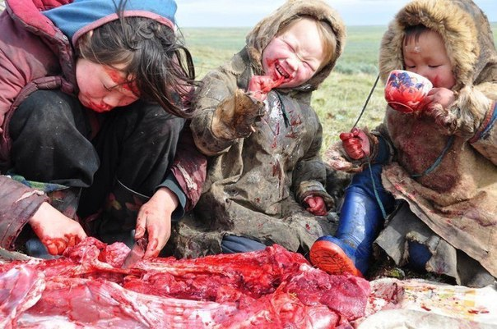
Fresh reindeer meat and blood (“uibarat”, “aiburdat”)
Source: Barents Photo
Notes:
Lactose intolerance – up to 90% of Nenets (among Nenets who had four Nenets grandparents was found to be 90%) - hypolactasia

Slide 16
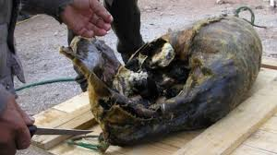
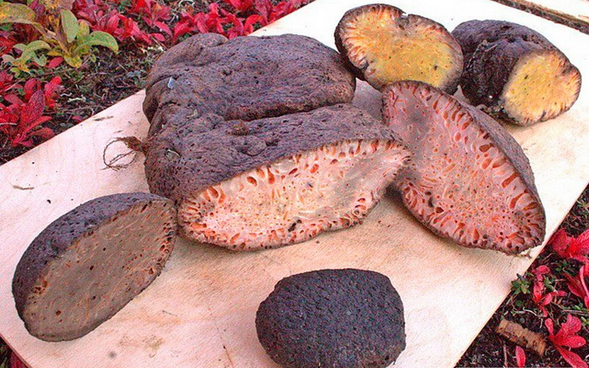
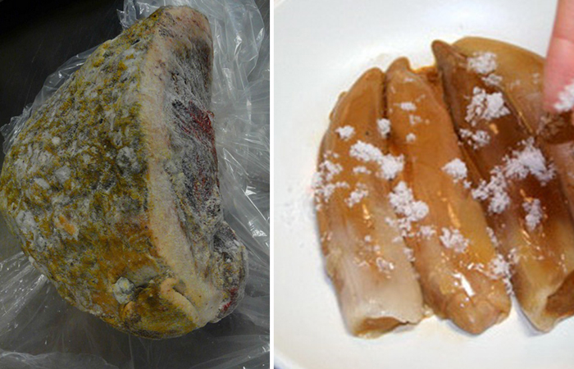
Fermented and stored reindeer meat, seal or walrus “Kopalkhen” (contain of cadaveric alcahoids – ptomains!)
Caught seal or walrus are cut into large chunks with the skin (up to 80 kg) and is dug into the ground. The pit is preliminarily layered with plants that add flavor to the dish. In six months the dish is ready (Chukchi).
Reindeer Is usually stored into the deep swamp.

Slide 17
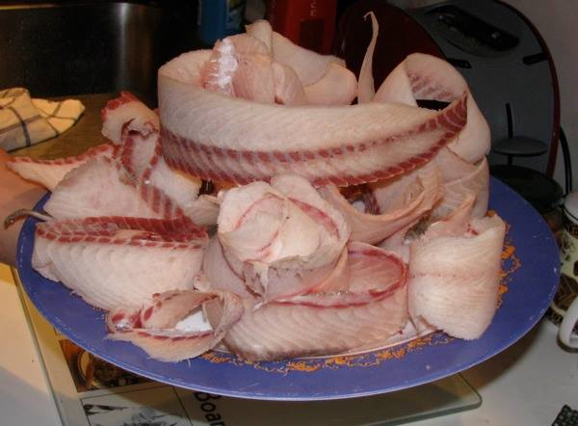
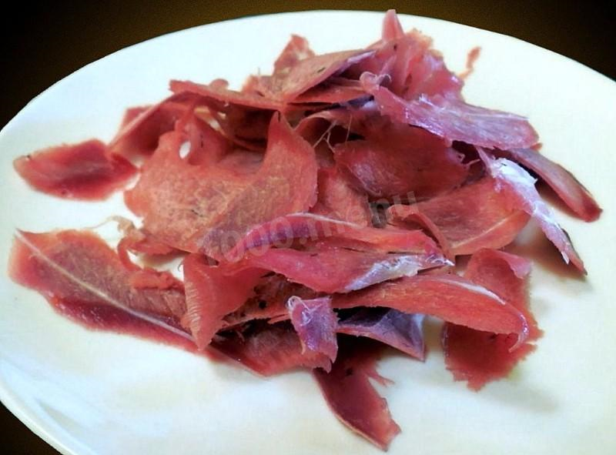
Fresh frozen fish and meat “Stroganina” (contain parasites!) - 172 kkal/100 g

Slide 18
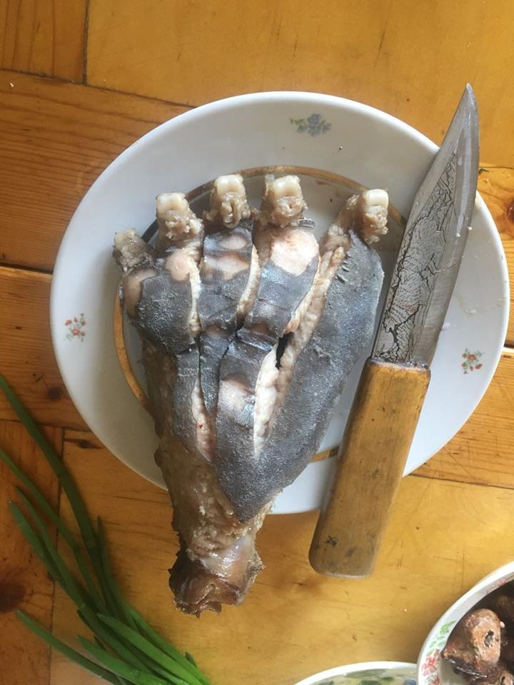
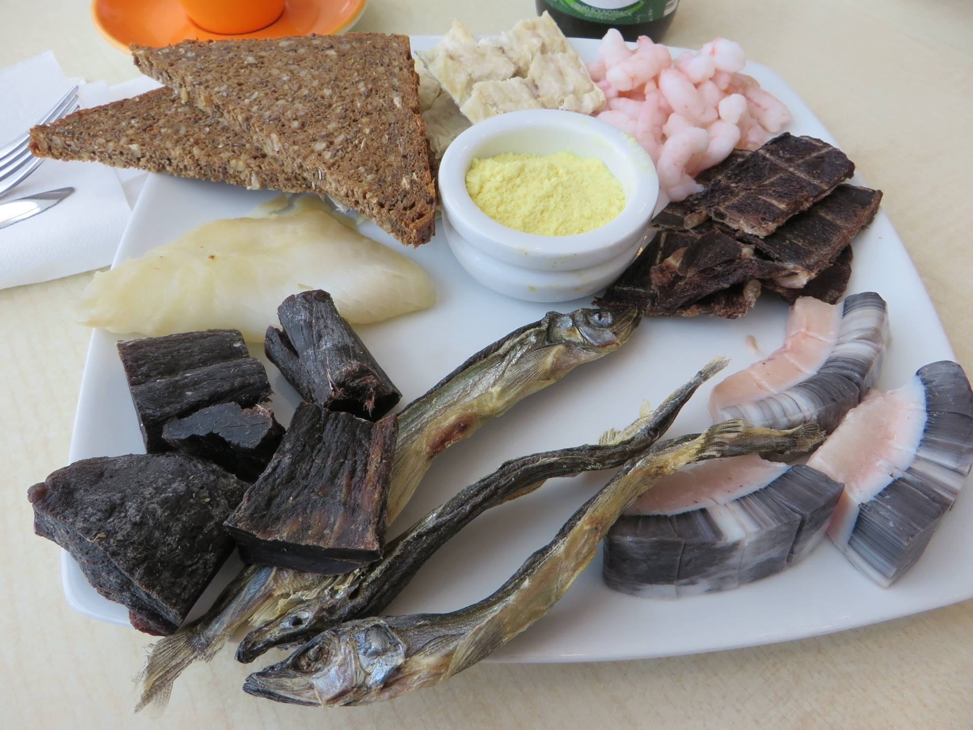
Other examples
Notes:
Mantak, Dried fish and whale meat.
Brown bear pad – “manaraga”

Slide 19
Health impact and food changes
Obesity (fast food, high consumption of CH)
Diabetes (refined sugars and high consumption of CH)
Alcohol abuse( supported by high consumption of CH, low consumption of non-processed meat and fish)
Urban life (economic, cultural and mental deprivation, hypo-dynamics, obesity, stress, depression alcohol and drug abuse, suicidal behavior).
Notes:
In the 1950s, various researchers found a low rate or near absence of atherosclerosis among the Inuit of Alaska and Canada. In Yakutia, Afanasyeva showed that atherosclerosis is seen significantly more often in the settler population than in the indigenous population.
For northerners, switching to carbohydrate nutrition is associated with a huge health risk, primarily for the cardiovascular system. Excess intake of light carbohydrates and isomeric fats leads to hypertension, coronary heart disease and other serious illnesses. In addition, over time, many develop a so-called metabolic syndrome, when metabolic disorders cause a whole complex of various diseases, up to and including diabetes.
In the NAO distribution of obesity is highest in Russia now. The reason of it is in growing consumption of carbohydrates and non-balanced diet. Among the reindeer herders obesity is very rare (Lobanov) [4].
Diabetes II in indigenous (Yakutia) was in 1996 – 8.90%, in 2005 – 18.93%, same in Nenets. Obesity in Nenets 1994 - <1% , 2004 – 7.3% (18.2% in the age 50 and more).
All the components of metabolic syndrome are growing in the indigenous people:
Diabetes, cardio-vascular diseases (IHD, AH),

Slide 20
Literature
Encyclopedia of Indigenous Peoples of the North, Siberia and the Far East of the Russian Federation. Translated from Russian by Jennifer Castner.Edited by Nikita Vronski. M, 2011, pp. 471.
Traditional Knowledge, Culture and Nature Use of the Northen Peoples. Moscow. RAIPON, 2005. P. 116
Hassan AA, Sandanger TM, Brustad M. Level of selected nutrients in meat, liver, tallow and bone marrow from semidomesticated reindeer (Rangifer t. tarandus L.), International Journal of Circumpolar Health (2012), 71:17997
Burtseva TE, Uvarova TE, Tomsky MI, Odland JØ. The health of populations living in the indigenous minority settlements of northern Yakutia. International Journal of Circumpolar Health. 2014;73:10.3402/ijch.v73.25758.
Sarkar A, Hanrahan M, Hudson A. Water insecurity in Canadian Indigenous communities: some inconvenient truths. Rural Remote Health. 2015 Oct-Dec;15(4):3354.
Sumarokov YA, Brenn T, Kudryavtsev AV, Sidorenkov O, Nilssen O. Alcohol and suicides in the Nenets Autonomous Okrug and Arkhangelsk Oblast, Russia. Int J Circumpolar Health 2016;75:30965

Slide 21
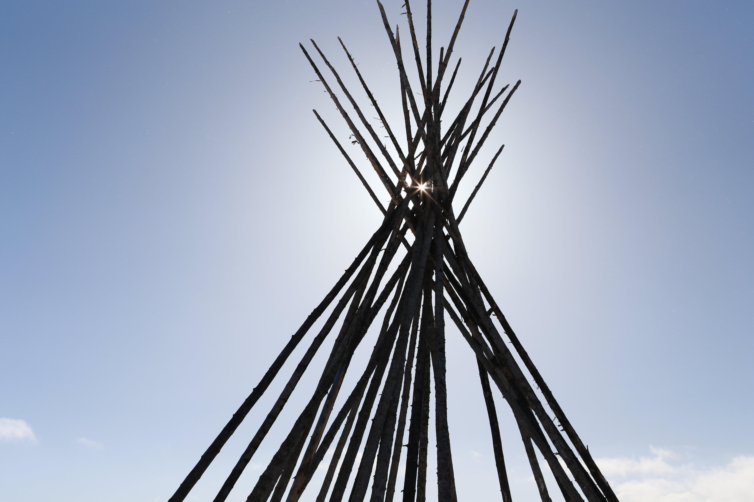
Thank you
for attention!
sioury@mail.ru
Notes:
Thank you for attention!

