Slide 1
Water supply in the north
Pernille Erland Jensen
Associate Professor
Head of studies BEng Arctic Technology
Department of Civil Engineering
Technical University of Denmark (DTU)

Slide 2
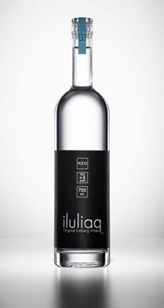
Water supply in the North

Slide 3
Current situation in Greenland
Kingdom of DK
Hennessy, T. W., Bressler, J. M., 2017, Results of an Arctic Council survey on water and sanitation services in the Arctic, International Journal of Circumpolar Health, 77: 1421368, doi: 10.1080/22423982.2017.1421368.

Slide 4
Current situation Greenland
Nukisiorfiit – a governmental owned company is responsible for water- and energy supply in all of Greenland.
Price of water has been tried differentiated for a period amongst settlements based on actual production costs, but 1st of january went back to one-price system (=19DKK for 1000 litres).
In the few larger towns having lover production costs than this the fish and seafood processing industry pay the lower cost-based prize (Nuuk, Sisimiut, Aasiaat, Ilulissat).
All water quality data available online
https://www.nukissiorfiit.gl/kundeservice/priser/?lang=da

Slide 5
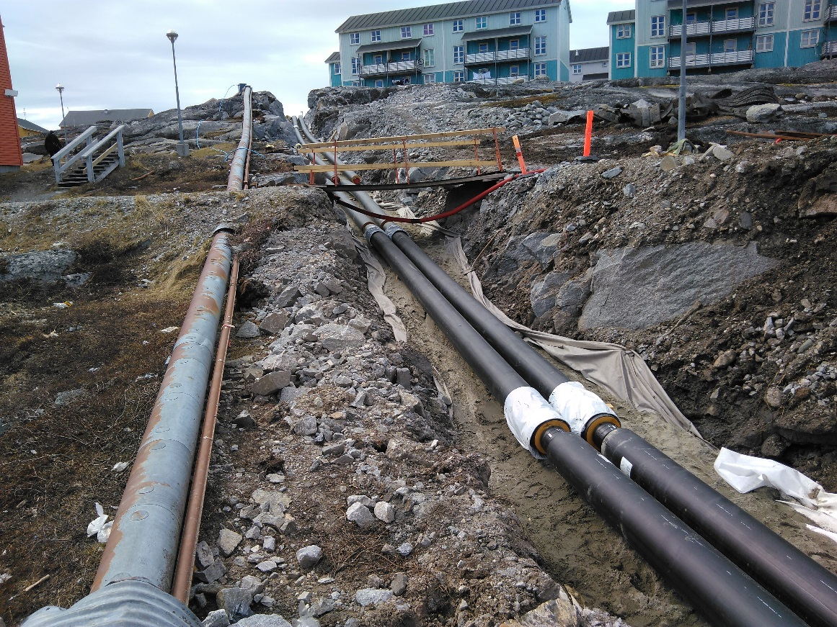
Typical water supply system in town
Only very few homes in larger towns (> 500 people) do not have piped water, and it is being phased out.
Water production is based on surface water
Electric heating/bleeding.
Development into underground piping – less maintenance costs, pays off in the long run.
(In particular) older people in towns prefer to pick up drinking water in small creeks due to the taste. Not aware of contamination risk.
Monitoring challenged by irregular transport of samples to lab.
Boiling advice happens but not in well functioning places.
High cost for fish and seafood industry upon contamination.
Changing water pipes in Nuuk

Slide 6
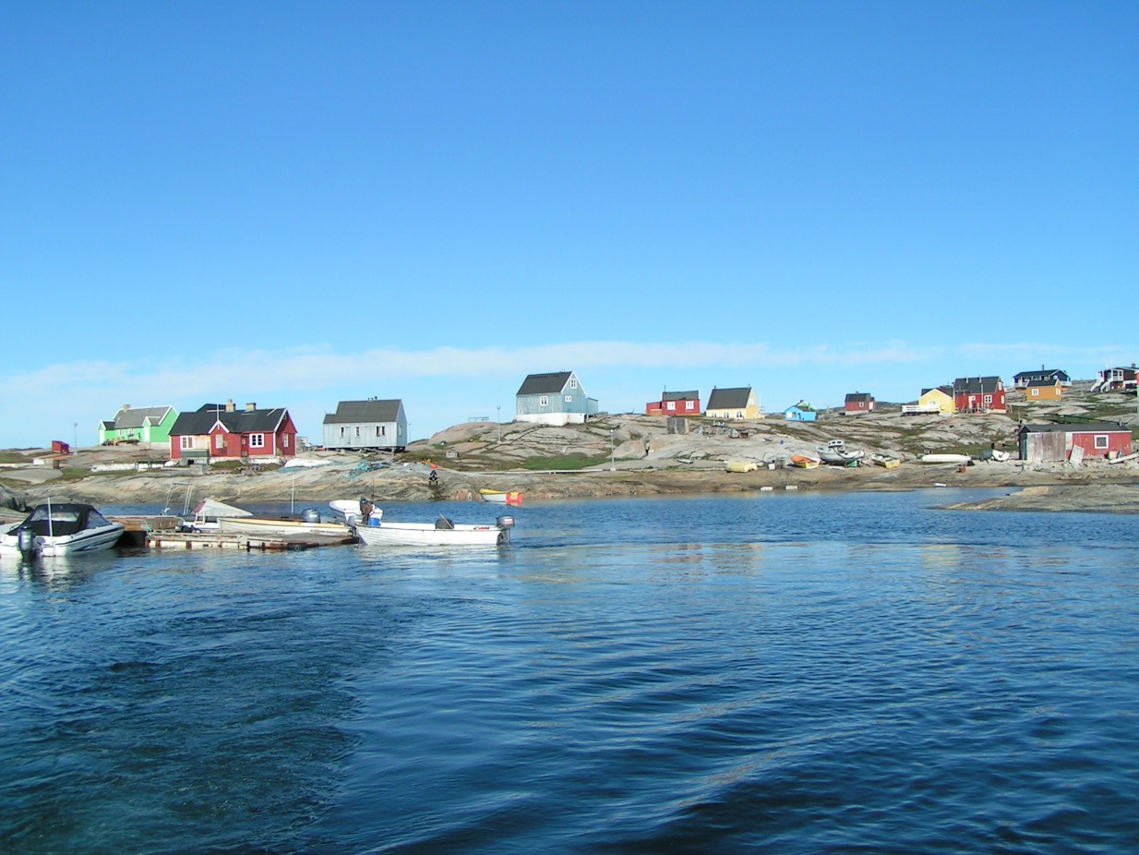
Water supply in Greenland
Only very few people in settlements (<500 people) do have piped water.
Only very few people have water tanks. Those that do often fill the tank by a hose directly to the tap-house – though not according to regulations.
Water is picked up in containers public wash-houses for free.
Some places have plenty high quality surface water.
Others (8 settlements) insufficient and rely on reverse osmosis of seawater and melting of sea ice during periods.
Monitoring HIGHLY challenged by infrastructure.

Slide 7
Climate and terrain makes hauling and trucking a challenge
Photos: Christian Hammeken

Slide 8
Water quality challenge during snow melt

Slide 9
New modular based water treatment system being implemented in all settlements by 2025
Pumping module (in).
Dual media pH adjusting sand filter
UV-module
Monitoring module for continuous monitoring of pH, conductivity and turbidity.
Storage tank.
Pumping module (out)
Operation module
Chlorination module for emergency (chlorine solution is prepared in nearest town)
RO module for places in need
Developed especially for Greenland in modules easy to ship and handle

Slide 10
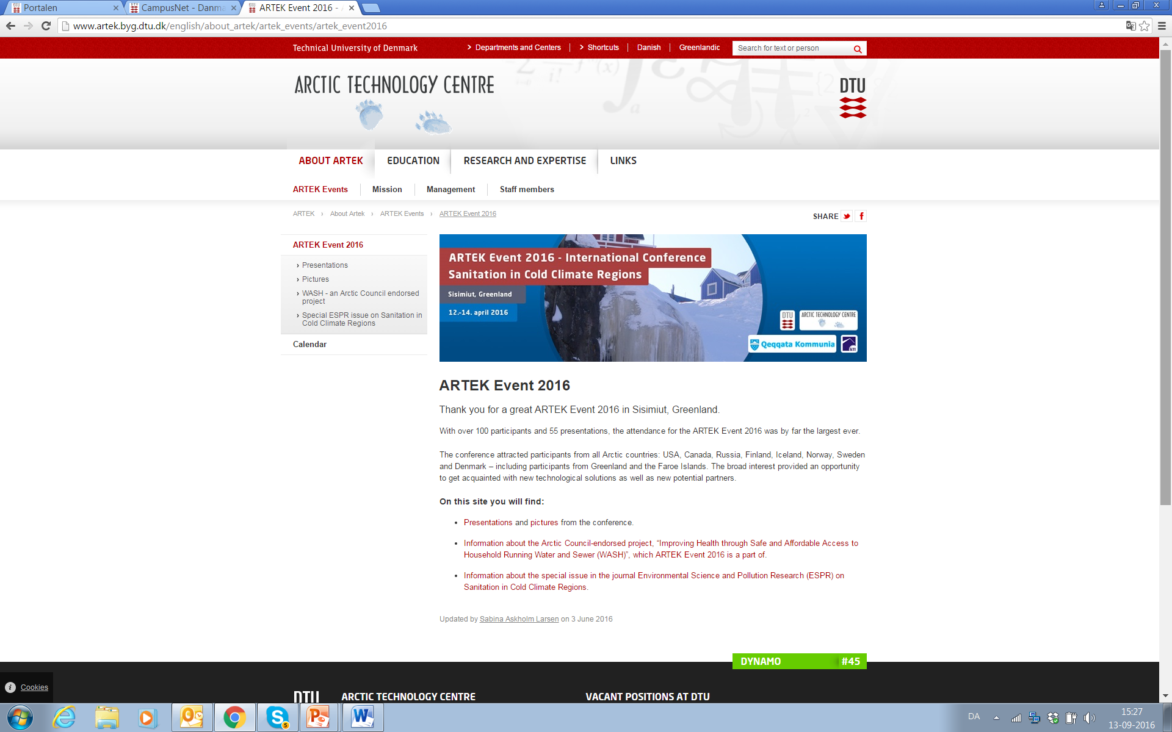
http://www.artek.byg.dtu.dk/

Slide 11
