Slide 1
Waste water in the north – concerns and treatment
Pernille Erland Jensen
Associate Professor
Head of studies BEng Arctic Technology
Department of Civil Engineering
Technical University of Denmark (DTU)

Slide 2
Overall content
Wastewater characteristics and concerns
Current wastewater management in he north
Experimental wastewater management in Greenland

Slide 3
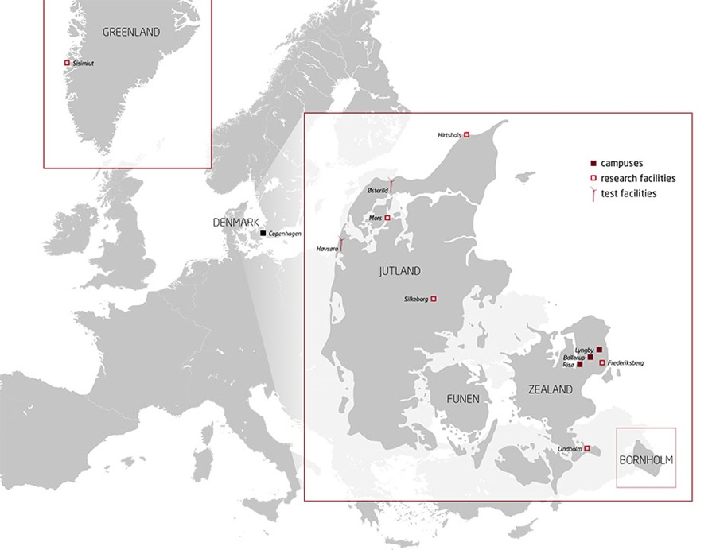
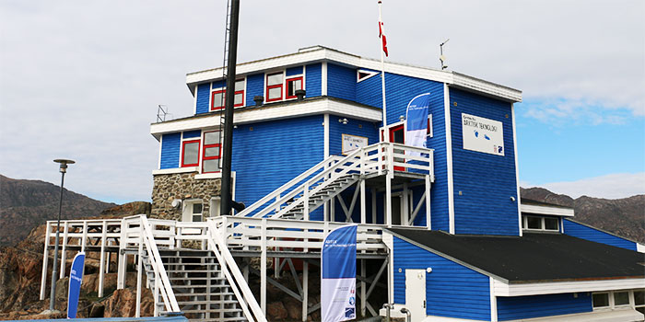
Arctic Engineering at DTU
DTU Campusses

Slide 4
Waste water – characteristics and concerns
Pernille Erland Jensen
Associate Professor
Head of studies BEng Arctic Technology
Department of Civil Engineering
Technical University of Denmark (DTU)

Slide 5
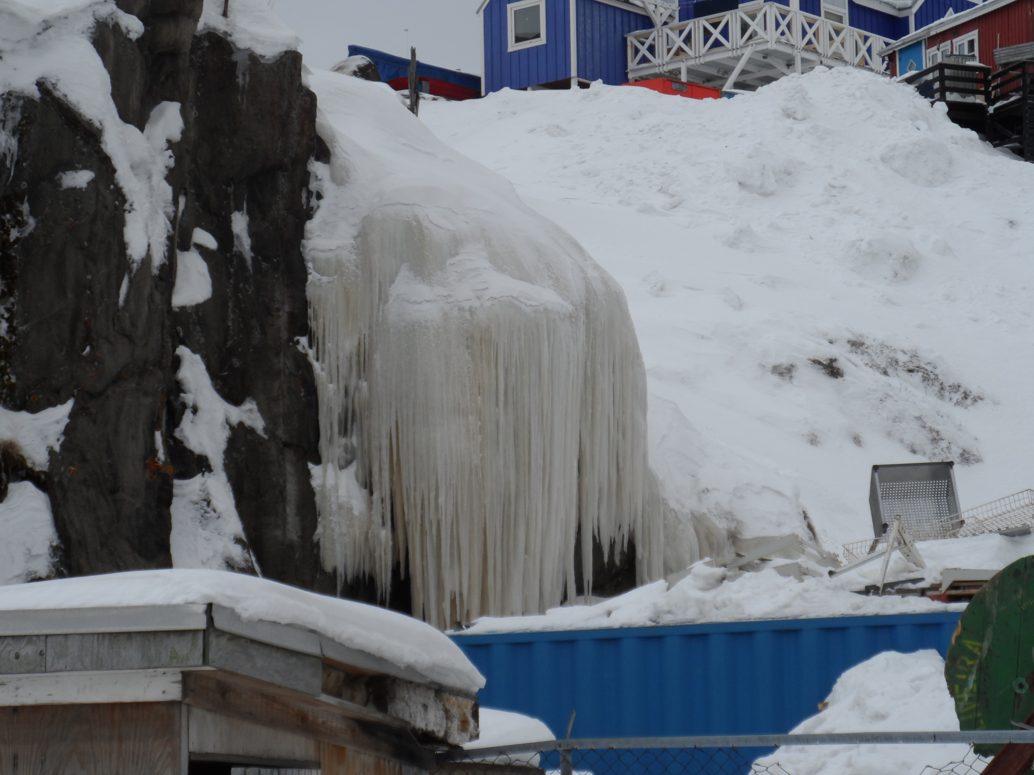
Lecture content
What is wastewater
How do we characterize wastewater
How does was wastewater in the north compare to that from elsewhere?
Which environmental effects are observed?

Slide 6

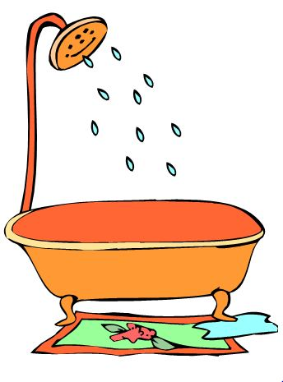
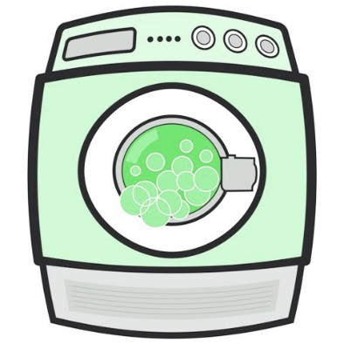

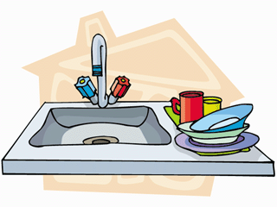

What is waste water?
Toilet waste
Kitchen drain
Bath drain
Laundry
Rain water
Industrial wastewaters
Black water
Domestic waste water
Grey water
Combined sewers

Slide 7

What does wastewater contain?
Particles
Nutrients
Color, Odor
Heavy metals
Organic matter
Other Salts
Grease
Microoroganisms

Slide 8
How do we commonly characterize wastewater
Solids
TSS (Total Suspended Solids) + other definitions of solids TDS, SS, Fixed, Volatile.
Organic matter
BOD₅ (Biological oxygen demand, 5 days, 20°C or TOC, COD, VOC
Nutrients
Nitrogen incl. various speciations: organic, free, nitrite, nitrate, ammonia
Phosphorous Organic, Inorganic
Salts
Cl
SO₄
Grease
Microoroganisms
Total coliform

Slide 9

But there is more to the story
Chemicals
Heavy metals
Personal care products
Medical residues
Micro plastics
Nano-materials
…

Slide 10
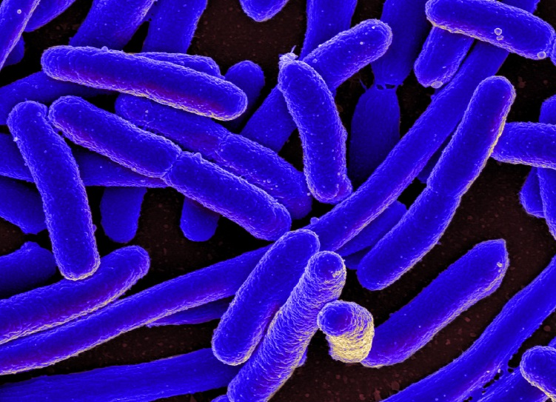
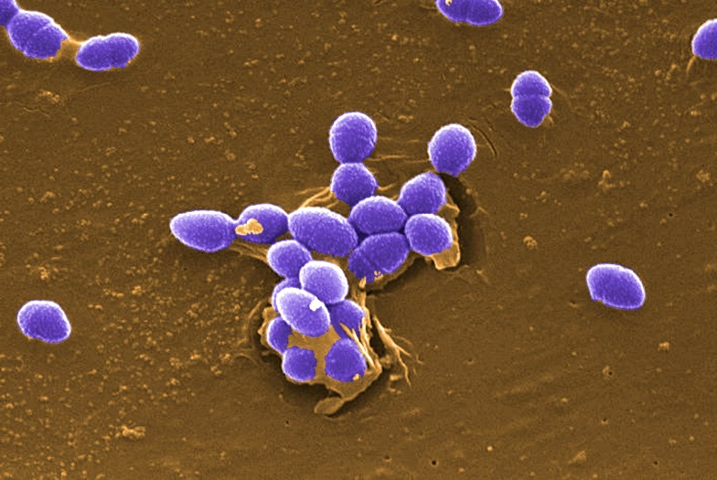
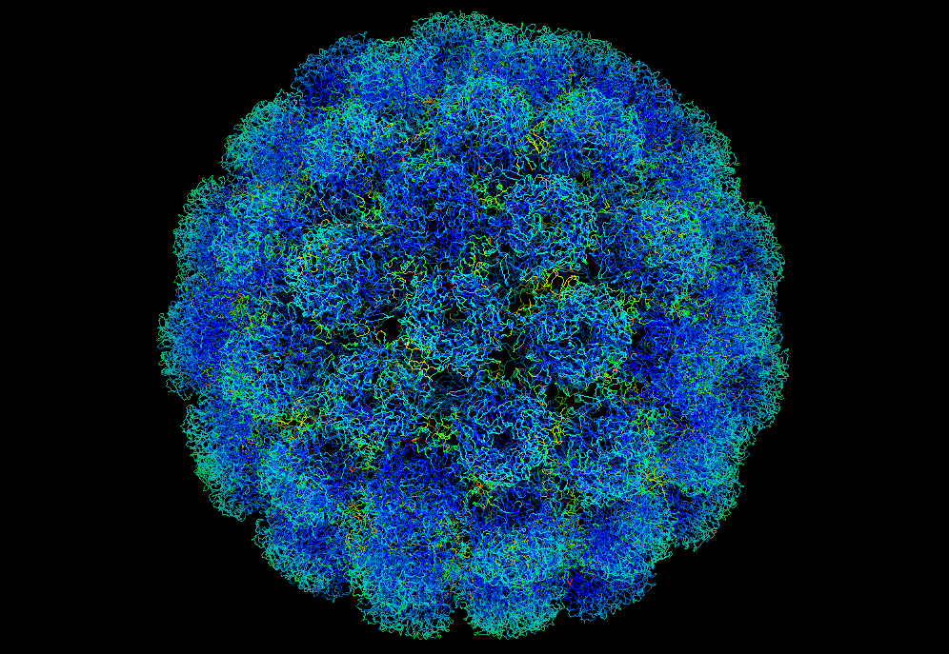
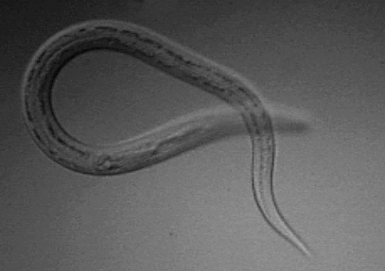
And the microbiology is more than just coliforms
E. coli – and gram negatives
Enterococci - and gram positives
Viruses
Helmints

Slide 11
How does wastewater in the north compare to wastewater other places?
 | Typical composition¹ |  |  | Sisimiut |  |  | Kanger-lussuaq | DK limit⁵
 | Weak | Medium | Strong | 2011³ | 2013⁴ | 2013²
COD (mg/L) | 250 | 500 | 1000 | NA | 143 | 400-700 | 636⁹ | 75
N (mg/L) | 20 | 40 | 85 | 46-130 | 30 | NA | 5-51⁸ 10-60⁹ | 8
P (mg/L) | 4 | 8 | 15 | 4-8 | 3 | 10-15 | 5-13⁸ 0.4-10⁹ | 1.5
Total coliforms | 10⁶ -10⁷ | 10⁷-10⁸ | 10⁸-10⁹ | 10⁵ -10⁶ | 10⁶ -10⁷ | NA | 10⁷-10⁸¹⁰ | NA
Entero-cocci |  | 10²-10³ |  | 10⁴ -10⁵ | 10⁴ -10⁶ | NA | 10⁵-10⁶¹⁰ | NA
Red number refer to reference (last slide)
Notes:
Red numbers refer to background literature

Slide 12
References
Tchobanoglus, G. & Burton, F. Wastewater Engineering, Treatment, Disposal and Reuse, Third Edition, Metcalf and Eddy, Inc., McGraw –Hill, Inc. 1991.
Drastrup, E.M., Petersen, S. B., Evaluering af effekten af et mekanisk-kemisk rensningsanlæg i Sisimiut, BSc Thesis (in Danish), ARTEK, DTU, 2013.
Martinsen, G., Nicolaisen, E.S. , Karakterisering af spildevand i Sisimiut, Grønland, med særligt fokus på antibiotikaresistente bakterier, BSc Thesis (in Danish), ARTEK, DTU, 2011.
Davidsen, S., Toke, J. Metoder til rensning og desinfektion af kloakeret spildevand I arktiske områder med få indbyggere, BSc Thesis (in Danish), ARTEK, DTU, 2013.
Miljøministeriet (2016) BEK nr 153 af 25/02/2016.
Selvstyrets bekendtgørelse nr. 10 af 12. juni 2015 om bortskaffelse af latrin og spildevand http://lovgivning.gl/lov?rid={0D5348FF-3943-4739-B3E9-9897D8B93713}
COWI Consultants 2006. Udrednings- og pilotprojekt vedr. håndtering af gråt spildevand i de grønlandske byer og bygder, Miljøstyrelsen (Danish EPA).
Mathiasen, L.V., Rosing Hansen, C.M., Freiberg, T. Analyser af Spildevand i Kangerlussuaq, Student report (In Danish), ARTEK, DTU, 2015.
Konring, A., Tang, C. Wastewater treatment potentials in Kangerlussuaq: Characterisation of flow and chemical loadings, Student report (In Danish), ARTEK, DTU, 2015.
Chhetri, R.; Klupsh, E., Andersen, H.R., Jensen, P., Treatment of Arctic wastewater by chemical coagulation, UV and peracetic acid disinfection, Environ Sci. Pollut. Res., DOI 10.1007/s11356-017-8585-5.
All student works may be found here: http://find.artek.byg.dtu.dk/pubs/frontpage/

Slide 13
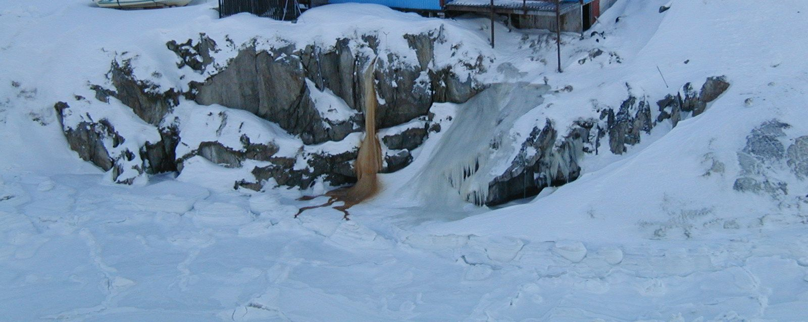
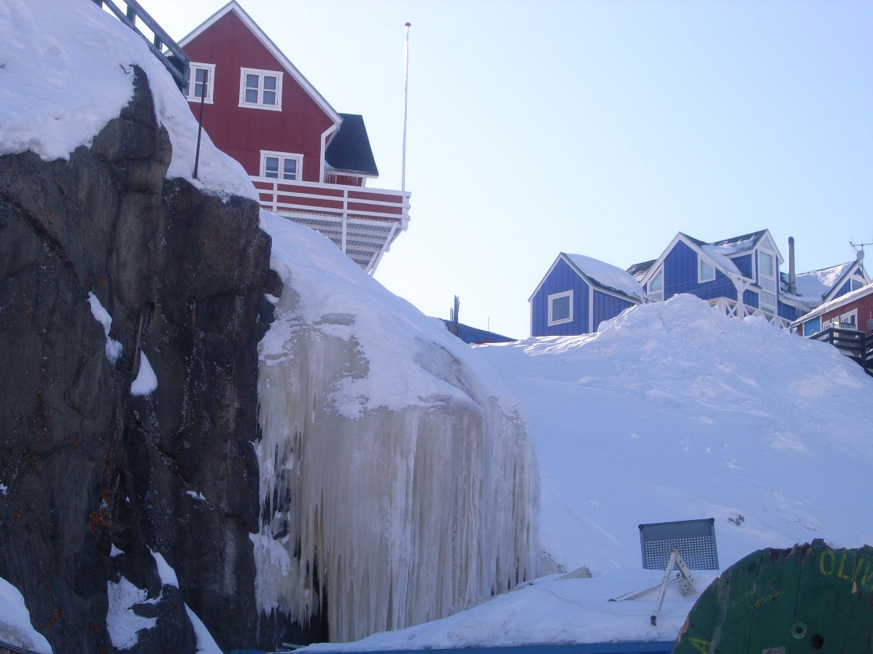
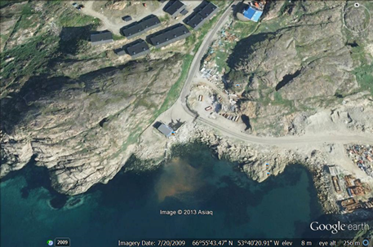
Observed environmental effects: Visibility

Slide 14
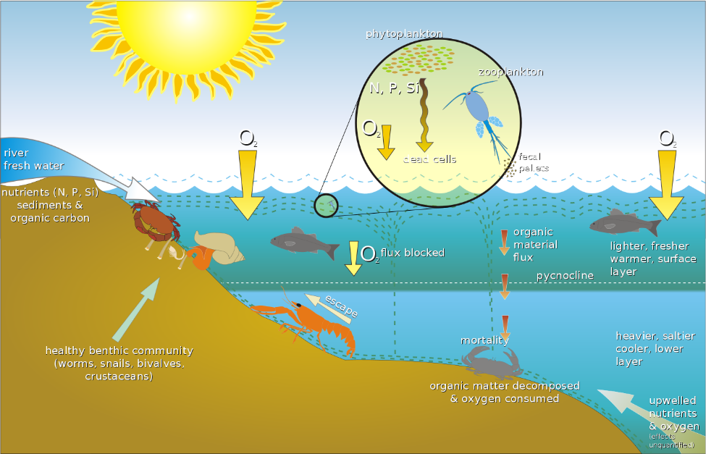
Observed environmental effects (no treatment)
Floating items on surface
Eutrophication
Heating
Dead bottom of bay
Ecosystem disturbance*
Heavy metal accumulation in sediments**
Antibiotic resistance***
Health effects?
New wastewater regulation implemented in 2015⁶
Leading out grey water to terrain may be problematic⁷
Eutrophication
References
*Bach, L. and Dahllöff, I. 2012, Local contamination in relation to population genetic diversity and resilience of an arctic marine amphipod. Aquatic Toxicology, 114-115, 58-66.*Bach, L., Fischer, A. and Strand, J. 2010, Local anthropogenic contamination affects the fecundity and reproductive success of an Arctic amphipod. Marine Ecology Progress Series, 419, 121-128.
**Villumsem,A. and Ottosen,L. 2006, Heavy metal and TBT contamination in the sediment around Sisimiut, Greenland, Proceedings of ARTEK Event 2006, pp. 21-23.
***Maria Granberg

Slide 15
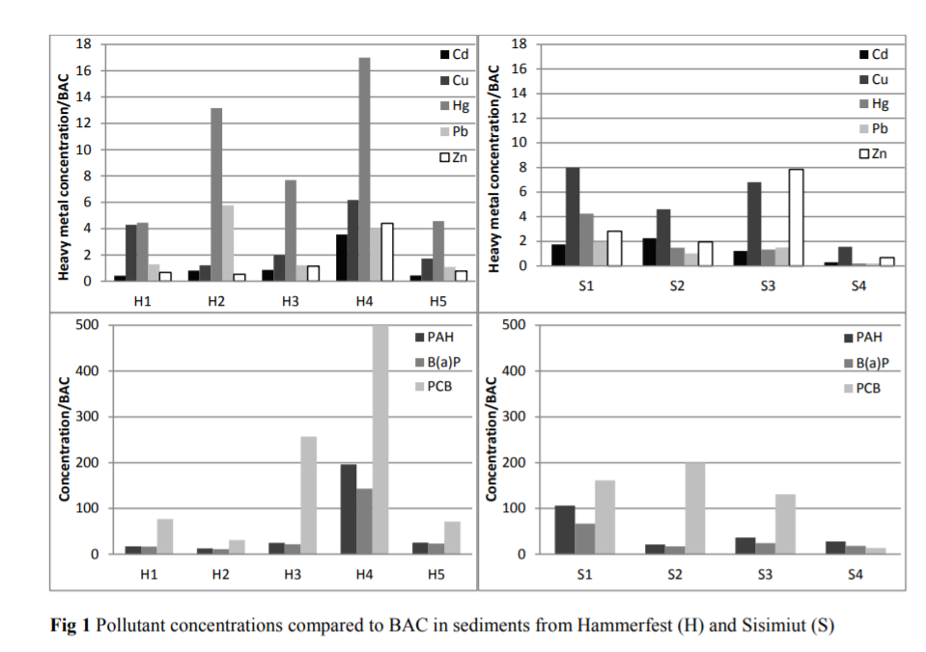
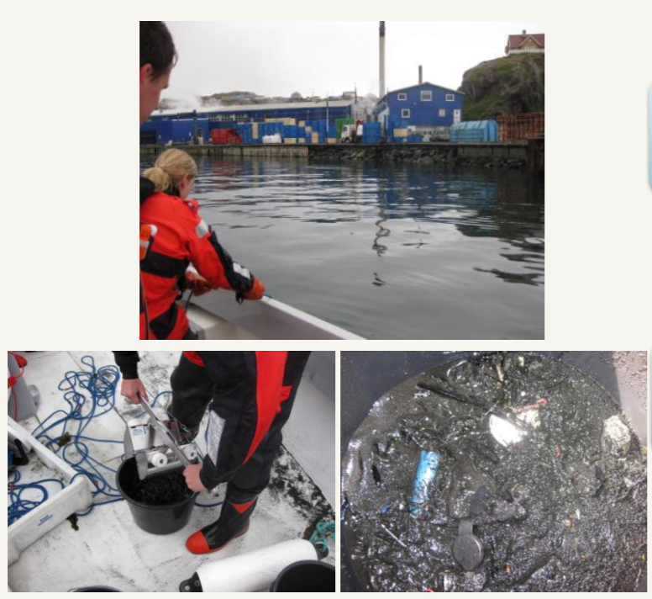
Elevated concentrations of heavy metals and anthropogenic compounds
Pedersen, K. B., Lejon, T., Jensen, P. E., & Ottosen, L. M. (2015). Chemometric Analysis for Pollution Source
Assessment of Harbour Sediments in Arctic Locations. Water, Air, and Soil Pollution, 226(5), 1-15. DOI:
10.1007/s11270-015-2416-4
H4: Sewage outlet, all others harbor activity, H: Hammerfest, S: Sisimiut

Slide 16
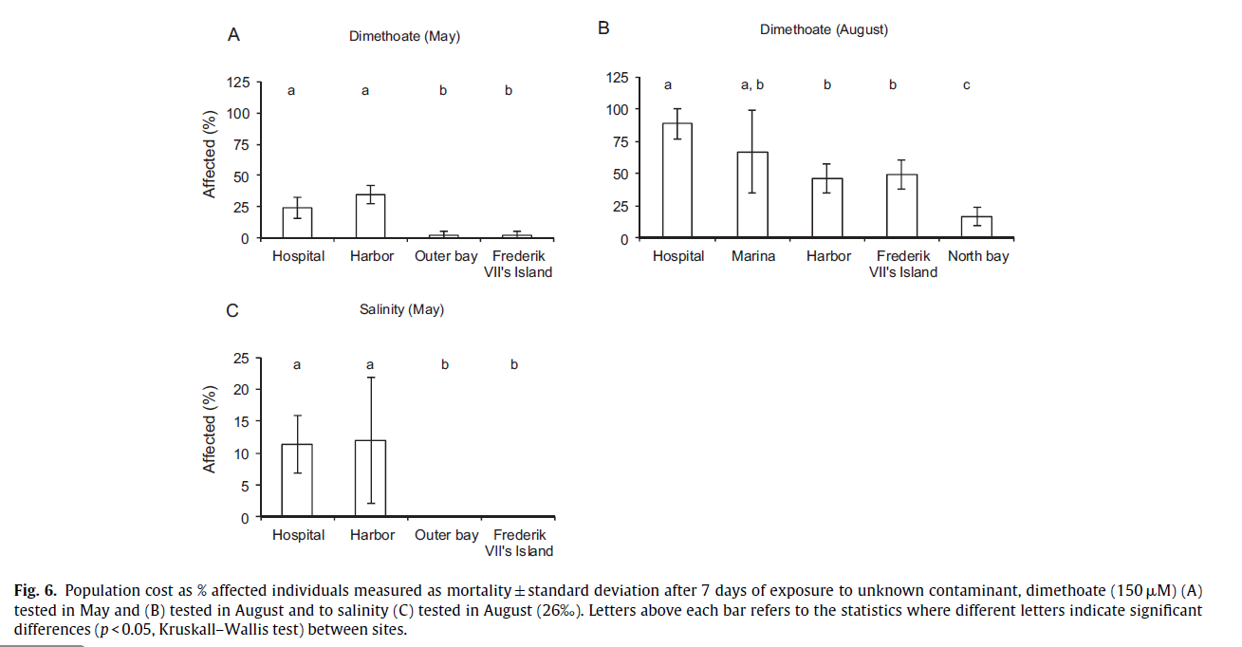
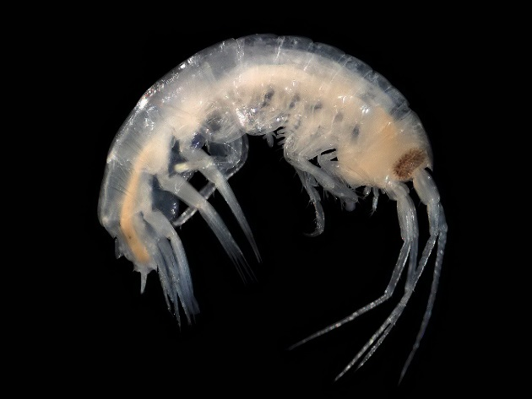
Ecosystem disturbance
Bach, L. and Dahllöff, I. 2012, Local contamination in relation to population genetic diversity and resilience of an arctic marine amphipod. Aquatic Toxicology, 114-115, 58-66.

Slide 17
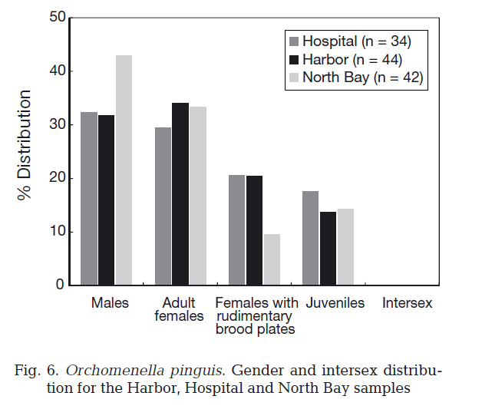
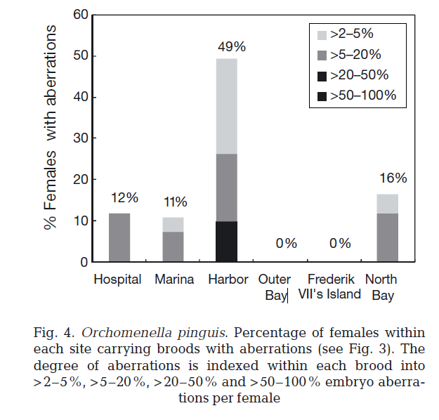
Ecosystem disturbance
Bach, L., Fischer, A. and Strand, J. 2010, Local anthropogenic contamination affects the fecundity and reproductive success of an Arctic amphipod. Marine Ecology Progress Series, 419, 121-128.

Slide 18
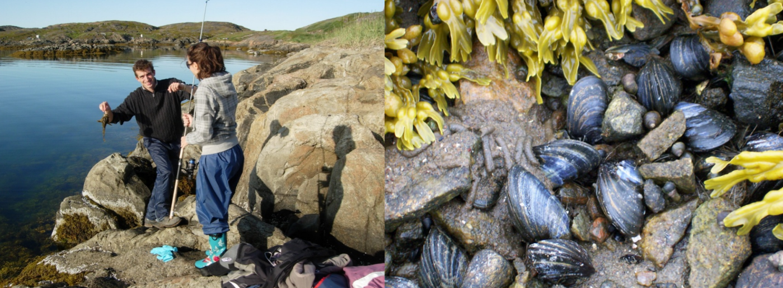
Antibiotic resistance
There is a difference in resistance patterns between unexposed and exposed areas
Ciprofloxacin, Tetracyclin and Macrolide resistance is only found near the sewage outlet.
β-lactam resistance is found everywhere as is one type of aminoglycoside resistance. This may be attributed to an extended heavy use of β-lactam antibiotics or natural occurrence of β-lactam and aminoglycoside resistance in nature.
Sediment bacterial communities from exposed sites differ from and are less diverse than communities from unexposed sites
Sediment bacterial community function at the sewage outlet shows signs of eutrophication impact
Bacterial abundance is severely reduced in guts of marine organisms living in the vicinity of the sewage outlet
Resistance patterns are replicated at different trophic levels along the exposure gradient
This indicates food chain transfer of ARG or resistant bacteria, and may be a potential risk for humans.
http://www.artek.byg.dtu.dk/english/-/media/Centre/Artek/artek_english/artek%20events/ARTEK-Event-2016/Presentations_web/Session_1/Maria-Granberg.ashx?la=da

Slide 19
Waste water management in the North
Pernille Erland Jensen
Associate Professor
Head of studies BEng Arctic Technology
Department of Civil Engineering
Technical University of Denmark (DTU)

Slide 20
Lecture content
Conventional treatment recap
Challenges in the north
How is wastewater handled currently in the north?
Effects of treatments
  Examples from Iceland, Faroe Islands, Norway, Canada and Greenland

Slide 21
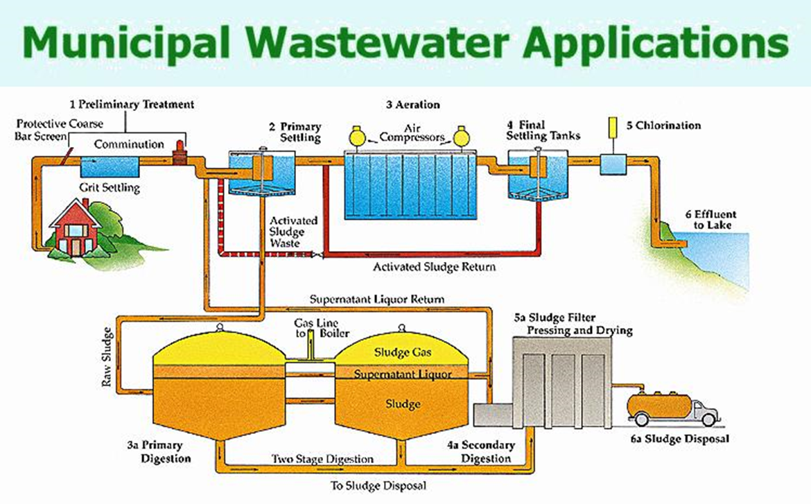
Conventional treatment recap
Treatment level | Method | Effect
Preliminary | Screening | Large particles removal
Primary | Screening and/ or sedimentation | Smaller particles removal, sand, fraction of OM inkl. some P, fraction of HM’s and other compounds bound to OM.
Secondary | Chemical and/or biological treatment (e.g. flocculation/ biological conversion and sedimentation) | Smaller biodegradable organics and suspended solids. Disinfection effect.
Tertiary | Biological treatment and or chemical (e.g. precipitation of nutrients with Fe and Al salts, fluctuating oxygen /anaerobic) | High level nutrient removal. Disinfection effect.
Advanced | Various additions | Depending on need

Slide 22
Effects of climate
Effects of geography
Water viscosity increases
  Mixing reduced
  Sedimentation slows down
  Filtration slows down
Longer survival of pathogenic bacteria
Metabolic (biological) and chemical reaction rates slow down:
  Often by 2-3 times per 10 °C temperature reduction (Arrhenius equation)
Increased retention time
High energy costs
High investment cost
Unreliable energy supply
Permafrost and other unstable site conditions OR surface bedrock
Small communities
Remoteness challenging during constructional and operational resupply
Lack of specialists on site
High investment cost per person
High maintenance cost
High risk of failure

Slide 23
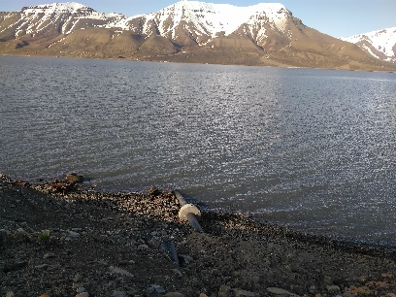
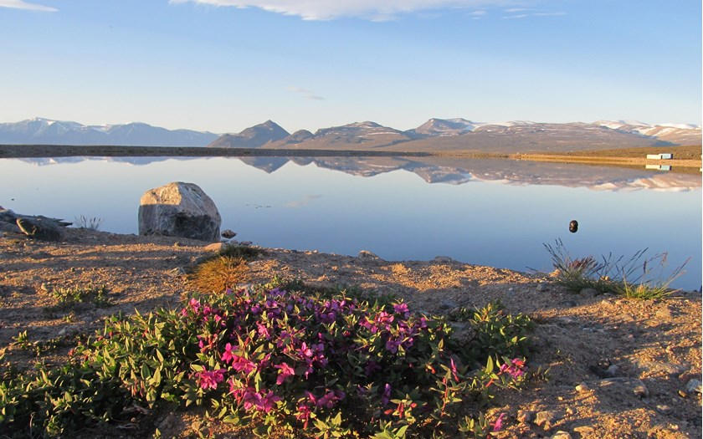
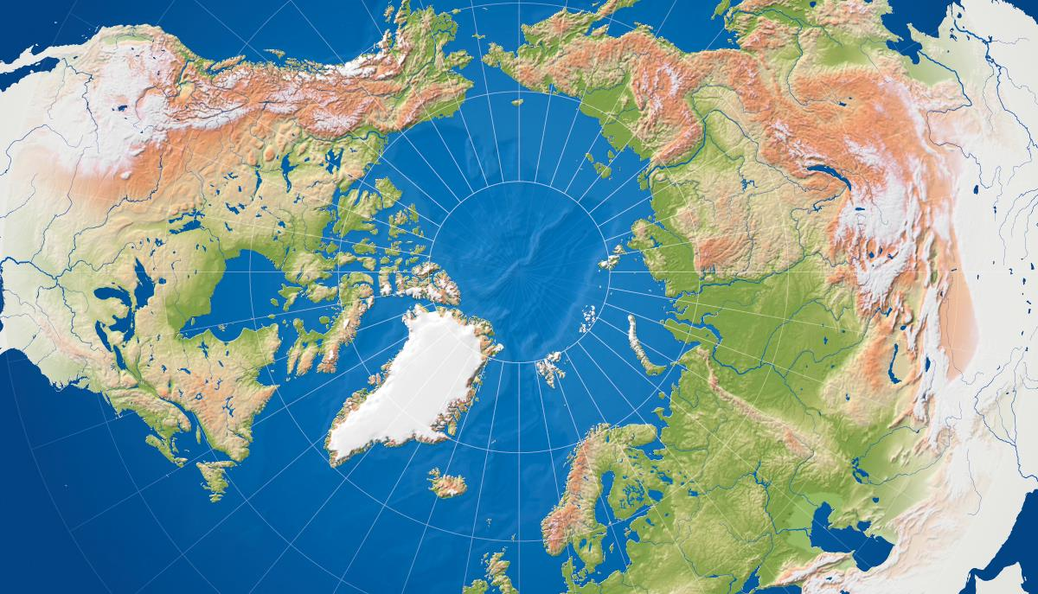
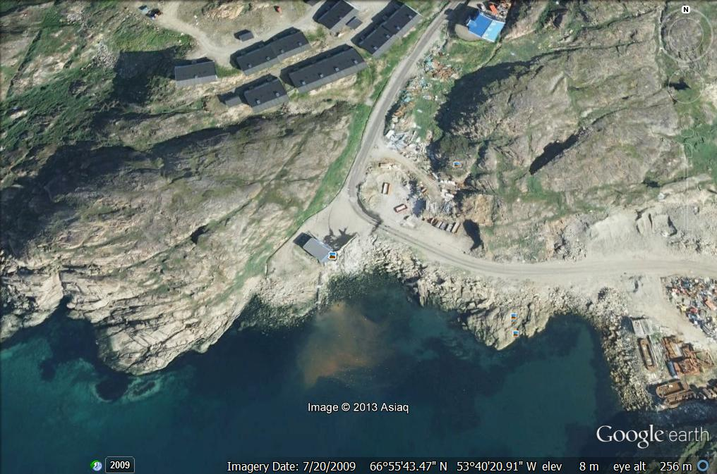
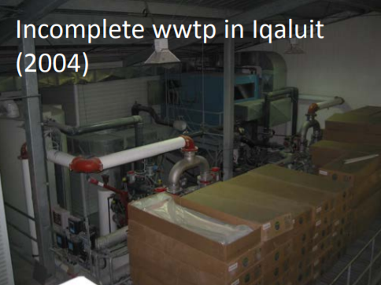
Present management of waste water the North
Secondary treatment for towns > 20.000persons
Smaller places no treatment
No treatment
Wastewater lagoons (photo: Lisbeth Truelstrup Hansen)
No treatment
Mechanical plants – primary/secondary (photo: Kenneth Johnson)
Primary treatment

Slide 24
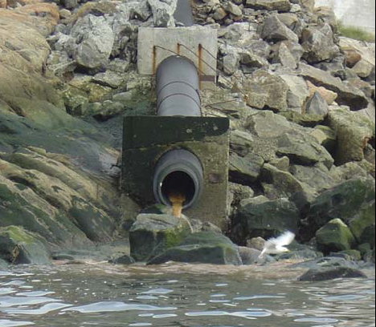
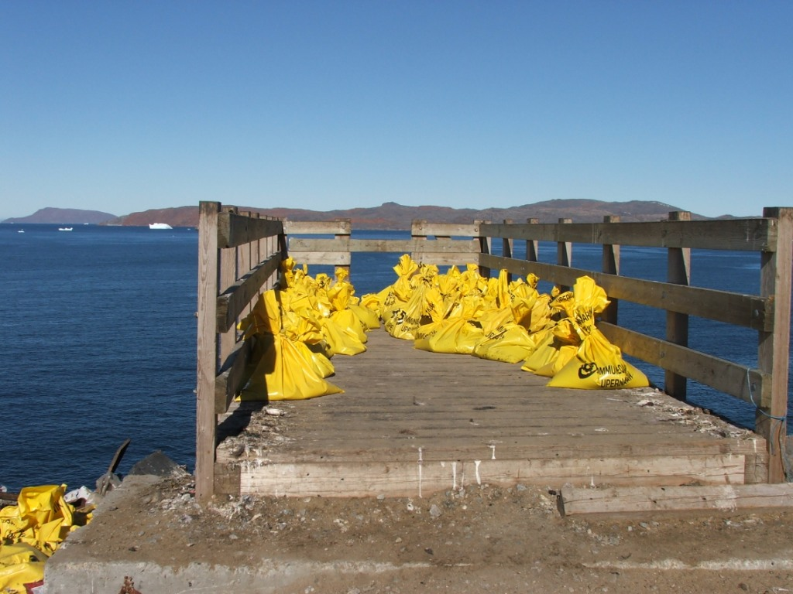
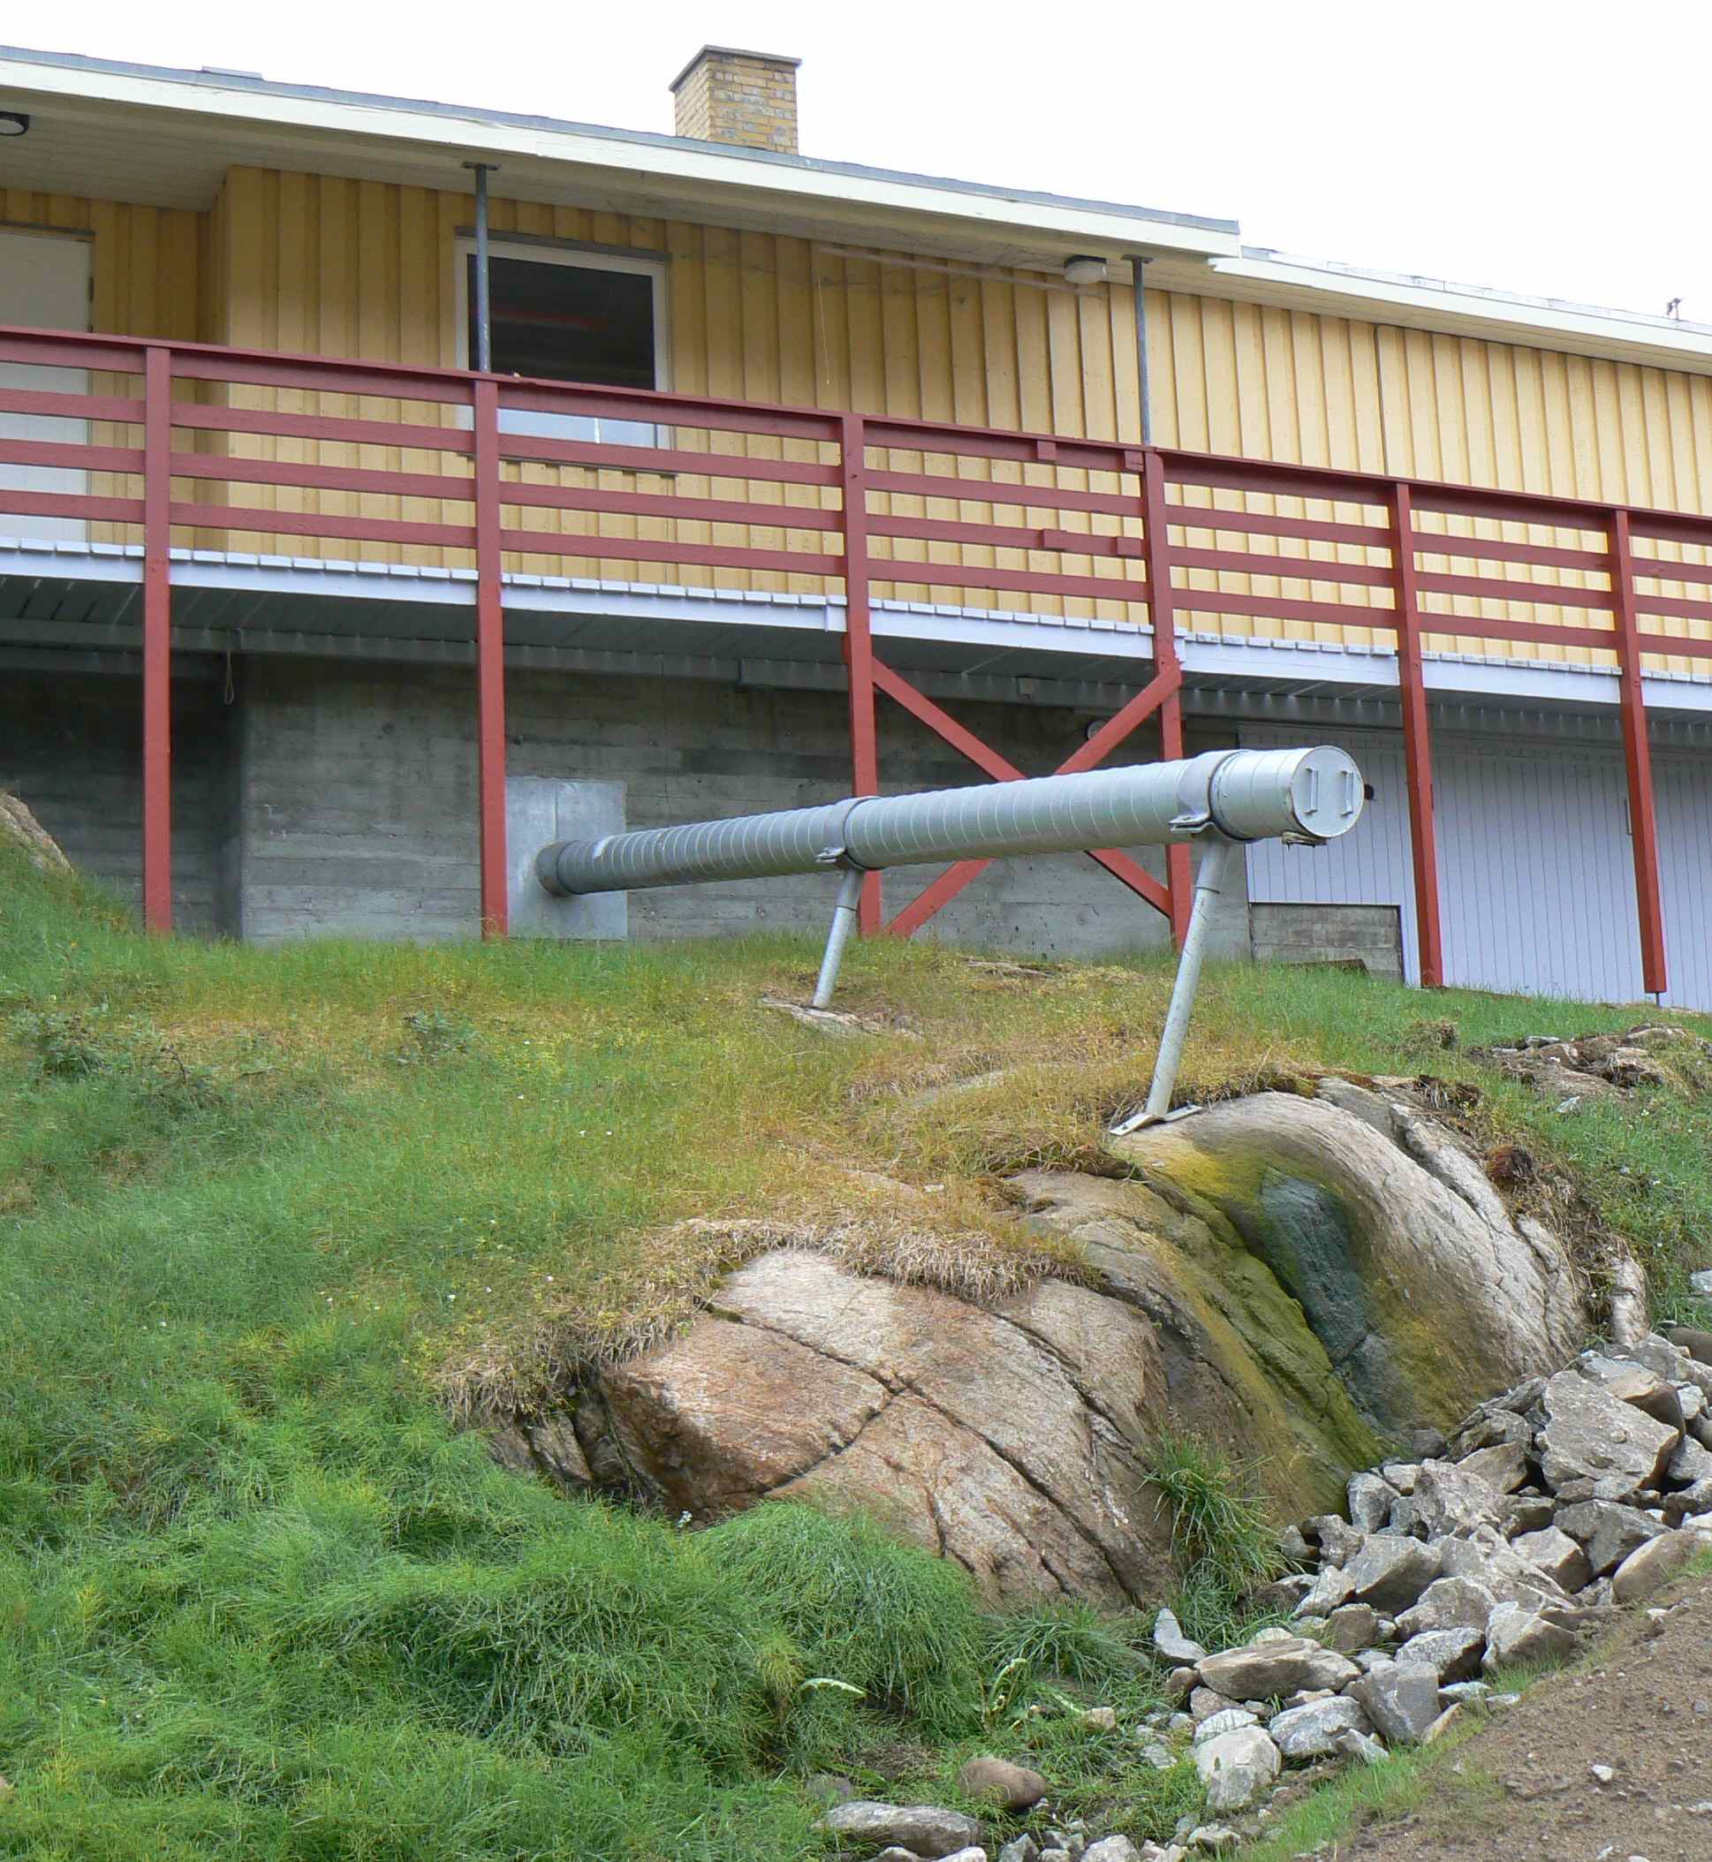
Wastewater in Greenland
Sewers in most of towns.
Bag toilets or septic tanks for the rest, grey water directly into environment.
All wastewater let out untreated at shoreline.

Slide 25
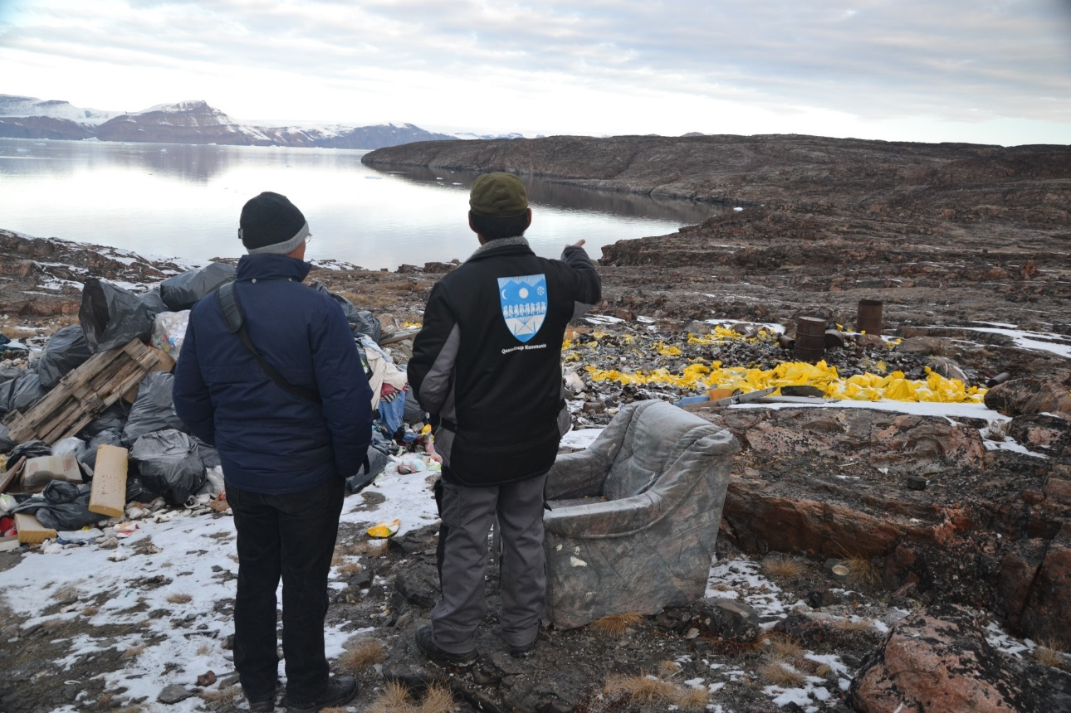
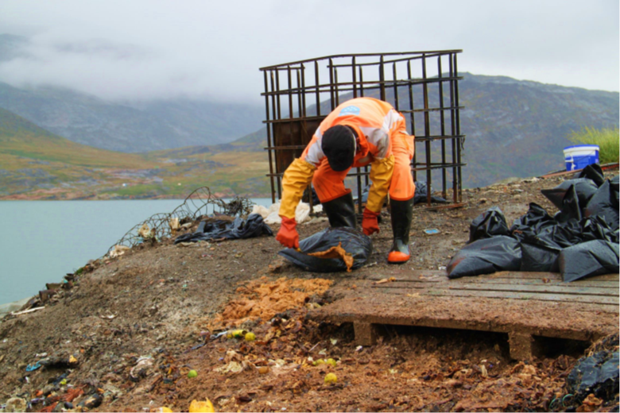
Wastewater in Greenland
In settlements modern replacement for honey buckets is needed:
  Convenience
  Dignity
  Environment

Slide 26
Wastewater in Greenland
In 2005 report concluded that no harm to the environment was to be expected from current practise *
BUT report also clearly states:
Only nutrients are considered, not e.g. pathogens, heavy metals or anthropogenic compounds.
The evaluation anticipates that the outlet is in open water and not closed Fjords.
New legislation requires municipalities to make environmental impact assessment of recipients and implement treatment of wastewater if impacts are observed **
Water quality criteria set for wastewater from mineral extraction projects***
*COWI Consultants 2005. Udrednings- og pilotprojekt vedrørende håndtering af miljøproblemer som følge af spildevand i de grønlandske byer. Miljøstyrelsen (Danish EPA).
**Selvstyrets bekendtgørelse nr. 10 af 12. juni 2015 om bortskaffelse af latrin og spildevand: http://naalakkersuisut.gl/~/media/Nanoq/Files/Kundgoerelser/DK/2015/Bekendtgoerelser/bkg_10%20dk.pdf
***http://naalakkersuisut.gl/~/media/Nanoq/Files/Hearings/2015/Nye%20retningslinjer%20for%20udarbejdelse%20af%20VVM%20for%20mineprojekter%20i%20Groenland/Documents/EIA%20Guidelines_UK_.pdf

Slide 27
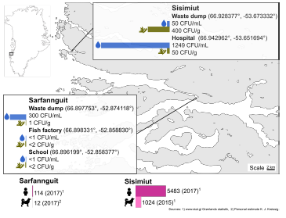
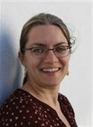
Faecal bacteria on seaweeds in Greenland
Faecal bacteria on seaweeds in Greenland
Kreissig, Katharina Johanna ; Hansen, Lisbeth Truelstrup ; Jensen, Pernille Erland , 2017, Poster presented at: 7th Nordic seaweed conference, 2017, Grenaa. http://orbit.dtu.dk/ws/files/140631837/Nordic_Seaweed_Conference_KJKR_poster_final.pdf

Slide 28
Micropollutants in wastewater in four arctic cities - is the treatment sufficient?
Treatment types
LSH (Hospital, Torshavn): Primary and secondary treamtent (mechanical biological)
Serjsjantviking (Torshavn): Primary treamtent (settling and flotation), uncontrolled secondary treatment may happen in the tank (septic tank type reactions)
Breivika (Tromsø): Primary treatment (filtering)
Langenes (Tromsø) : Primary treatment (filtering)
Klettag (Reykjavik): Primary Treatment (mechanical settling)
Ánanaust (Reykjavik): Primary Treatment (mechanical settling)
Sisimiut (Greenland): None
Micropollutants in wastewater in four arctic cities - is the treatment sufficient?
Maria Dam, Guðjón A. Auðunsson, Hans H. Poulsen, Ingrid A. Berg, Lone Kristensen, Jan Stenersen, Fríðbjørg N. Joensen, Vivie K. Davidsen, and Susanne B. Petersen
ISBN 978-92-893-5121-8 (PRINT), ISBN 978-92-893-5123-2 (PDF), ISBN 978-92-893-5122-5 (EPUB), http://dx.doi.org/10.6027/TN2017-550, TemaNord 2017:550, ISSN 0908-6692, Standard: PDF/UA-1, ISO 14289-1
© Nordic Council of Ministers 2017

Slide 29
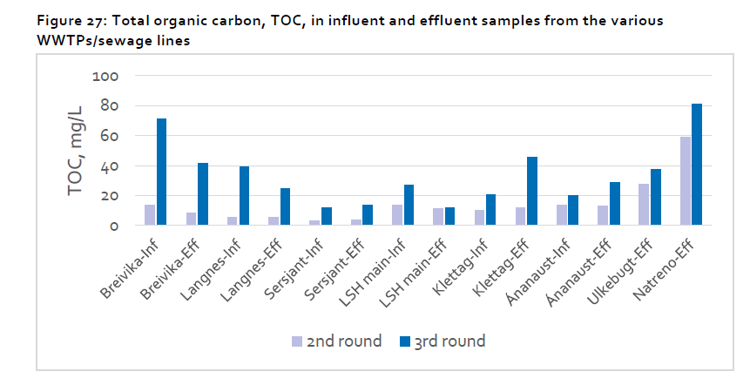
Effect of primary wastewater treatment
Treatment types
LSH: Primary and secondary treamtent
Serjsjant: Primary, occationally secondary
Sisimiut: None
All others: Primary

Slide 30
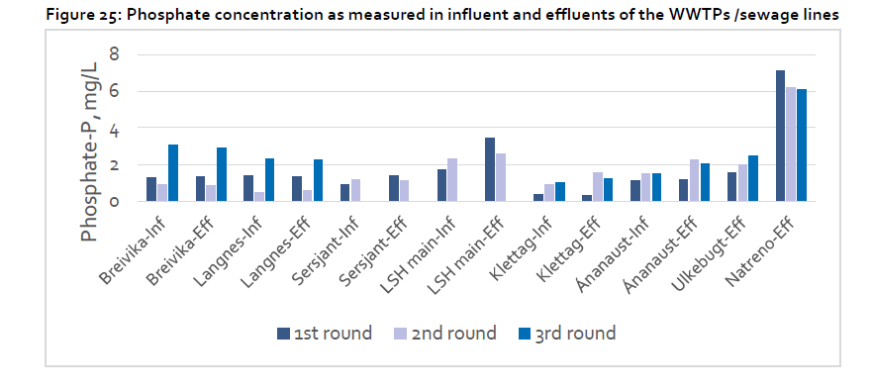
Common Nordic Project results
Treatment types
LSH: Primary and secondary treamtent
Serjsjant: Primary, occationally secondary
Sisimiut: None
All others: Primary

Slide 31
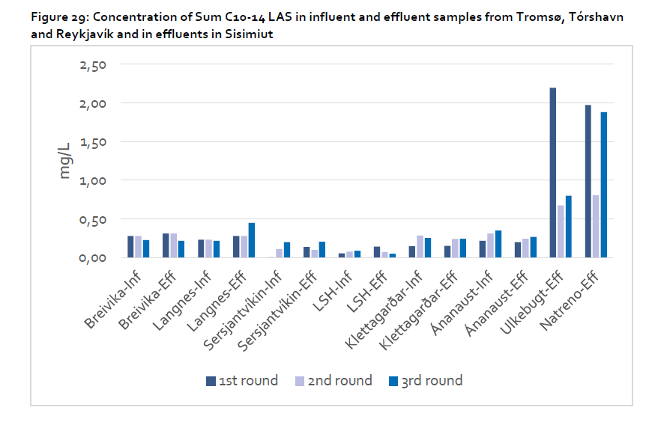
LAS (linear alkylbenzene sulphonates (LAS), anionic surfactants in detergents )
Treatment types
LSH: Primary and secondary treamtent
Serjsjant: Primary, occationally secondary
Sisimiut: None
All others: Primary

Slide 32
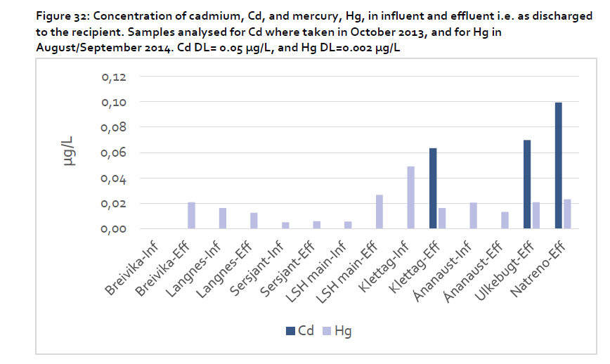
Cadmium
Treatment types
LSH: Primary and secondary treamtent
Serjsjant: Primary, occationally secondary
Sisimiut: None
All others: Primary

Slide 33
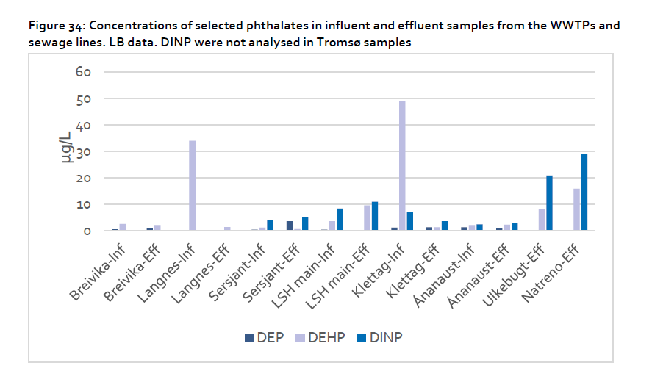
Phtalates
Treatment types
LSH: Primary and secondary treamtent
Serjsjant: Primary, occationally secondary
Sisimiut: None
All others: Primary

Slide 34
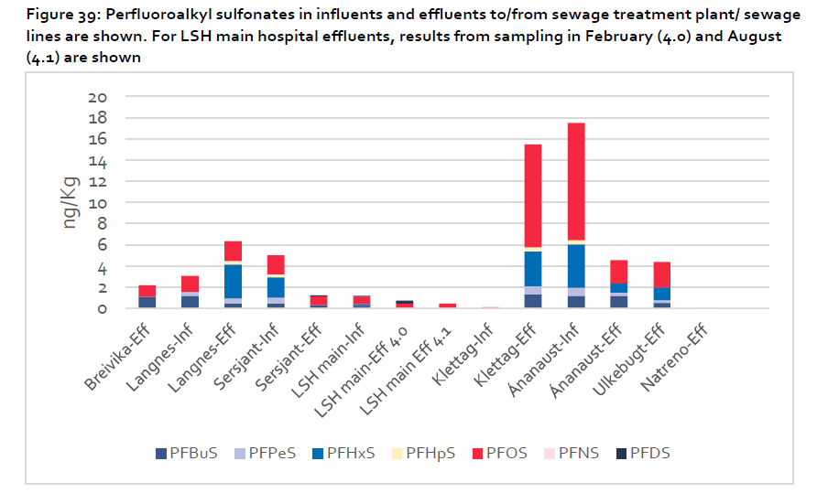
PFAS
Treatment types
LSH: Primary and secondary treamtent
Serjsjant: Primary, occationally secondary
Sisimiut: None
All others: Primary

Slide 35
Overall conclusions on effect of treatments
TOC: Reduced
Nutrients (P,N): Some effect
LAS: Some effect
PAH: No effect
Phenols: No reduction effect
Mercury: No effect – except Klettagardar
Phthalates: Reduced
PFAS: No effect – except Langnes

Slide 36
Canada – experience with lagoons
New legislation in Canada – January 2015
Northwest Territories, Nunavut, and northern regions of Quebec and Newfoundland and Labrador are temporarily exempt.
^{http://www.ec.gc.ca/eu-ww/}

Slide 37
Experimenting wastewater handling in Greenland
Pernille Erland Jensen
Associate Professor
Head of studies BEng Arctic Technology
Department of Civil Engineering
Technical University of Denmark (DTU)

Slide 38
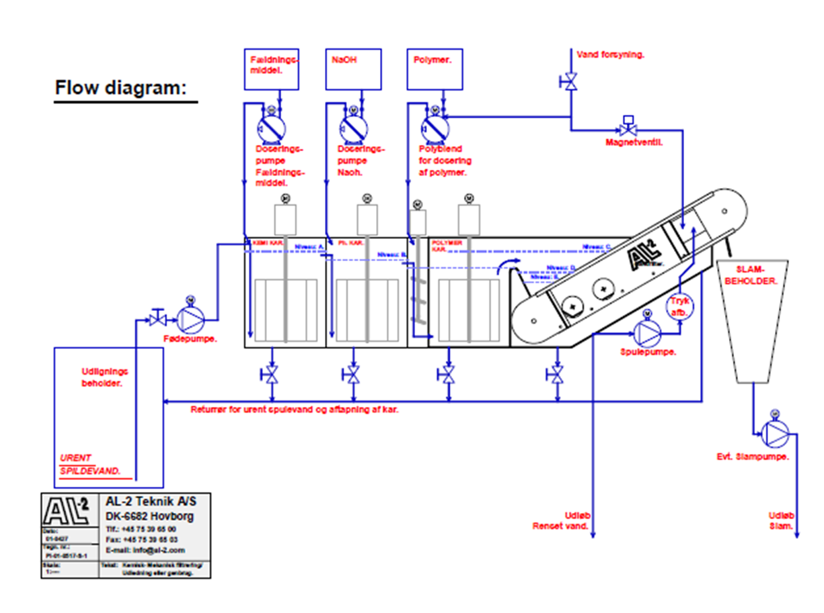
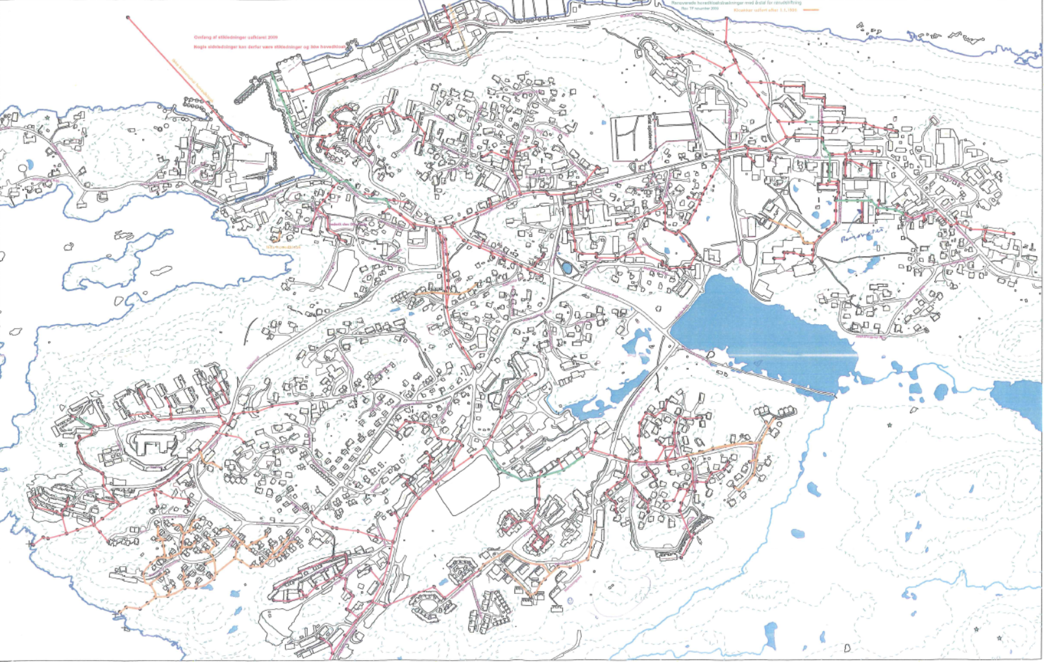
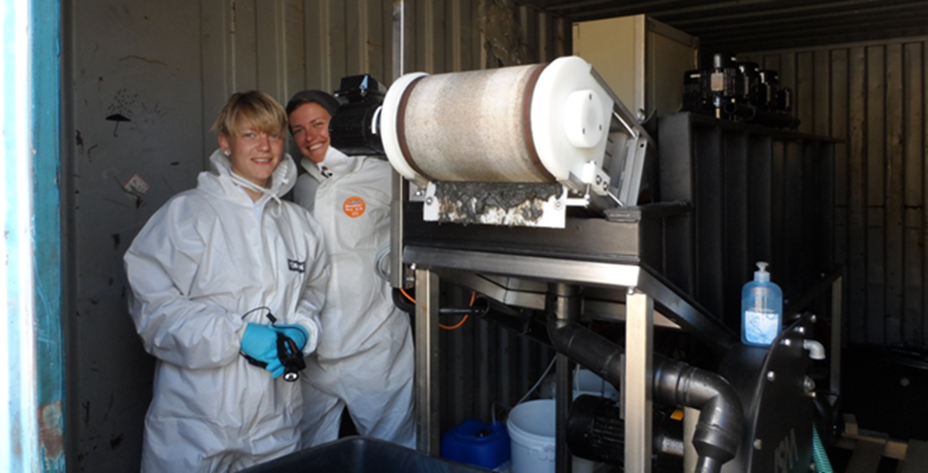
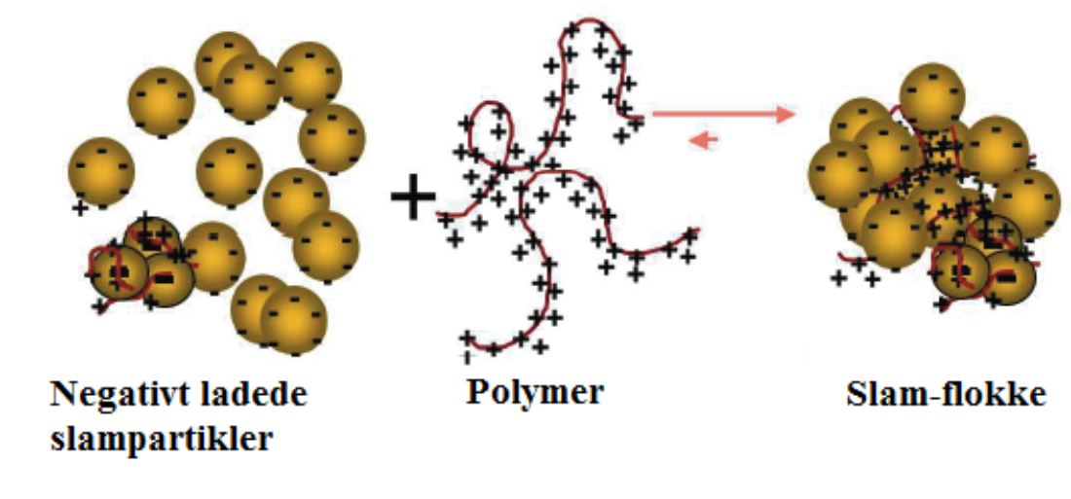
Chemical mechanical treatment in container size

Slide 39
Results pilot scale experiments
COD in untreated and treated wastewater
BOD₅ in untreated and treated wastewater

Slide 40
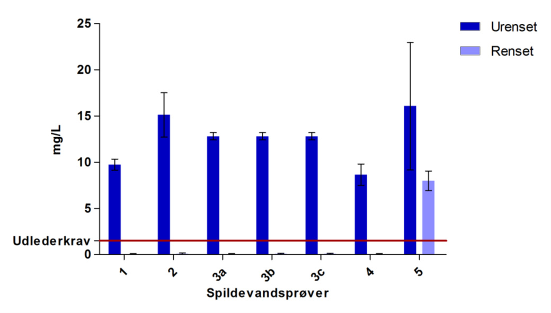

Results pilot scale experiments
Phosphorous in untreated and treated wastewater

Slide 41
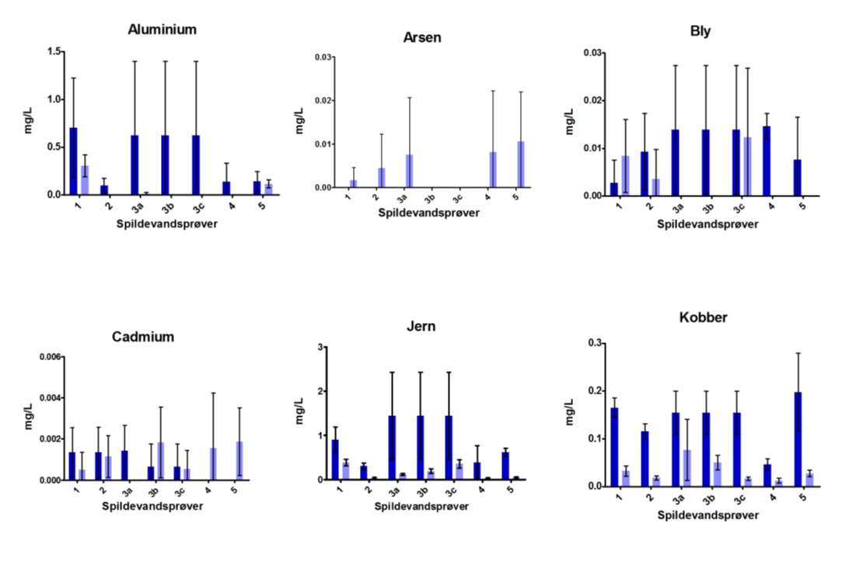
Heavy metals

Slide 42
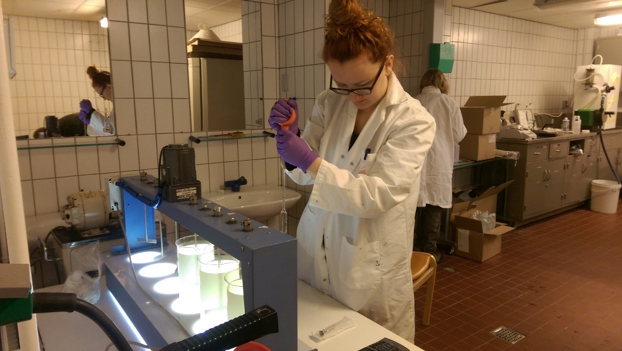
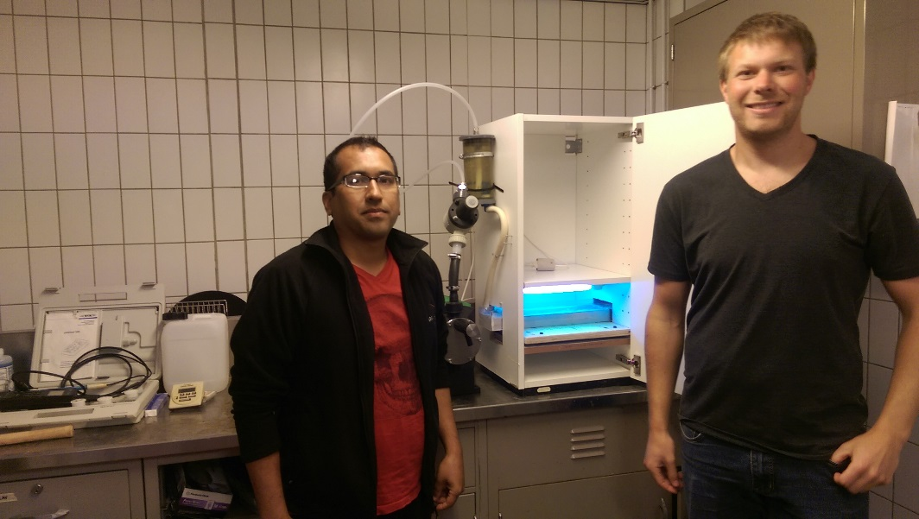
How about hygiene
Lab scale (jar test) + PAA disinfection

Slide 43
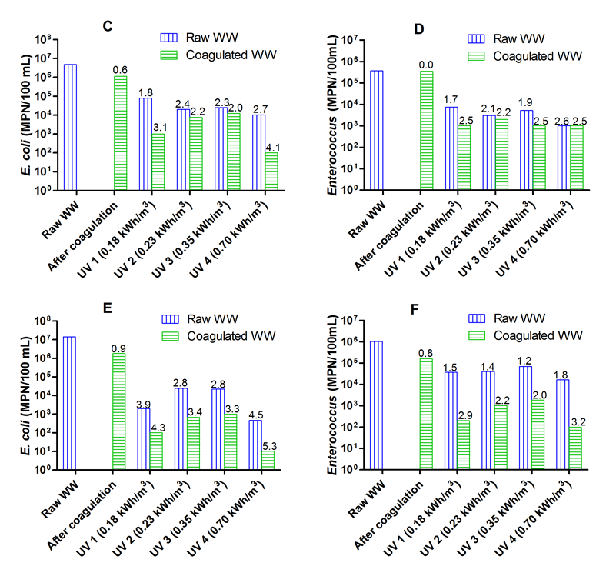
Results, coliforms and enterococci* removal
Chhetri, R.K., Klupsch, E., Andersen, H.R., Jensen, P.E., Treatment of Arctic Wastewater by Chemical Coagulation, UV and Peracetic Acid Disinfection, Environmental Science and Pollution Research, DOI: http://dx.doi.org/10.1007/s11356-017-8585-5, 2017.
*Max 35 CFU/100mL in recreational waters US

Slide 44
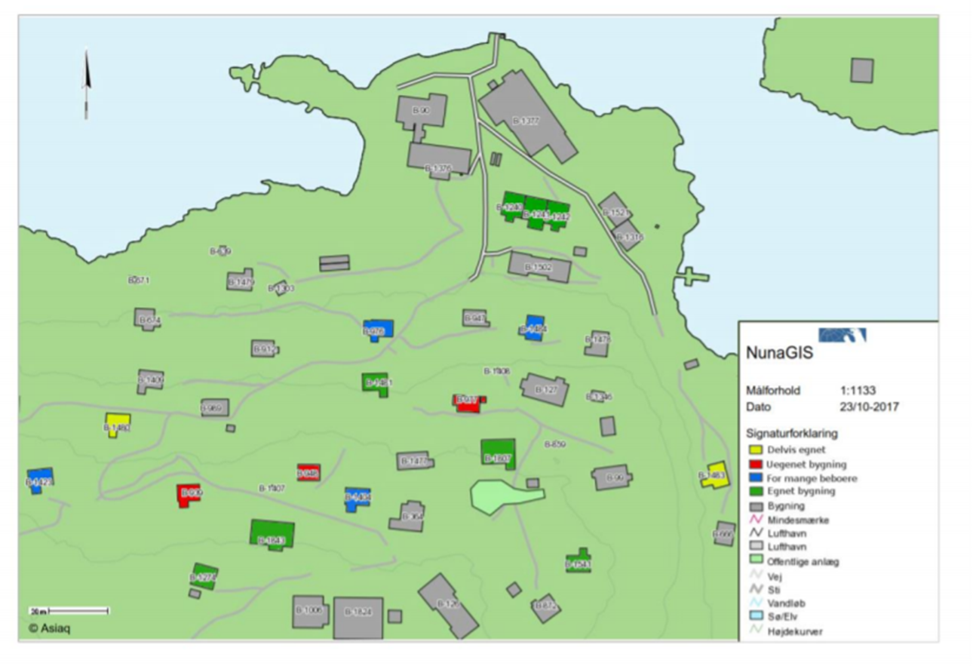

Test of composting toilets
Feasibility of installing composting toilets in selected houses, Sarfannguit, Greenland.
Green: feasible
Yellow: can become feasible Blue: too small
Red: non feasible
Bak, A.M.; Mogensen,C.S.J.; Munck, M.H. (2017), Sanitære forhold i Sarfannguit, report, course 11837 AT sommerprojekt, DTU.

Slide 45


Challenges honey bag toilets
Citizens would indeed like more convenient and decent solutions.
Would prefer water flushed toilets, nut are open towards composting toilet solutions.
Composting toilets should theoretically be able to work fine in Greenland since they do in other northern places.
Observed challenges:
Houses too small
Rooms too cold (in Winter time)
Tested toilets designed for 4 persons, but many families are larger
Energy expenditure – when you live from fishing and hunting
Imported stabilization material – also a cost
Instructions in swedish
No running water in the room

Slide 46





Slide 47




Gunnarsdóttir, R.; Heiske, S.; Jensen, P.E.; Schmidt, J.E.; Villumsen, A; Jenssen, P.D. Effect of anaerobiosis on indigenous microorganisms in blackwater with fish offal as co-substrate, Water Research, 63, 1-9, 2014.

Slide 48



Slide 49




Gunnarsdóttir, R.; Müller, K;. Jensen, P. E.; Jenssen, P.; Villumsen, A. Effect of long-term freezing and freeze/thaw-cycles on indigenous and inoculated microorganisms in dewatered blackwater, Environmental Science & Technology, 46, 12408-12416, 2012

Slide 50
Combined composting and freeze-thaw dewatering in Iqaluit, Nunavut
Johnson, K., Sewage Composting in Iqaluit, Nunavut – Black Gold, in: Water (the new gold), proceedings of WCW Conference & Trade Show, Winnipeg, September 20 – 23, 2009.
Freeze thaw cycles:
Causes particles to coagulate
Improves dewater ability significantly

Slide 51
Post treatment conditioning
Untreated sludge may not be used as fertilizer
Stabilized sludge can be used with restrictions (not for food production, private or public parks). Must be dug into the soil within 6 hours.
After controlled composting can be used with restrictions (not for food production, private or public parks).
Unrestricted use after hygienization:
Heat treatment
Pasteurisation
Drying
Thermal reduction

Slide 52

Aka Høegh, mother of the sea

