Slide 1
THT312: Water Management in Cold Regions
Wastewater treatment in cold climate -
Source separating systems
Department of Environmental Sciences (IMV), P.D. Jenssen
NORWEGIAN UNIVERSITY OF LIFE SCIENCES (NMBU)
Petter D. Jenssen, Faculty of Environmental Sciences and Natural Resource Management (MINA), Norwegian University of Life Sciences (NMBU), petter.jenssen@umb.no,
www.umb.no

Slide 2
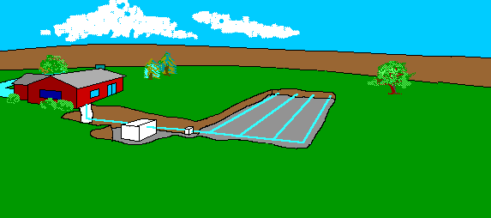
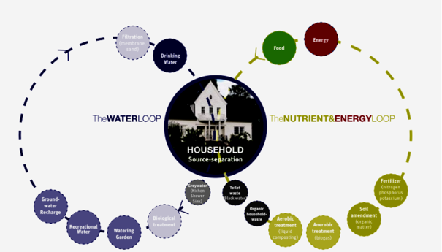
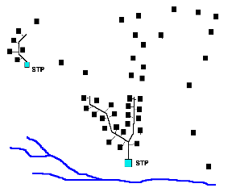
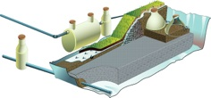
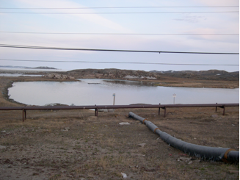
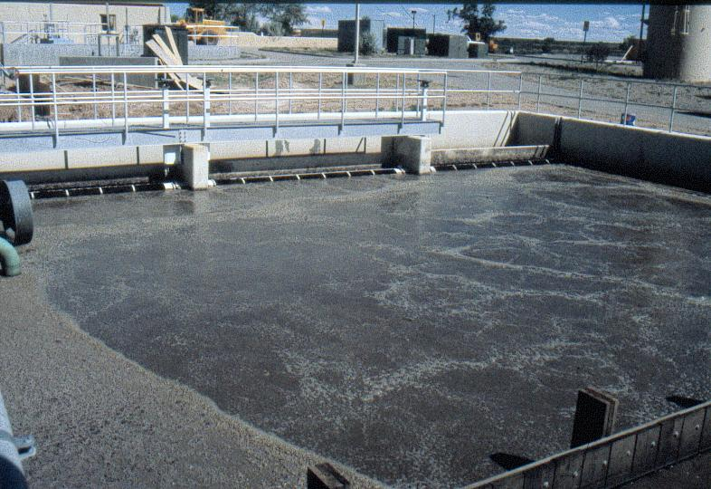
Wastewater treatment options
Infiltration
Source separation
Constructed
wetlands
Ponds - lagoons
Conventional systems

Slide 3
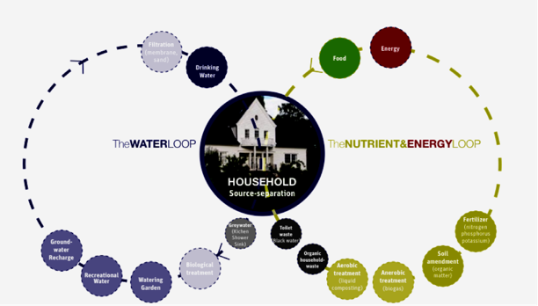
Source separation of wastewater
NORWEGIAN UNIVERSITY OF LIFE SCIENCES
Department of Environmental Sciences (IMV) Petter D. Jenssen
91
91
(Alsen and Jenssen2005)
www.umb.no

Slide 4
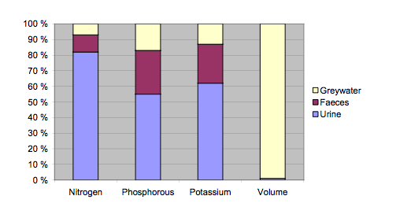
Nutrients and volume of domestic wastewater fractions
NORWEGIAN UNIVERSITY OF LIFE SCIENCES
Department of Environmental Sciences (IMV) Petter D. Jenssen
95
1 % of the volume contains:
>80% of the resources
(Jönsson et al., 1999).
www.umb.no

Slide 5
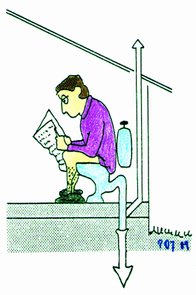
Contribution from the toilet * 90 % of N * 90 % of P * 80 % of K * > 50 % of org. matter * Majority of the pathogens
Source separation of wastewater
NORWEGIAN UNIVERSITY OF LIFE SCIENCES
Department of Environmental Sciences (IMV) Petter D. Jenssen
Vinnerås et al. 2006, Todt et al. 2015
156
www.umb.no
Notes:
The majority of the nutrients in wastewater originates from our excreta, urine and feces and ends up in the toilet waste termed blackwater;

Slide 6
Future toilet types (commercially available today)
NORWEGIAN UNIVERSITY OF LIFE SCIENCES
Composting /dry sanitation 0 - 0.1 liter/visit
Urine diverting 0.1 - 4.0 liter/visit
Water saving (vacuum&gravity) 0.5 - 1.0 liter/visit
Department of Environmental Sciences (IMV) Petter D. Jenssen
157
www.umb.no

Slide 7
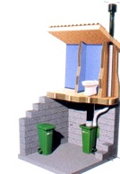
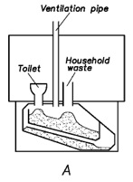
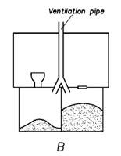
Dry/composting toilets
NORWEGIAN UNIVERSITY OF LIFE SCIENCES
Department of Plant and Environmental Sciences, P.D. Jenssen
A
B
C
A: single chamber B. Dual chamber C: Removable compartments
Dry or composting toilets can have many different designs and may also use urine diverting toilet bowls. It is possible and preferable to add carbon rich bulking material to improve the C/N ratio. Organic household waste can be used and some designs (A) have a separate chute where organic household waste can be loaded. The bulking material enhances the structure of the compost and covers up fecal matter so as to avoid flies and odour. It can also absorb liquid that is especially important if the urine is not diverted. Many different organic substances may be used as bulking material; ground up bark, sawdust, leaves etc.
35
www.umb.no

Slide 8
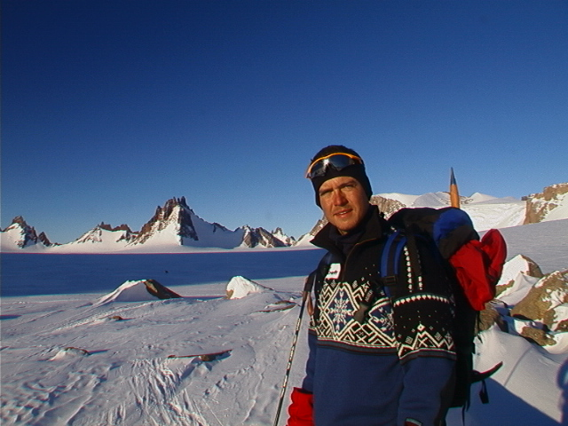
Antartica 2001
http://www.polarhistorie.no/hendelser/1209014134.59/tidslinjehendelse_view?geografi=&hovedemne=&underemne=&hovedepoke=&underepoke=&
and
http://www.adlibris.com/no/product.aspx?isbn=8292309020

Slide 9
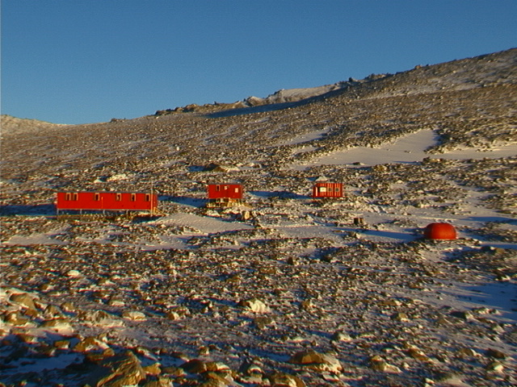
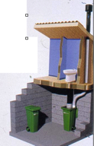
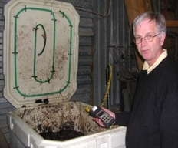
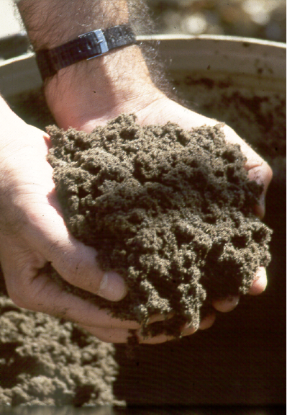
Troll research station - Antartica
Composting of excreta
Collection
Secondary composting
End product

Slide 10
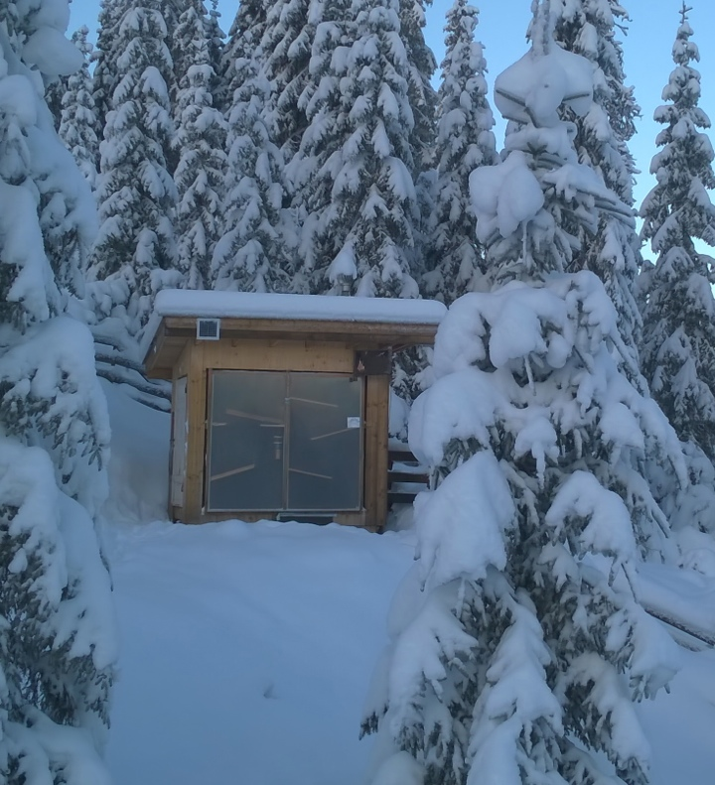
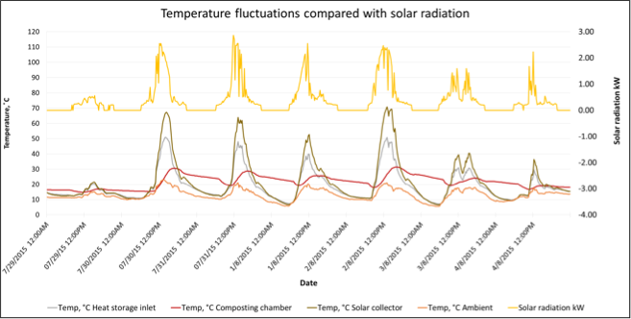
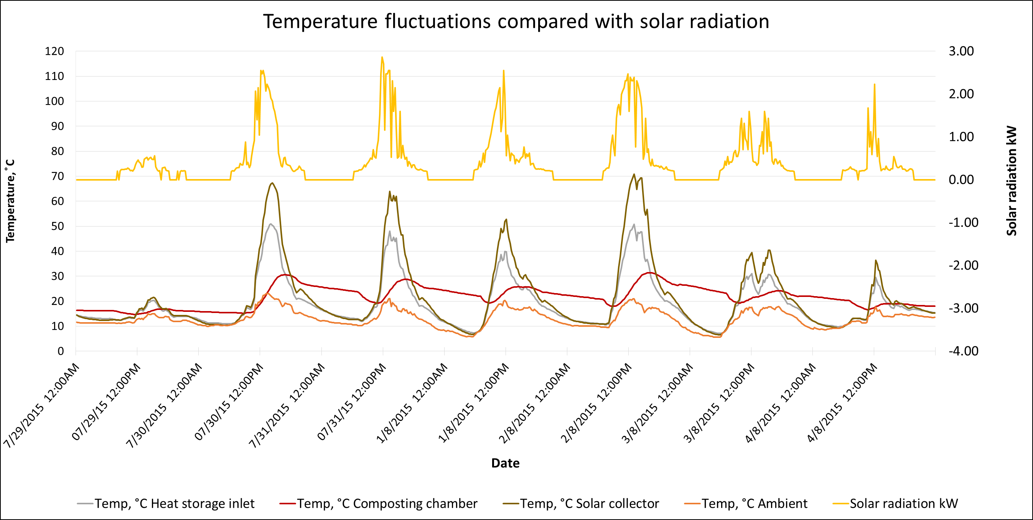
A solar powered toilet for cold climate
Conclusions
The compost chamber has a higher temperature than the ambient at all times.
The heat collection is more dependent on sun intensity than the ambient temperature.
Only 10 – 20 % of the solar energy input is utilized by the current design, thus there is room for improvements.
The prototype has potential to sanitize the compost, especially in periods with high sun intensity, and it can substantially increase the efficiency in the cold months.
The system can be modified for dehydration of the excreta.
Department of Environmental Sciences (IMV), P. D. Jenssen
NORWEGIAN UNIVERSITY OF LIFE SCIENCES (NMBU)

Slide 11
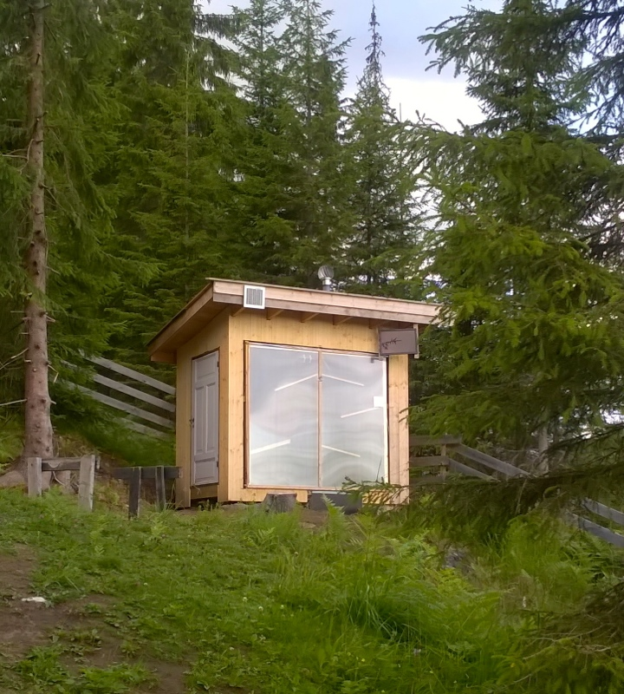
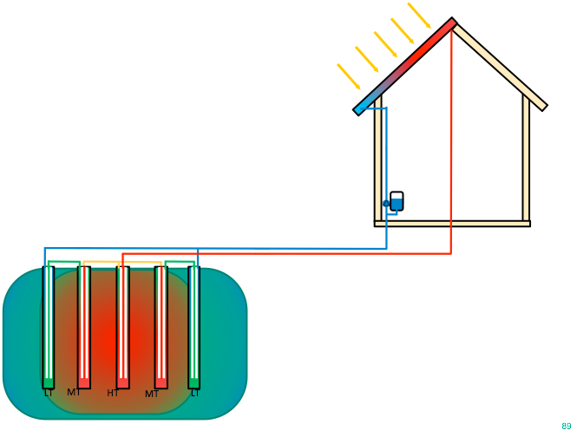
SUMMER:
Solar energy is stored in the ground under or near the building
P. Heyerdahl (2015)
Bolig solvarmet hele året
Norges miljø- og biovitenskapelige universitet

Slide 12
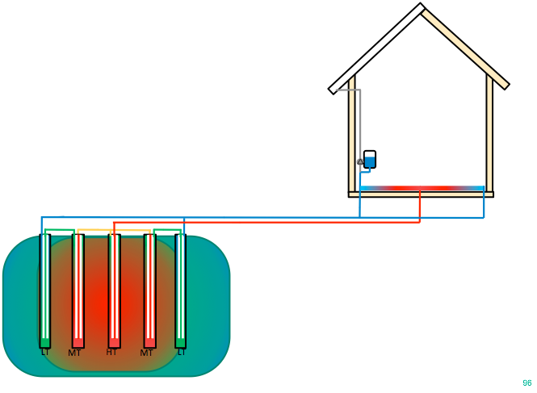
WINTER:
Stored heat is extracted from the ground
P. Heyerdahl (2015)
Bolig solvarmet hele året
Norges miljø- og biovitenskapelige universitet

Slide 13
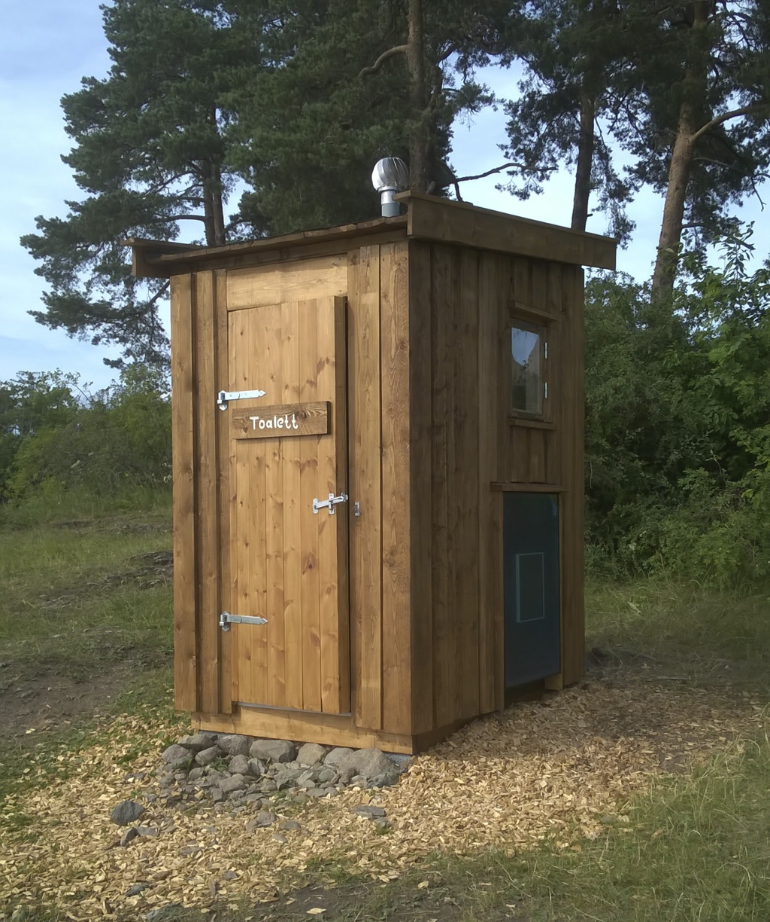
Institutt for miljøvitenskap (IMV) Petter D. Jenssen
NORGES MILJØ OG BIOVITENSKAPLIGE UNIVERITET (NMBU)
Solar panel
www.umb.no

Slide 14
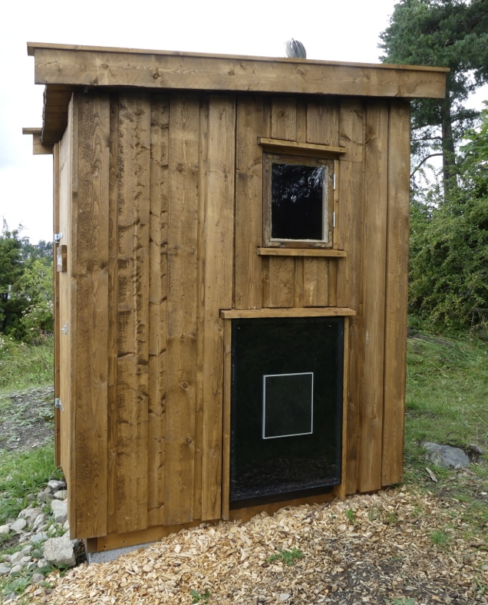
Soldrevet tørr
toalettløsning
Institutt for miljøvitenskap (IMV) Petter D. Jenssen
NORGES MILJØ OG BIOVITENSKAPLIGE UNIVERITET (NMBU)
www.umb.no

Slide 15
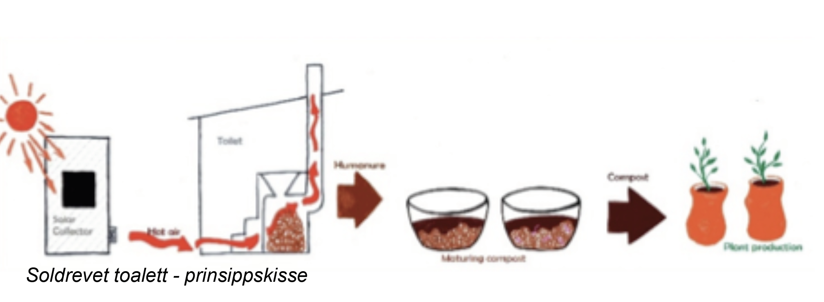
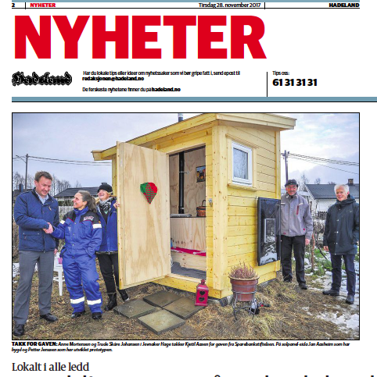
Solar driven toilet - principle
Institutt for miljøvitenskap (IMV) Petter D. Jenssen
NORGES MILJØ OG BIOVITENSKAPLIGE UNIVERITET (NMBU)
www.umb.no

Slide 16
Dry toilets - how to avoid smell
Extend the ventilation chimney above the highest point of the roof
Use a wind fan
Drain excess liquid
Use bulking material
Use urine diversion
Institutt for miljøvitenskap (IMV) Petter D. Jenssen
NORGES MILJØ OG BIOVITENSKAPLIGE UNIVERITET (NMBU)
www.umb.no

Slide 17
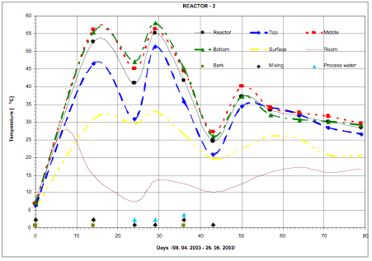
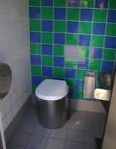
Dry sanitation - hygiene
International research show that dry sanitation may give an equal or higher reduction of pathogens and a high reduction in risk of exposure. (Stenström 2002)
NORWEGIAN UNIVERSITY OF LIFE SCIENCES
Department of Plant and Environmental Sciences, P.D. Jenssen
(From: Hanssen et al. 2005)
4
www.umb.no

Slide 18
Future toilet types (commercially available today)
NORWEGIAN UNIVERSITY OF LIFE SCIENCES
Composting /dry sanitation 0 - 0.1 liter/visit
Urine diverting 0.1 - 4.0 liter/visit
Water saving (vacuum&gravity) 0.5 - 1.0 liter/visit
Department of Environmental Sciences (IMV) Petter D. Jenssen
157
www.umb.no

Slide 19
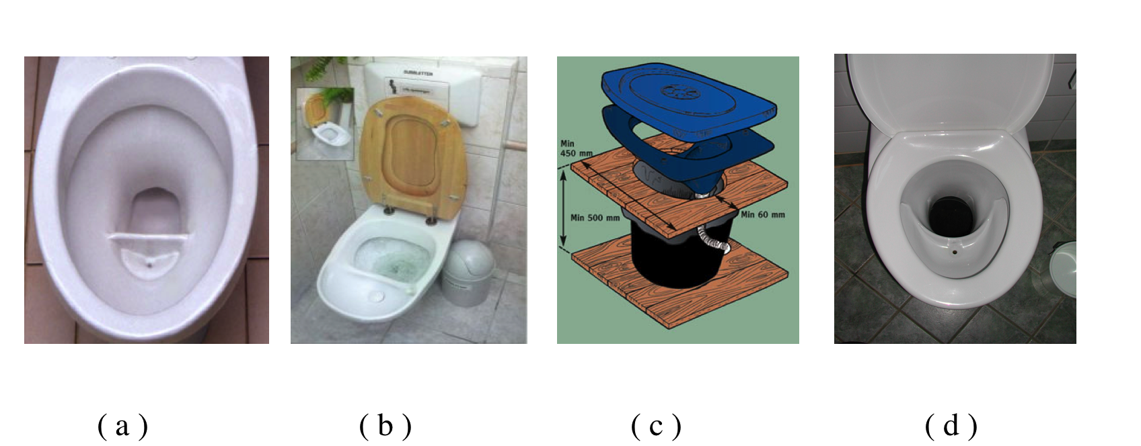
Urine diverting toilets
NORWEGIAN UNIVERSITY OF LIFE SCIENCES
Department of Plant and Environmental Sciences, P.D. Jenssen
Dual flush: a and b Single flush: c and d
26
41
www.umb.no

Slide 20
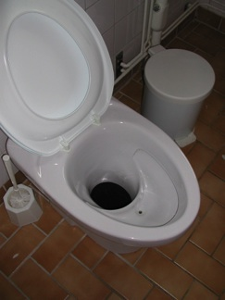
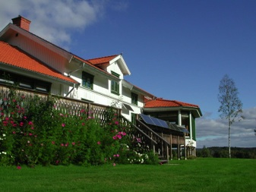
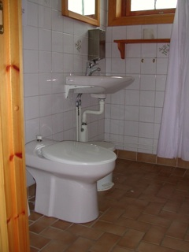
Urine diverting toilets
Single flush and dry composting of fecal matter at
Tingvall conference center Sweden
NORWEGIAN UNIVERSITY OF LIFE SCIENCES
Department of Plant and Environmental Sciences, P.D. Jenssen
43
Photo: P.D. Jenssen
www.umb.no

Slide 21
Urine diverting toilets
Single flush and dry composting of fecal matter at
Tingvall conference center Sweden
NORWEGIAN UNIVERSITY OF LIFE SCIENCES
Department of Plant and Environmental Sciences, P.D. Jenssen
44
Photo: P.D. Jenssen
www.umb.no

Slide 22
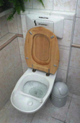
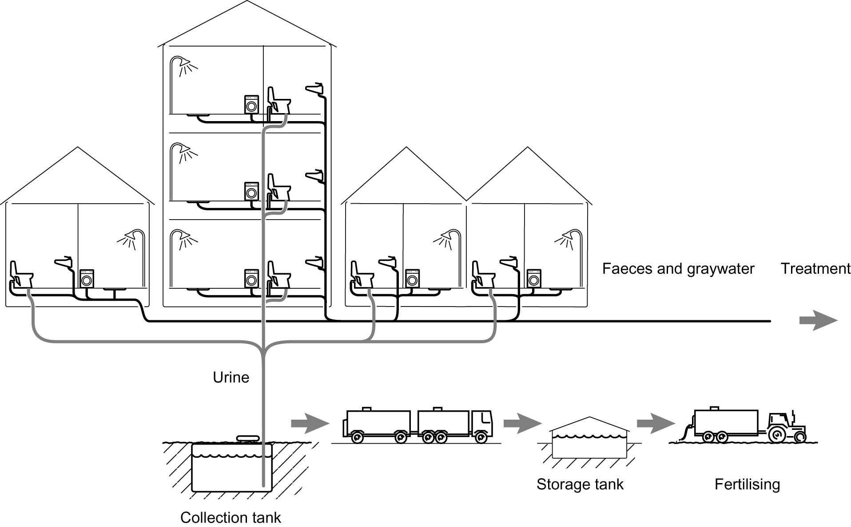
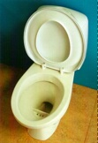
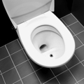
Urine diverting toilets – dual flush system
NORWEGIAN UNIVERSITY OF LIFE SCIENCES
Department of Plant and Environmental Sciences, P.D. Jenssen
(Jønsson et al. 2000)
Urine flushed with 0.1 – 1,6 liters
Faeces - flushed with 2 - 4 liters
46
www.umb.no

Slide 23
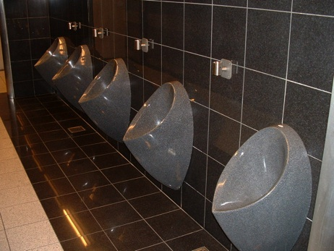
Waterless urinals
In waterless urinals urine is collected without the use of water. Provided the urinals are cleaned once per day there is no smell from these urinals.
NORWEGIAN UNIVERSITY OF LIFE SCIENCES
Department of Plant and Environmental Sciences, P.D. Jenssen
Kastrup airport
Copenhagen
47
Photo: P.D. Jenssen
www.umb.no

Slide 24
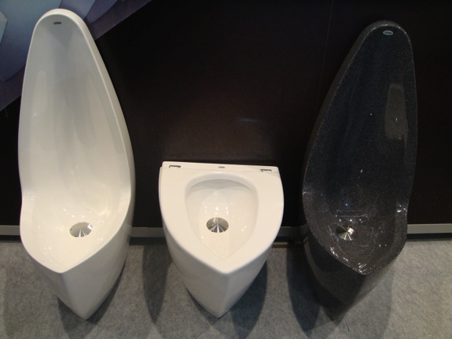
Waterless urinals - Female and male
Male (and female)
NORWEGIAN UNIVERSITY OF LIFE SCIENCES
Department of Plant and Environmental Sciences, P.D. Jenssen
Female
48
48
Photo: Uridan/Jan Moe
www.umb.no

Slide 25
Avling med urin og handelsgjødsel
Institutt for miljøvitenskap (IMV) Petter D. Jenssen
4000
3000
2000
1000
NORGES MILJØ OG BIOVITENSKAPLIGE UNIVERITET (NMBU)
Urin
Handelsgjødsel
0kg 60kg 80kg 100kg 120kg
0kg 60kg 80kg 100kg
(Cottis 2000)
www.umb.no

Slide 26
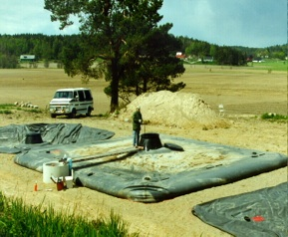
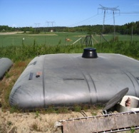
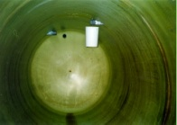
Storing of urine General rule: 6 months to achieve hygienization (WHO 2006)
NORWEGIAN UNIVERSITY OF LIFE SCIENCES
Department of Plant and Environmental Sciences, P.D. Jenssen
Both pillow tanks and tanks of harder material as polyester can be used for storing of urine
51
Photo: Eco San Res
www.umb.no
Notes:
Urine is collected, by tank trucks, from three housing areas in Stockholm (appr. 350 – 400 inhabitants) transported to storage and reuse at Lake Bornsjön

Slide 27
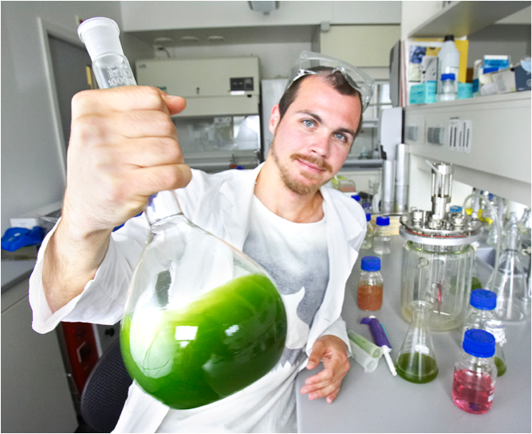
Biodiesel from algae grown in urine
(Eikås 2008)

Slide 28
Future toilet types (commercially available today)
NORWEGIAN UNIVERSITY OF LIFE SCIENCES
Composting /dry sanitation 0 - 0.1 liter/visit
Urine diverting 0.1 - 4.0 liter/visit
Water saving (vacuum&gravity) 0.5 - 1.0 liter/visit
Department of Environmental Sciences (IMV) Petter D. Jenssen
157
www.umb.no

Slide 29
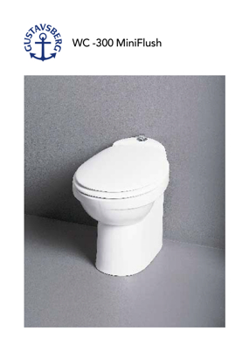
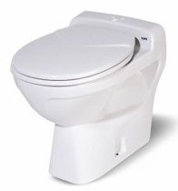
Low flush toilets
Vacuum
0.5 - 1.5 liters/flush
Gravity
1 liter/flush
Department of Environmental Sciences (IMV), P. D. Jenssen
NORWEGIAN UNIVERSITY OF LIFE SCIENCES (NMBU)
NORWEGIAN UNIVERSITY OF LIFE SCIENCES
Department of Plant and Environmental Sciences, P.D. Jenssen
23
www.umb.no

Slide 30
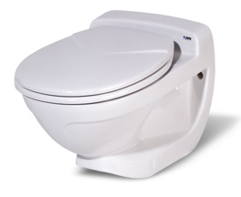
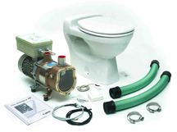
Vacuum toilets - energy use
NORWEGIAN UNIVERSITY OF LIFE SCIENCES
Department of Environmental Sciences (IMV) Petter D. Jenssen
4 Kwh/person and year
www.umb.no

Slide 31
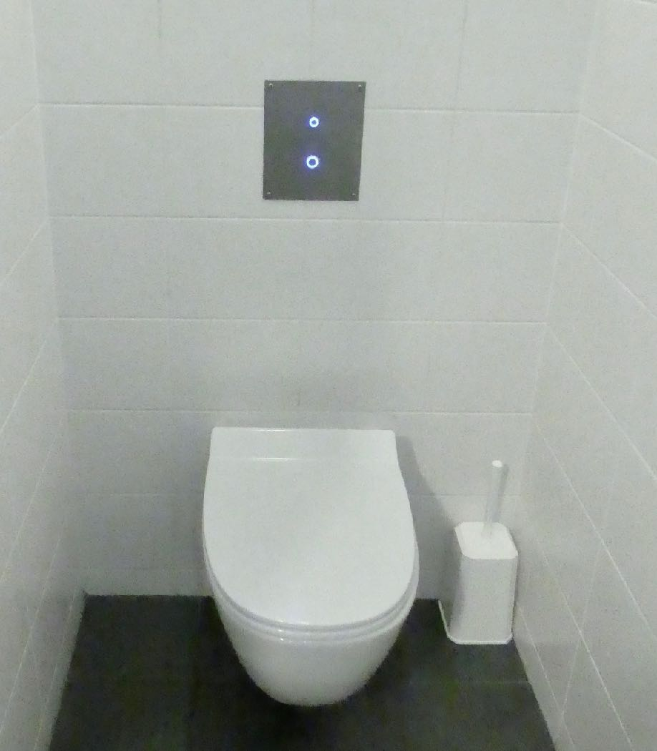
Vacuum toilets - dual flush
Dual flush
Low noise
NORWEGIAN UNIVERSITY OF LIFE SCIENCES
Department of Environmental Sciences (IMV) Petter D. Jenssen
Average water use/flush about 0.5 liters
www.umb.no

Slide 32
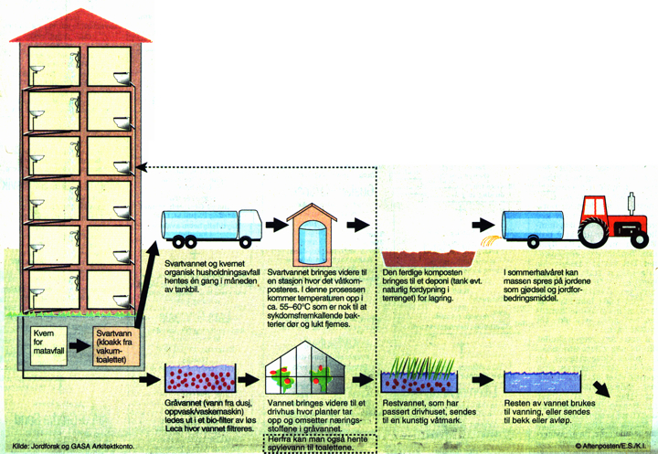
Kildesep prinsipp
Source separating system - logistics
Using vacuum toilets any building can be served. Organic household waste (OHW) can be integrated in the system using kitchen grinders or a common grinder at the discharge to the collection tank.
Vacuum or low flush gravity toilets
NORWEGIAN UNIVERSITY OF LIFE SCIENCES
Toilet waste (blackwater) +
organic household waste (OHW)
OHW
BW
25
www.umb.no

Slide 33
Kildesep prinsipp
Source separating system - logistics
Vacuum or low flush gravity toilets
NORWEGIAN UNIVERSITY OF LIFE SCIENCES
Toilet waste (blackwater) +
organic household waste (OHW)
OHW
BW
25
Greywater
www.umb.no

Slide 34
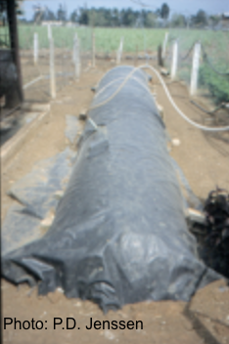
Kildesep prinsipp
Source separating system - logistics
Vacuum or low flush gravity toilets
NORWEGIAN UNIVERSITY OF LIFE SCIENCES
Biogas CH4
Toilet waste (blackwater) +
organic household waste (OHW)
OHW
BW
25
Greywater
www.umb.no

Slide 35
Kildesep prinsipp
SiEUGreen Horizon 2020
Source separating system - circular economy
Thermophilic anaerobic
treatment - BIOGAS
CHP - combined heat
and power
El.
OHW
Heat
BW
CO2
Nutrients
Growth medium
January 11, 11

Slide 36
Kildesep prinsipp
SiEUGreen Horizon 2020
Source separating system - circular economy
Thermophilic anaerobic
treatment - BIOGAS
CHP - combined heat
and power
Local nutrient recycling
El.
OHW
Heat
BW
CO2
Nutrients
Growth medium
January 11, 11

Slide 37
Kildesep prinsipp
SiEUGreen Horizon 2020
Source separating system - circular economy
Thermophilic anaerobic
treatment - BIOGAS
CHP - combined heat
and power
Local nutrient recycling
El.
OHW
Heat
BW
CO2
Nutrients
Growth medium
January 11, 11

Slide 38
Source separation of wastewater
NORWEGIAN UNIVERSITY OF LIFE SCIENCES
Department of Environmental Sciences (IMV) Petter D. Jenssen
Greywater
treatment
91
91
(Alsen and Jenssen2005)
www.umb.no

Slide 39
Wastewater treatment options
Source separation
Infiltration
Constructed
wetlands
Ponds - lagoons
Conventional systems

Slide 40
Compact greywater treatment system
Institutt for miljøvitenskap (IMV)
NORGES MILJØ OG BIOVITENSKAPLIGE UNIVERITET (NMBU)
BOF < 5 mg/l
SS < 2 mg/l
E.coli 2-3 log reduction
Heistad (2015)
www.umb.no

Slide 41
Membrane bioreactor systems (MBR´s)
NORWEGIAN UNIVERSITY OF LIFE SCIENCES
Department of Environmental Sciences (IMV) Petter D. Jenssen
Potential for making very compact greywater treatment systems
www.umb.no

Slide 42
Source separation of wastewater
Treatment - BOD, TSS, nutrients | HIGH
Treatment - Hygiene | HIGH
Treatment - Organic micropollutants | HIGH
Investment cost | MEDIUM/LOW
O & M | LOW/MEDIUM
Technical complexity | LOW/HIGH
Suitability arctic conditions | HIGH
NORWEGIAN UNIVERSITY OF LIFE SCIENCES
Department of Environmental Sciences (IMV) Petter D. Jenssen
91
91
(Alsen and Jenssen2005)
www.umb.no

Slide 43
Conclusions
Source separating solutions are designed for reclamation and recycling of wastewater resources - circular economy
Source separating solutions can be used for single households apartment buildings or upscaled to do towns or cities
Source separation has potential for very low water use and production of bioenergy fertilizer and soil amendment products
Dry toilets are not inferior to flush toilets if constructed right and have a large potential for optimization and adaption to cold climate
Dry sanitation may give an equal or higher reduction of pathogens and a high reduction in risk of exposure
A new generation vacuum toilets cuts average flush volume to about 0.5 liter
Source separation opens for very compact – inhouse – greywater treatment systems
Source separation facilitates removal of organic micropollutants´s as PPCP´s
Institutt for miljøvitenskap (IMV) Petter D. Jenssen
NORGES MILJØ OG BIOVITENSKAPLIGE UNIVERITET (NMBU)
www.umb.no

Slide 44
References
Alsen, K. and P.D. Jenssen. 2005 Ecological sanitation – an option for all. Norwegian University of Life Sciences. 39 p.
Gunnarsdóttira, R., K. Müller, P. E. Jensen, P.D., Jenssen, and A. Villumsen, (2012). Effect of Long-Term Freezing and Freeze−Thaw Cycles on Indigenous and Inoculated Microorganisms in Dewatered Blackwater. Environ. Sci. Technol., 46: 12408−12416
Gunnarsdóttira, R., Jenssen, P.D., Jensen, P.E., Villumsen, A., Kallenborn, R., (2013). A review of wastewater handling in the Arctic with special reference to Pharmaceuticals and Personal Care Products (PPCPs) and microbial pollution, 2012. Ecological Engineering, 50, pp.76– 85.
Hennessy, T.W., Ritter, T., Holman, R.C., Brüden, D.L., Yorita, K.L., Bulkow, L.,
Cheek, J.E., Singleton, R.J., Smith, J., 2008. The Relationship between In-Home Water Service and the Risk of Respiratory Tract, Skin, and Gastrointestinal Tract Infections Among Rural Alaska Natives. American Journal of Public Health. 98 (11) 2072-2078.
Jenssen P.D, P.H. Heyerdahl, J.F. Hanssen and M.E. Kelova, 2015. Solar powered dry toilet for cold climate. Results from a pilot study. Poster presentation at the 5th International Dry Toilet Conference. Tampere, Finland 19-22/8-2015.
Johnsen, K. 2016. A brief history of the past 60 years of water and sanitation practices in the arctic. Presentation at the conference: Sanitation in cold climates. Sisimiut Greenland, 12-18. April. Arctic Technology Centre, DTH, Copenhagen.
Kallenborn, R., Fick, J., Lindberg, R., Moe, M., Nielsen, K.M., Tysklind, M., Vasskog, T., 2008. Pharmaceutical residues in Northern European environments: consequences and perspectives. In: Kümmerer, K. (Ed.), Pharmaceuticals in the Environment. , 3rd ed. Springer Verlag, New York, Tokyo, Heidelberg, 522 p.
Rogers, J., C. Schulz, C. Nelson. 2016. The Alaska Water Challenge. Presentation at the conference: Sanitation in cold climates. Sisimiut Greenland, 12-18. April. Arctic Technology Centre, DTH, Copenhagen.
Todt D. and P.D.Jenssen ,2015. Particle removal in a novel sequential mechanical filter system loaded with blackwater. Water Science and Technology, 71 (9): 1407-1413.
U.S. Congress, 1994. U.S. Congress, Office of Technology Assessment, An Alaskan Challenge: Native Village Sanitation, OTA-ENV–591.Washington, DC: U.S.Government Printing Office, May 1994.
NORWEGIAN UNIVERSITY OF LIFE SCIENCES
Department of Environmental Sciences (IMV) Petter D. Jenssen
www.umb.no

Slide 45
References continued
Gallagher, N.T., Sharvelle, S.E., 2010. Decentralized Anaerobic Blackwater Management: A Sustainable Development Technology Concept for Urban Water Management. World Environmental and Water Resources Congress 2010: Challenges of Change. Proceedings of the World Environmental and Water Resources Congress 2010.
Jenssen, P.D., Greatorex, J., Warner, W.S., 2004. Sustainable wastewater management in urban areas. In K. Kayser (ed.) "Konzeptionen Dezentralisierter Abwasserreinigung und Stoffstrommanagement" (concepts of de-centralized wastewater treatment and resource management). Universitat Hannover Weiterbildendes Studium Bauingenieurwesen "Wasser und Umwelt", 51p.
Smith, D.W., Low, N., 1996. Cold regions utilities monograph, third ed. Technical Council on Cold Regions Engineering, American Society of Civil Engineers and Cold Regions Engineering Division, Canadian Society for Civil Engineering.
Umhverfisstofun (UST), 2003. Staða mála hvað varðar hreinsun skólps á Íslandi, skýrsla Umhverfisstofunanar sbr. 28. gr. reglugerðar nr. 798/1999, um fráveitur og skólp (report in Icelandic. English title: Status of wastewater treatment in Icland)
Vogelsang, C., Grung, M., Jantsch, T.G., Tollefsen, K.E., Liltved, H., 2006. Occurrence and removal of selected organic micropollutants at mechanical, chemical and advanced wastewater treatment plants in Norway. Water Research 40, 3559-3570.
Winker, M., Faika, D., Gulyas, H. and Otterpohl, R. (2008). A comparison of human pharmaceutical concentrations in raw municipal wastewater and yellowwater. Science of the Total Environment. 399 (1-3), 96-104.
NORWEGIAN UNIVERSITY OF LIFE SCIENCES
Department of Environmental Sciences (IMV) Petter D. Jenssen
www.umb.no

Slide 46
Thank you!
petter.jenssen@nmbu.no

