Slide 1
Tools for Environmental Impact Assessment of Wastewater Treatment
Manoj K. Pandey
NMBU

Slide 2
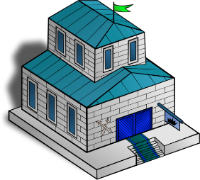
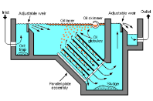
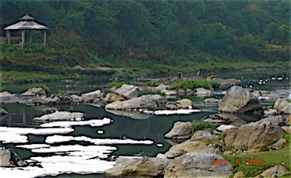
General objective of wastewater treatment
Protecting public health and environment
Protecting surface and groundwater resources from pollution
Improvement of aestheic quality of the environment

Slide 3
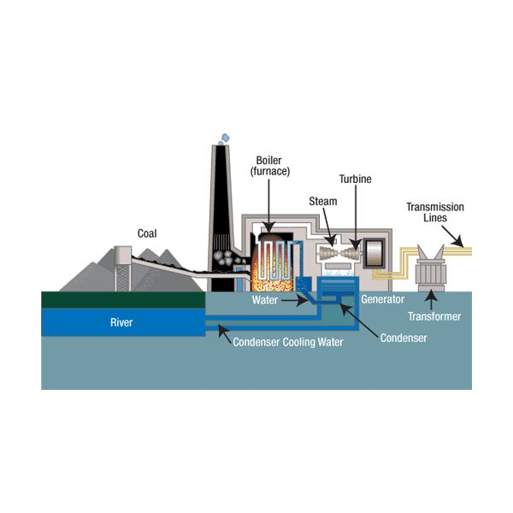
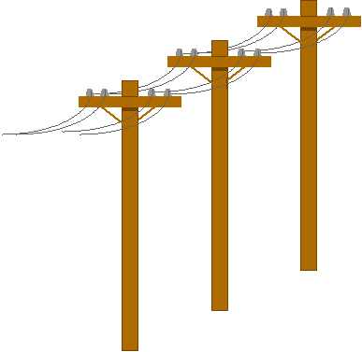
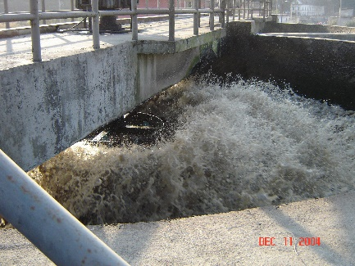
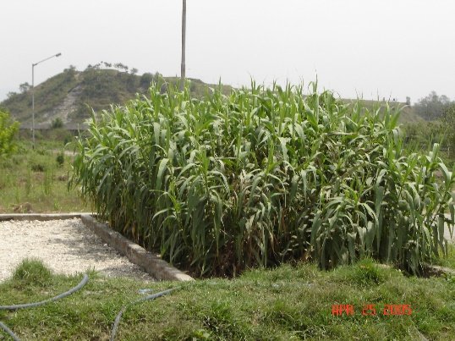

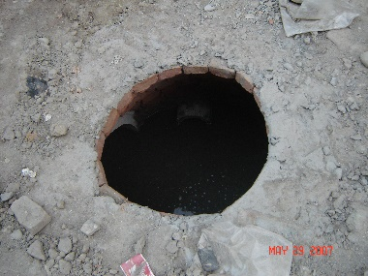
Concerns of wastewater treatment
SO₂ NO_{x}
CO₂, N₂0; N₂
The water industry is the fourth
most energy intensive sector in the UK!^{[1]}
CH_{4,} N₂O
CH₄
CO₂
Energy issue is much more important in Cold region (Arctic)

Slide 4
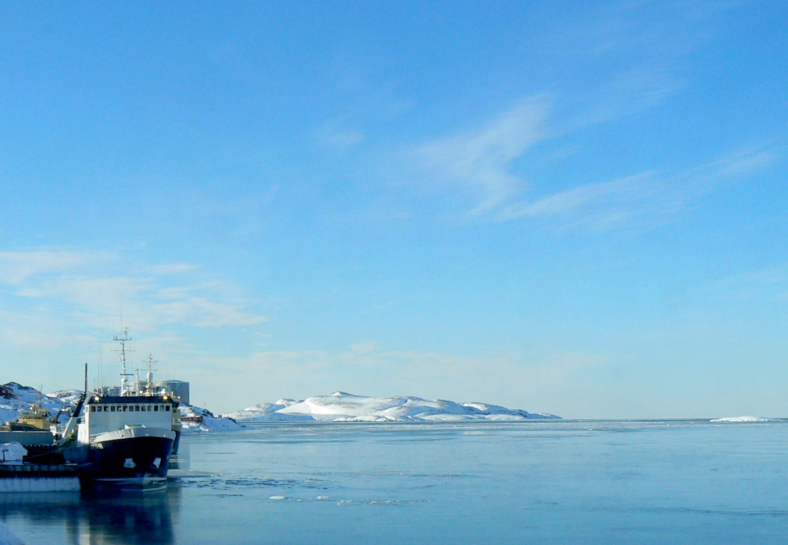

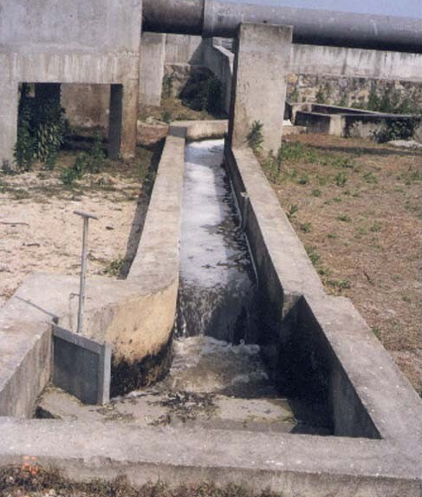
Wastewater discharge to marine waters – problems?
Trace Organic matters ?
Pathogens ?
Medicinal residue
20-40% of the water consumption
in sewered cities is used
for flushing toilets^{[1]}

Slide 5
Sustainable System?
Sustainablity
Economy
(Affordable)
Environment
Socio-cultural
Technical
Low capital cost
Low O/M cost
Low fossil energy use
Resource conservation
Reuse and recycling
Public health protection
Culturally compatible
Socially acceptable
Community participation
High performance
Use of local material
Robust and resilient

Slide 6
Sustainability Analysis tools
LCA (Life cycle analysis)
CBA (Cost benefit analysis)
AHP (Analytical hierarchy process)- Multi criteria decision making tool
Environmental Audit
Material flow analysis
Environmental impact assessment (EIA)

Slide 7



What is LCA?
Was originally developed to obtain cleaner production of Industrial products
It analyses of environmental performance of a product ( or processes) from:
Therefore there is less chance of environmental burden shifting
Saving energy and resources
Less emissions of harmful substances
Promoting recycle and reuse
CRADLE
GRAVE

Slide 8

If minimization of environmental impacts is one of the main functions of wastewater treatment systems then they should be designed so that their total impact on the environment is reduced [1]
45 LCA studies on wastewater have been reported to be published in peer reviewed Journals [2]
Numerous other studies published in the form of reports, thesis etc.
LCA exactly does that !!!
Notes:
Wastewater is a product

Slide 9
What is Life cycle of wastewater treatment system?
Households
Solid waste
Energy
Construction
Water emissions
Material
Airborne emissions
Collection and transport
Energy
Solid waste
Operation
Water emissions
Material
Airborne emissions
Wastewater treatment
Sludge treatment
Energy
Solid waste
Material
Demolition
Water emissions
Airborne emissions

Slide 10
LCA Framework
Interpretation
Goal and scope defination
Objectives of study
Functional unit
System boundaries
Inventory analysis
Impact assessment

Slide 11
LCA Framework
Interpretation
Goal and scope defination
Data for material and energy consumption during construction and operation of WWTP
Data for environmental emission during construction, operation and demolition ????
Inventory analysis
Impact assessment

Slide 12
LCA Framework
Interpretation
Goal and scope defination
Impact characterization
Impact normalization and weighing (optional)
Impact evaluation (optional)
Inventory analysis
Impact assessment

Slide 13
LCA of WWT options for small and decentralized community (example)
Wastewater infiltration in 2000 m² planted with Populas euroamericana (40)
- Wood cut- every 5 years; Used to produce pulp
Willow system / slow rate infiltration
Activate sludge made of stainless steel tanks with 2 aerators, sludge treated and used for soil amendments
Activated sludge
HF bed- 277 m²; VF bed- 317 m² ; Planted with Phragmites australis; geotextiles as liner; gravel bed for the biomass growth; Imhoff tank of PVC and concrete
Constructed wetland

Slide 14
LCA of WWT options for small and decentralized community
Goal: to compare two natural systems (constructed wetland and willow/soil infiltration) with a conventional one.
Functional unit: 1 Population equivalent
Design life: 10 years
System Boundry: As shown in figure -
Scope: Construction, operation, dismantling

Slide 15
LCA Framework
Interpretation
Goal and scope defination
Data for material and energy consumption during construction and operation of WWTP
Data for environmental emission during construction, operation and demolition ????
Inventory analysis
Impact assessment

Slide 16
Inventory table (1 p.e)
Inventory | Unit | Constructed wetland | Slow rate infiltration | Activated sludge
Energy input
Fossil fuel | g | 952 | 98 | 38
Electricity | kWh | - | - | 321
Material input
Gravel | t | 10 | - | -
Steel | kg | - | - | 24.2
Emissions
To air
CO₂ | kg | -141 | -956 | 592
Sulphur oxides | g | 785 | 112 | 154
To water
Phosphorus | g | 456 | 456 | 456
Sludge
Total N | g | 28.5 | - | 8.22

Slide 17
Life Cycle Assessment software
Gabi
Open LCA – Free open source software
SimaPro

Slide 18
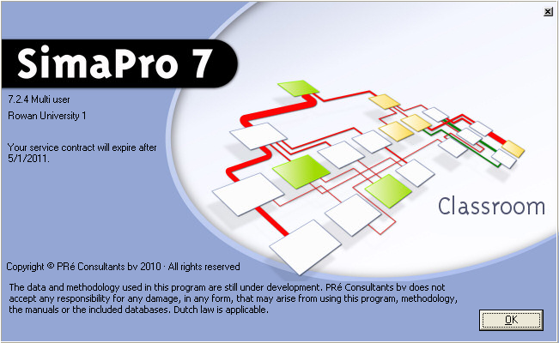
This is the opening screen of SimaPro
Click to proceed

Slide 19
LCA Framework
Interpretation
Goal and scope defination
Impact characterization
Impact normalization and weighing (optional)
Impact evaluation (optional)
Inventory analysis
Impact assessment

Slide 20
Impact Category | Examples of LCI Data (i.e. classification) | Indicator | Description of Characterization Factor
Global Warming | Carbon Dioxide (CO2) Nitrogen Dioxide (NO2) Methane (CH4) Chlorofluorocarbons (CFCs) | Global Warming Potential | Converts LCI data to carbon dioxide (CO2) equivalents
Ozone Depletion | Chlorofluorocarbons (CFCs) Hydrochlorofluorocarbons (HCFCs) Halons Methyl Bromide (CH3Br) | Ozone Depleting Potential | Converts LCI data to trichlorofluoromethane (CFC-11) equivalents.
Acidification | Sulfur Oxides (SOx) Nitrogen Oxides (NOx) Hydrochloric Acid (HCL) | Acidification Potential | Converts LCI data to hydrogen (H+) ion equivalents as SO2 eqv
Eutrophication | Phosphate (PO4) Nitrogen Dioxide (NO2) Nitrates Ammonia (NH4) | Eutrophication Potential | Converts LCI data to phosphate (PO4) equivalents.
Photochemical Smog | Non-methane hydrocarbon (NMHC) | Photochemical Oxident Creation Potential | Converts LCI data to ethane (C2H6) equivalents.

Slide 21
Impact Category | Examples of LCI Data (i.e. classification) | Indicator | Description of Characterization Factor
Terrestrial Toxicity | Toxic chemicals with a reported lethal concentration to rodents | LC50 | Converts LC50 data to equivalents; uses multi-media modeling, exposure pathways.
Aquatic Toxicity | Toxic chemicals with a reported lethal concentration to fish | LC50 | Converts LC50 data to equivalents; uses multi-media modeling, exposure pathways.
Resource Depletion | Quantity of minerals used Quantity of fossil fuels used | Resource Depletion Potential | Converts LCI data to a ratio of quantity of resource used versus quantity of resource left in reserve.
Land Use | Quantity disposed of in a landfill or other land modifications | Land Availability | Converts mass of solid waste into volume using an estimated density.
Water Use | Water used or consumed | Water Shortage Potential | Converts LCI data to a ratio of quantity of water used versus quantity of resource left in reserve.

Slide 22
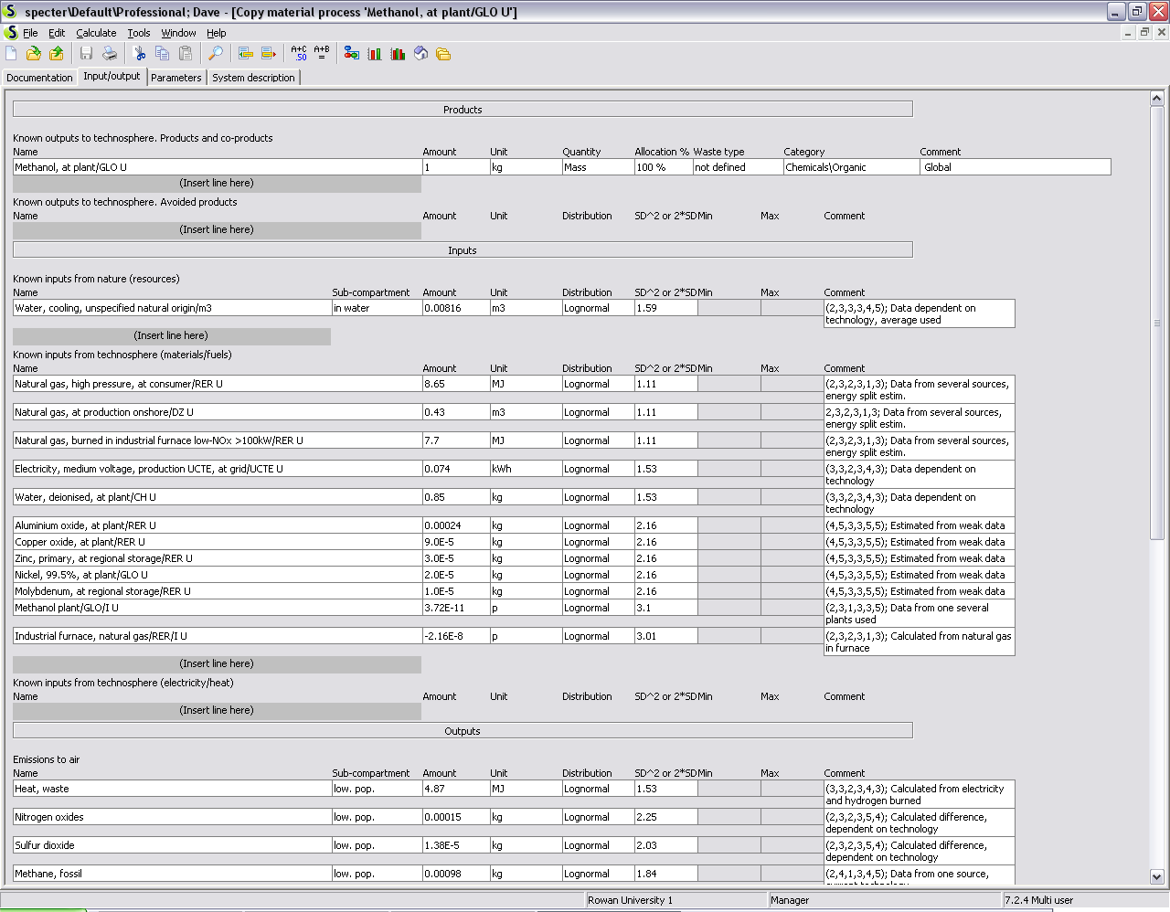
Process information and the amount produced
The inputs from nature
The inputs from the technosphere (manufacturing processes and resources)
The inputs from the technosphere (manufacturing heat and electricity
Direct emissions to the environment
Notes:
The methanol plant input is explained in the notes for the next slide
The distribution and SD columns are used for uncertainty analyses to show the errors associated with each LCI. Our version cannot do this.

Slide 23
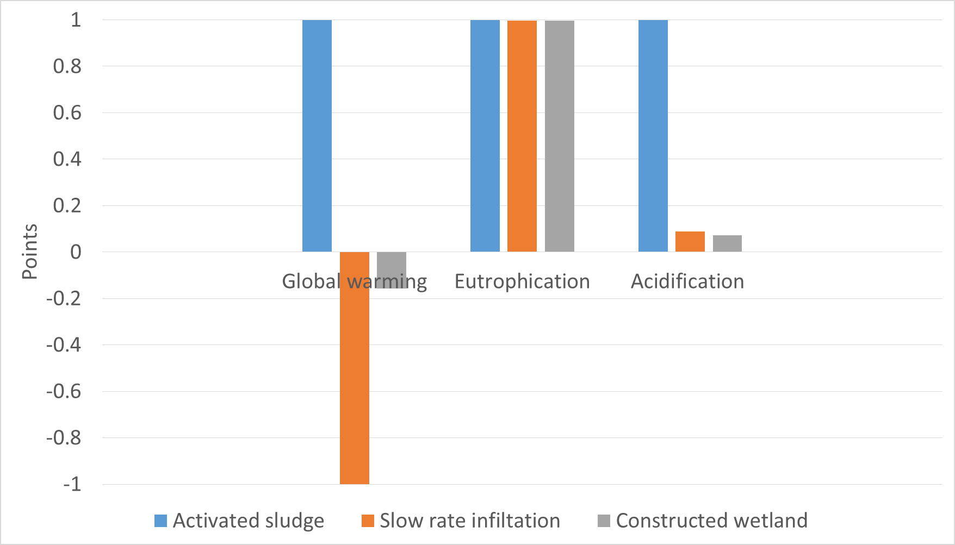
Impact assessment

Slide 24
Critical issues in application of LCA
Functional unit
  Commonly used functional unit is m³ or ML of treated water - could be misleading [1]
  Unit population equivalent (p.e)-includes both quantity and quality of wastwater (1 p.e = 60 g BOD/day)
System boundry
System boundaries have significant impact on the outcome of LCA result [1]
Boundry of the study should be extended to fertilizer production and agricultural application – especially for analysis source separating systems [2]
Most of the studies have excluded demolition phase [3]
For small system construction phase could have significant impact on some impact categories
Data uncertainty

Slide 25
Weakness of LCA
Does not takes into account social and cultural aspects of wastewater managment
LCA results vary with change in boundry condition therefore no robust conclusion can be made
Time consuming, require skill therefore cannot be easily used by the decision makers
Lack of universal standards for assessment of wastewater treatment

Slide 26
Conclusions
What can LCA do?
Avoid environmental problem shifting
Is a powerfull tool to ensure environmental sustainability of wastewater management
Can be used to optimize system design
What it cannot do?
Ensure economic and socio-cultural sustainabilliy
What we can do?
Combine LCA with life cycle cost analysis
Ensure that the technology we select is socio-culturally acceptable
Keep in mind!
Uncertainity in the data used for LCA

Slide 27
Lo Manthang, Upper Mustang, NEPAL
Thank you
Thank you
Photo- Martina Karli

