Slide 1
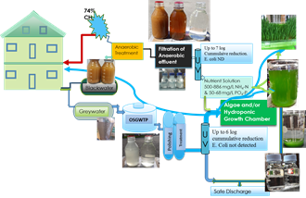
Occurrence, Sources, Pathways and Fate of Emerging contaminants in wastewater and recipients
Can Source-separation and On-site Wastewater Treatment Make a Difference?
Melesse Eshetu
PhD Candidate
Norwegian University of Life Sciences

Slide 2
What are Emerging pollutants?
Emerging does NOT necessarily mean NEW chemicals but their presence and significance are only now being elucidated.
  Synthetic or naturally occurring compounds
    not commonly monitored or regulated in the environment
    not currently covered by the existing legislation in the area of water quality,
    whose environmental impact is not yet sufficiently understood and
    potentially harmful to environmental ecosystems and human health (La Farré M, Pérez S, Kantiani L, Barcelo D 2008)

Slide 3
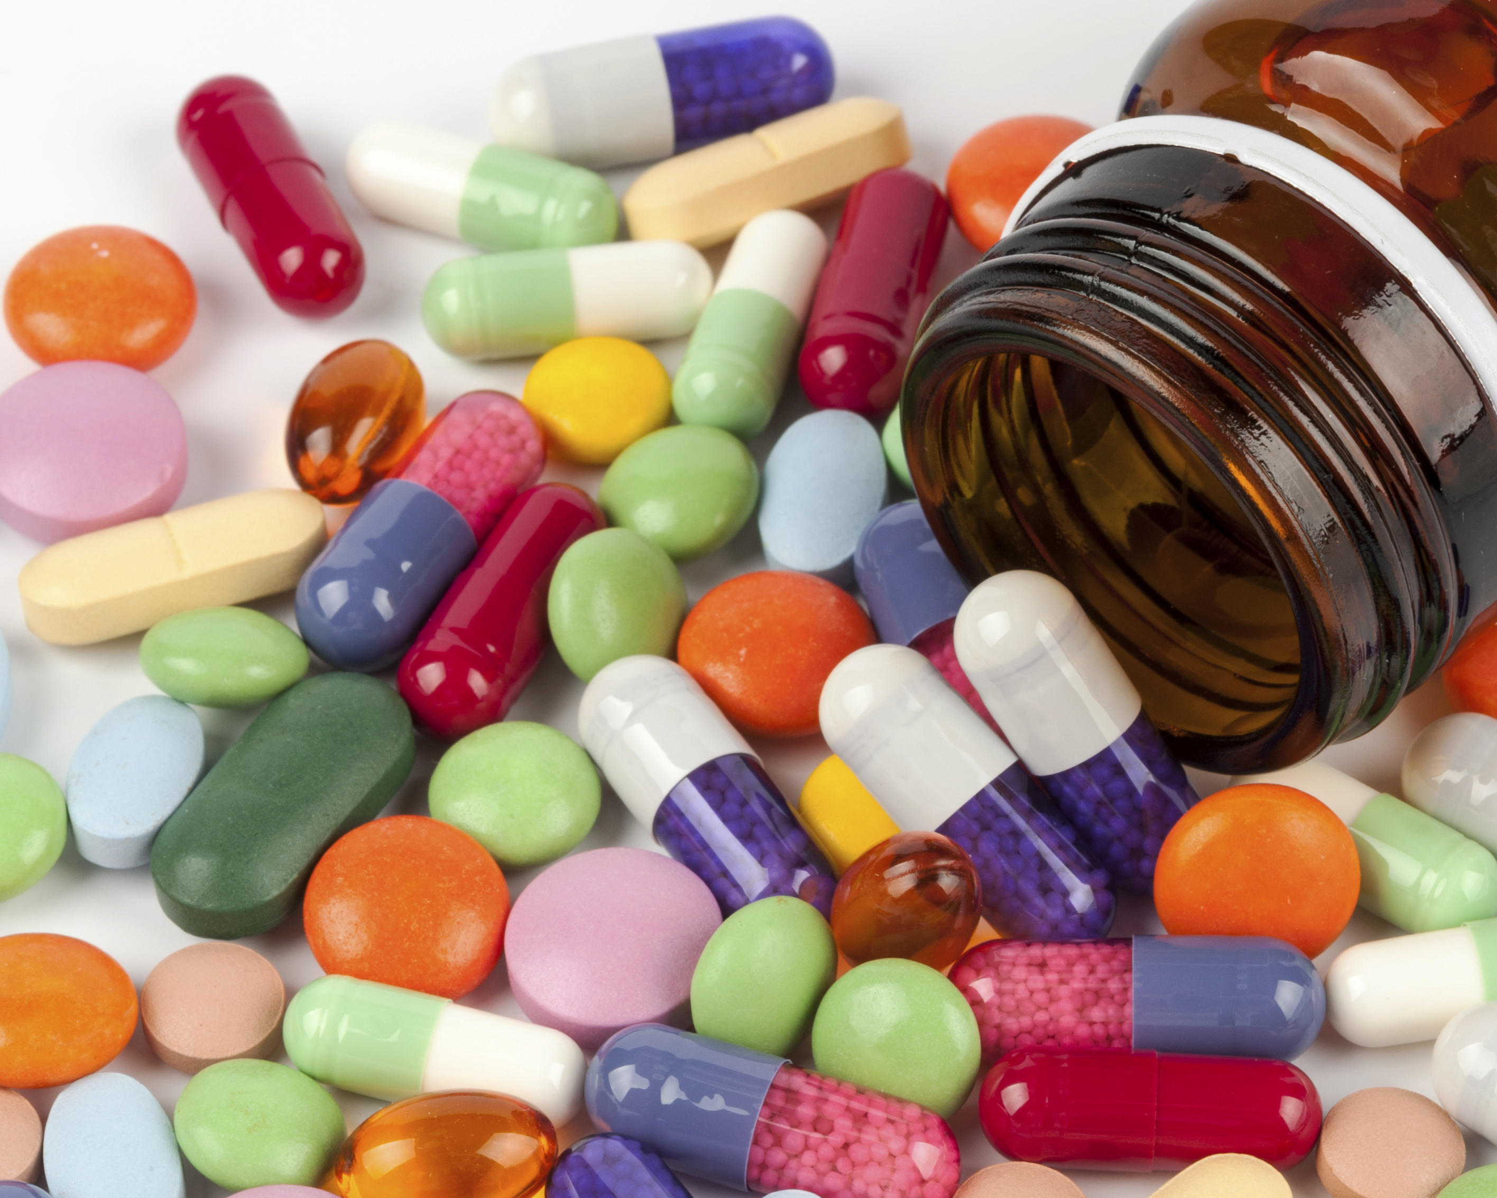
Emerging pollutants includes
Pharmaceuticals
Human and Veterinary
  for supporting general health and hygiene
  for prevention and treatment of disease or therapeutic applications
  Antibiotic Growth-Promoters in Food Animals
Illicit drugs (recreational drugs)
Food additives and solvents
Synthetic hormones

Slide 4
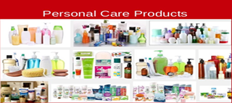
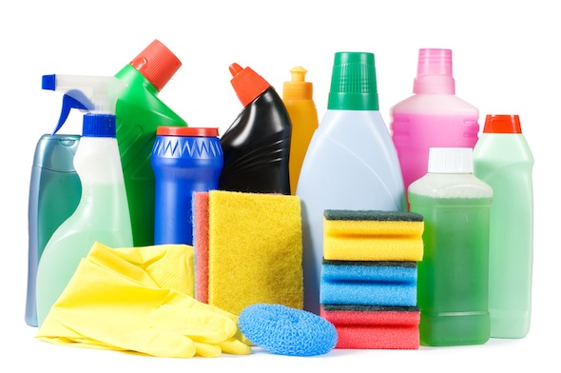
Personal Care Products
  to improve the quality of daily life
  Toothpastes, mouth washes, lotions, makeups, facial cleansers, antibacs, conditioners, hair colours and relaxers, fragnances, sunscreen products
    biocides - triclosan and triclocarbon
    synthetic musks – galaxolide and musk ketone
    UV filters – sunscreen products
      benzophenone-3 and 4-methylbenzylidene
  Surfactants – surface active agents
    Soaps, detergents, wetting agents,
    emulsifiers, foaming agents, and
    dispersants.
  Household chemicals –
    Cleaning, sanitizing and disinfecting agents

Slide 5
Endocrine Disrupting Chemicals
- interfere with the production or activity of hormones in the endocrine system
– leading to adverse health effects
  endocrine-related diseases in humans and animals, including declining male fertility
  deleterious effects on the reproduction and physiological effects in wildlife and aquatic organisms

Slide 6
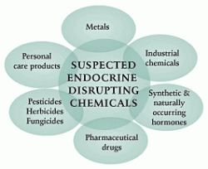
the synthetic steroid hormone 17a-ethynylestradiol (EE2)
  - prescribed as oral contraceptive for birth control or
  estrogen substitution therapies
the natural hormone 17ß-estradiol (E2) and its main metabolite Estrone (E1)

Slide 7
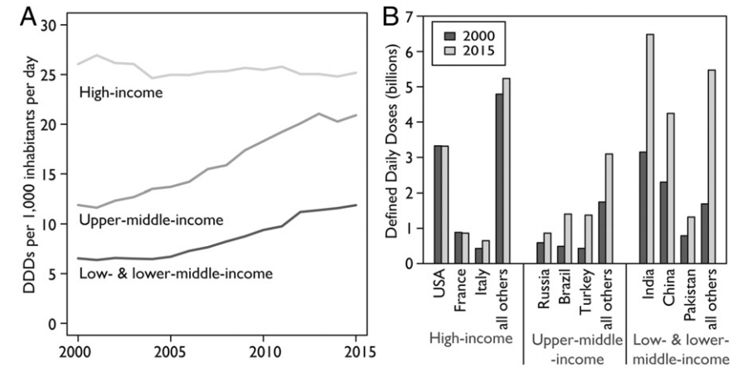
Consumption of Pharmaceuticals
At present, over 3000 pharmaceuticals are in use in Europe (Ternes and Joss, 2006)
Antibiotic consumption
Global antibiotic consumption increased by 65% between 2000 and 2015 (Klein, et al. 2018)
Klein, Eili Y, Thomas P Van Boeckel, Elena M Martinez, Suraj Pant, Sumanth Gandra, Simon A Levin, Herman Goossens, and Ramanan Laxminarayan. "Global Increase and Geographic Convergence in Antibiotic Consumption between 2000 and 2015." Proceedings of the National Academy of Sciences (2018): 201717295.

Slide 8
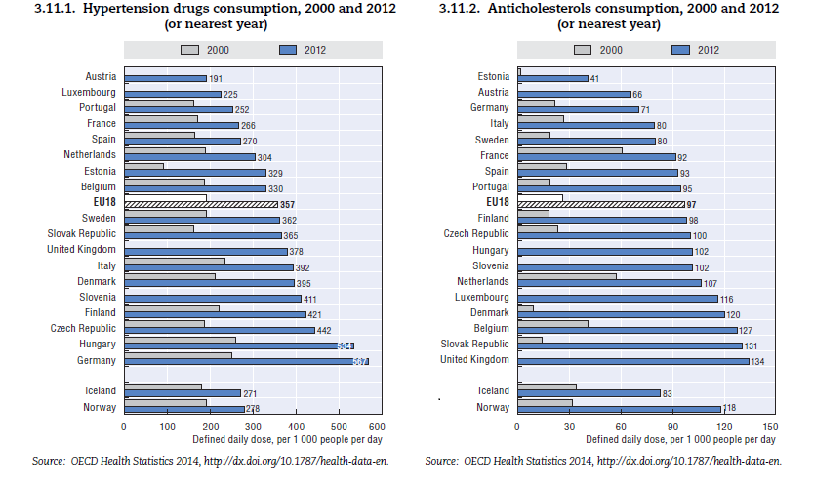

Slide 9
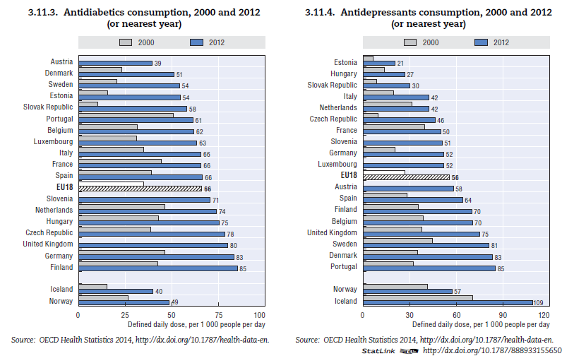

Slide 10
Extensive and increasing use of human and veterinary pharmaceuticals
their constant release
  as parent compounds,
  metabolites and
  transformation products
  into the environment is an issue of increasing concern (Długosz et al., 2015).
  frequently detected in treated wastewater effluents, aquatic and terrestrial environment.
Present New Global Water Quality Challenges

Slide 11
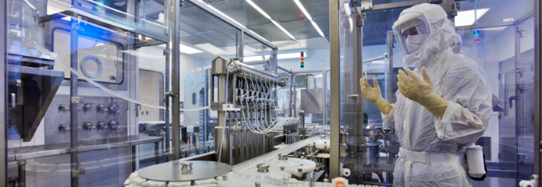
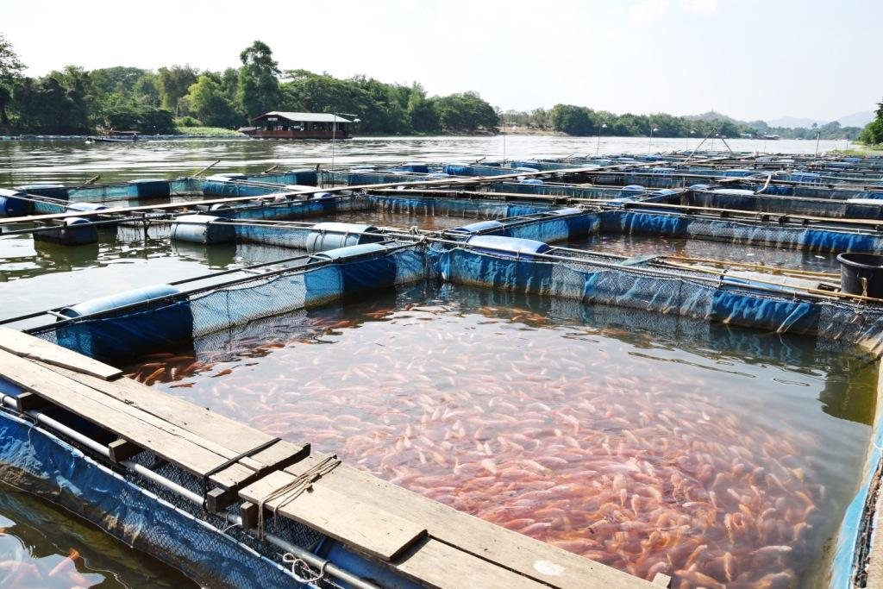


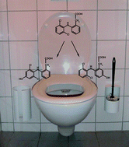
Main sources and pathways of PPCP to the environment
PPCP production
Aquaculture
Hospitals
Metabolism
Domestic Use
Disposal
Household Waste
Urine and faeces
manure spreading
Metabolism
LANDFILL
Urine and Faeces
Leachates
Irrigation Water, Sludge as fertilizer
LAND
Discharge
Runoff
SURFACE WATER
Leachates
GROUND WATER
Drinking water
Lakes, Sea, Oceans

Slide 12
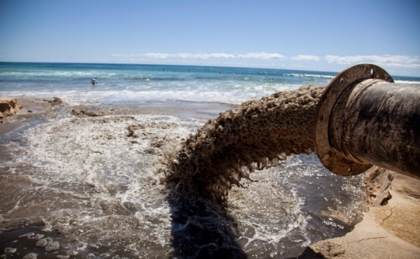
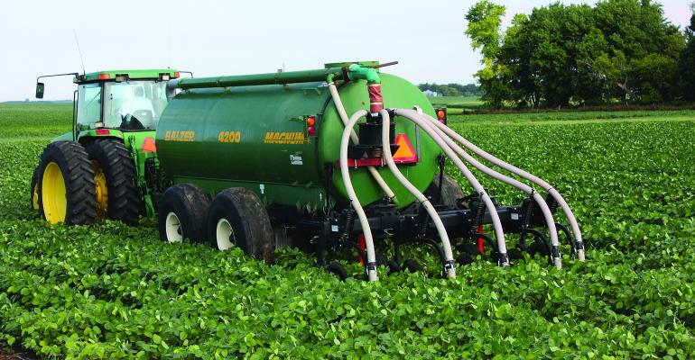
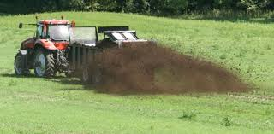
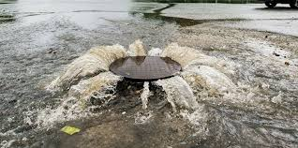
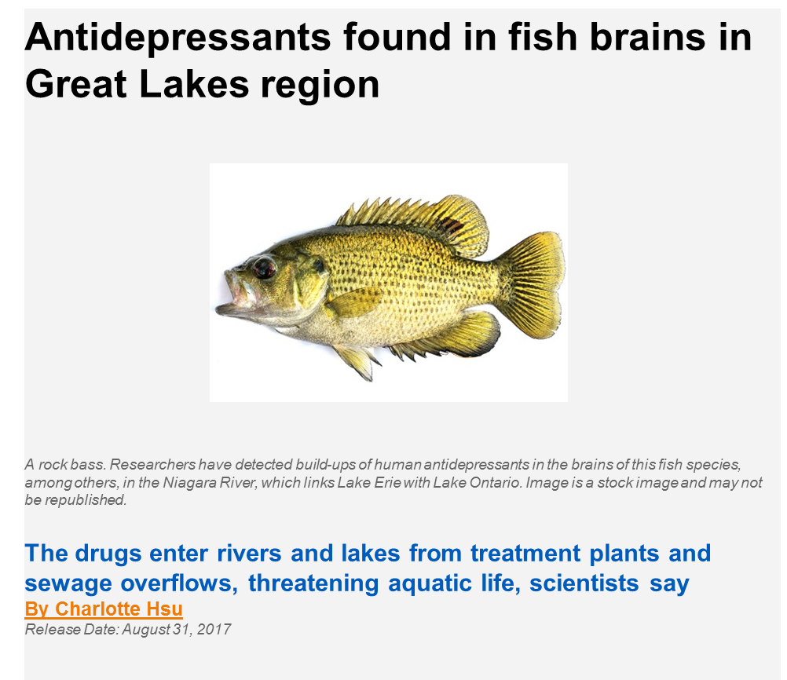
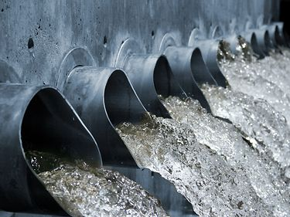

Slide 13
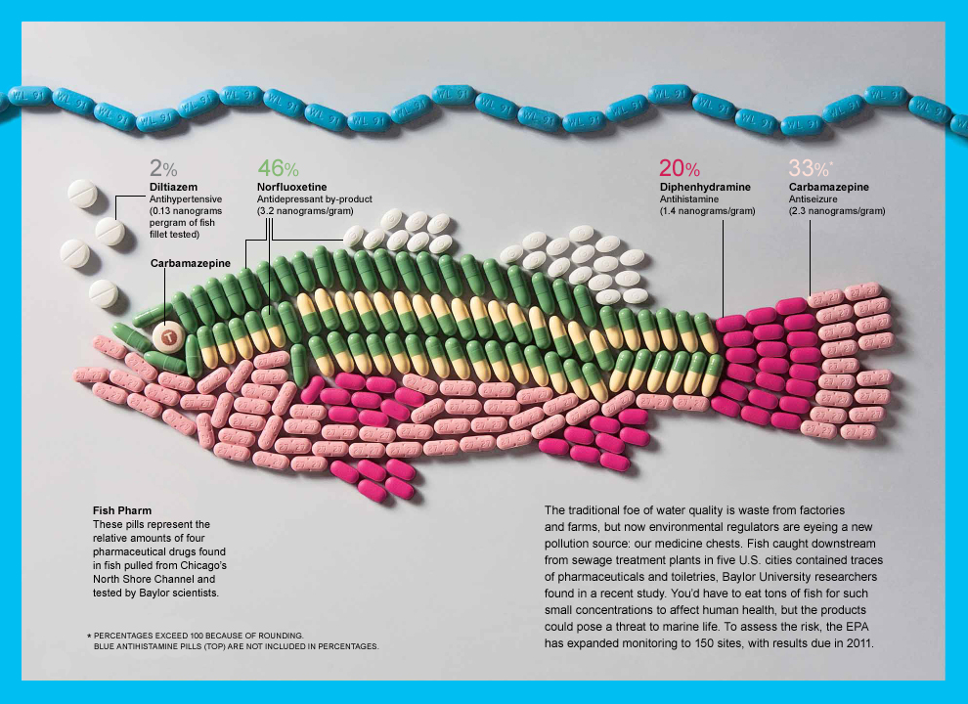

Slide 14
In suburban and rural areas, wastewater is often treated using on-site wastewater treatment systems such as
septic tank, infiltration systems, and package treatment systems.
The current On-site wastewater disposal systems could account for the largest volume of contaminated water discharged to the subsurface
WWTS - designed for removal of OM and TP
  but are not designed for removal of PPCPs
Spread of sludge and animal manure on farm fields

Slide 15
Moreover, a concise picture of the relevant pharmaceuticals,
  their prevailing concentrations in the environment, and
  their potential effects on human and ecosystem health is still understudied and is elusive in most countries. (Schwarzenbach et al., 2010)
Pharmaceutical substances have to be prioritized for targeted monitoring and treatment based upon their
  Predicted environmental concentration (PEC),
  Observed and/or predicted no-effect concentration (PNEC)

Slide 16
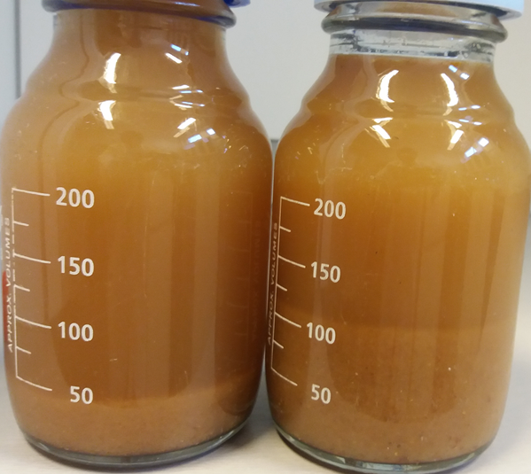
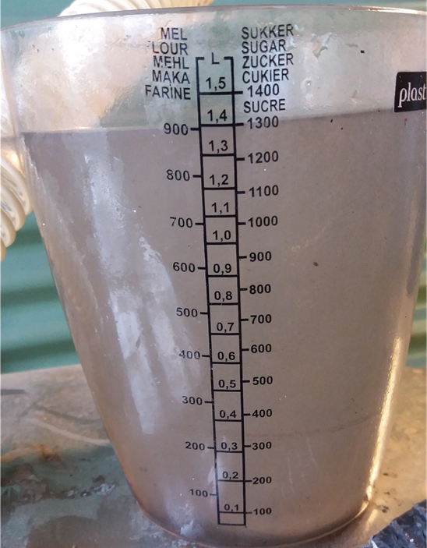
Can Source-separation & On-site Wastewater Treatment offer a more sustainable solution?
Blackwater
Greywater
OSGWTP

Slide 17
Separate collection, transport and treatment of blackwater and greywater
Separating the blackwater stream - concentrate the risks in a very small volume [<5 %].
  The majority of pathogens, OM, and Nutrients
  The majority of pharmaceuticals,
  including analgesic paracetamol, antibiotics, antidepressant, antidiabetic metformin, hormones, etc, can be present in source-separated blackwater at high concentration (up to several mg/l).
[Kujawa-Roeleveld and Zeeman, 2006].

Slide 18
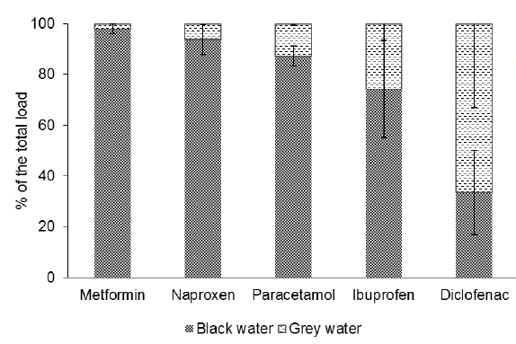
Distribution of the total load of analyzed pharmaceuticals between influent black water and influent grey water
A. Butkovskyi , L. Hernandez Leal , H.H.M. Rijnaarts, G. Zeeman (2015). Fate of pharmaceuticals in full-scale source separated sanitation system. Water Research 85 :384-392

Slide 19
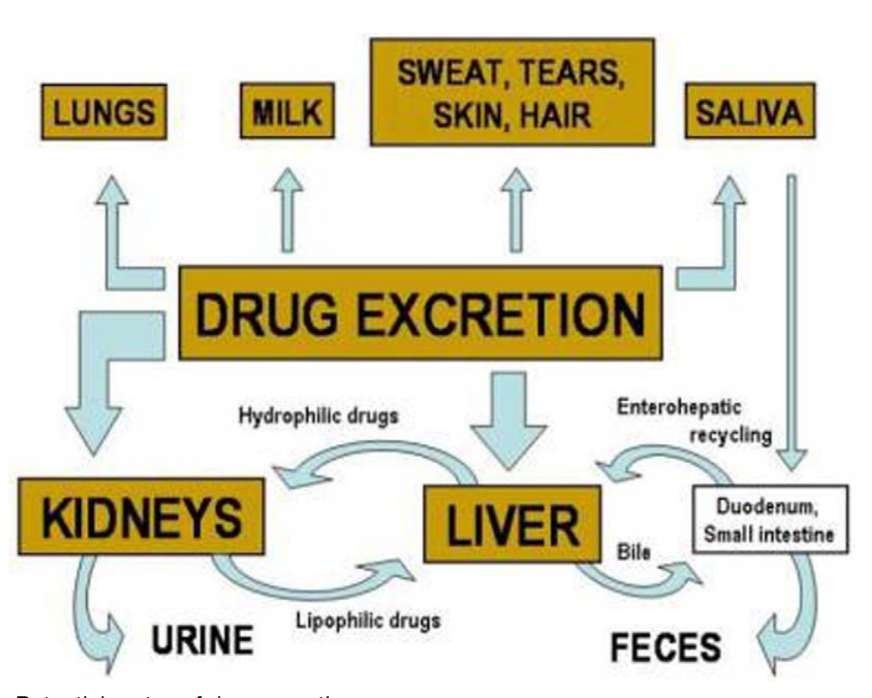
70 % of consumed pharmaceuticals are excreted in Urine and the rest as feces
Potential routes of drug excretion
(Daniel Kapusta, 2007)
Kapusta, Daniel. "Drug Excretion." In Xpharm: The Comprehensive Pharmacology Reference, 1-2. New York: Elsevier, 2007.

Slide 20
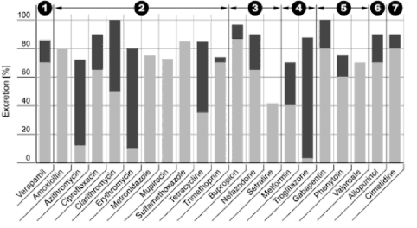
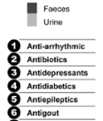
Stumpf, M., Ternes, Th., Haberer, K., and Baumann, W. (1998). Isolation of ibuprofen metabolites and their importance as pollutants of the aquatic environment. Vom Wasser 91, 291–30

Slide 21
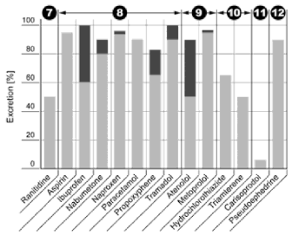

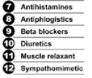
Stumpf, M., Ternes, Th., Haberer, K., and Baumann, W. (1998). Isolation of ibuprofen metabolites and their importance as pollutants of the aquatic environment. Vom Wasser 91, 291–30

Slide 22
Removal Mechanisms
Conventional sewage treatment facilities, including activated sludge processes, do not fully remove PPCPs from wastewater
Advanced Treatment options
  Adsorption,
  Advanced Oxidation Processes (AOPs)*
  Nanofiltration (NF)**, and
  Reverse Osmosis (RO) membranes**
  * high investment and operation cost, formation of secondary toxic by-products
  **high investment and maintainance cost
Adsorption processes
  Activated carbon, biochar, clay minerals
    -high surface area, micropores, surface chemistry (charges)
  Simple (design and operation)
  Insensitive to formation of toxic by-products
  do not add undesirable by-products Could be effective for some PPCPs

Slide 23
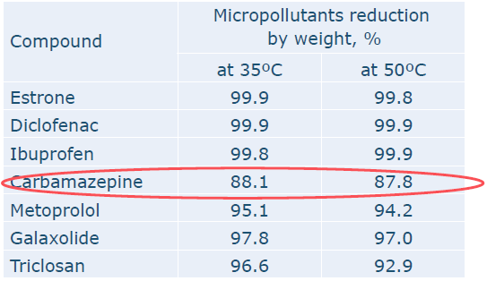
A combined resource recovery and pollutant removal strategy
Biological degradation
  Sludge Blanket Anaerobic Baffle Reactor
    Hydrolysis
    Acidogenesis
    Acetogenesis
    Methanogenesis
    Highly biodegradable
    Moderately biodegradable
    Hardly biodegradable
Butkovskyi, A. G. N, Hernandez Leal, L., Rijnaarts, H.H.M. , Zeeman, G. (2016). Mitigation of micropollutants for black water application in agriculture via composting of anaerobic sludge. Journal of HazardousMaterials303, 41–47

Slide 24
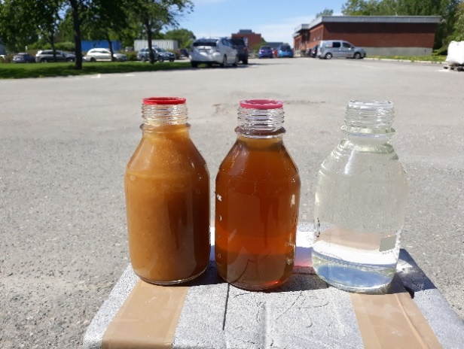

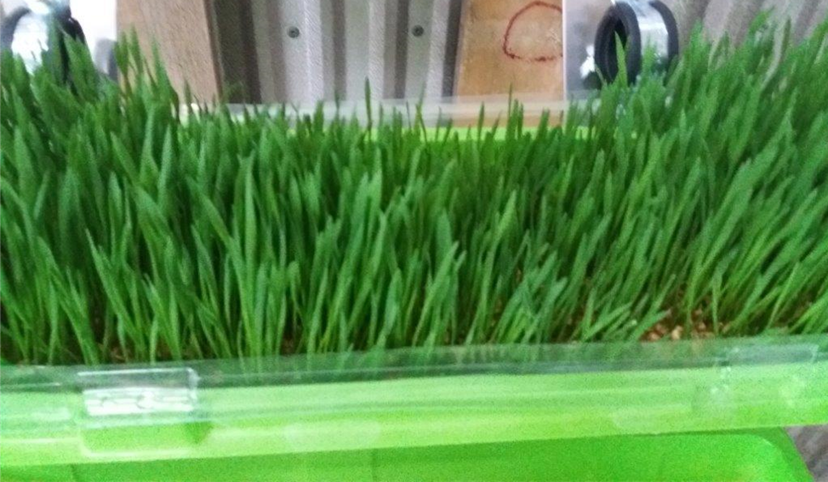
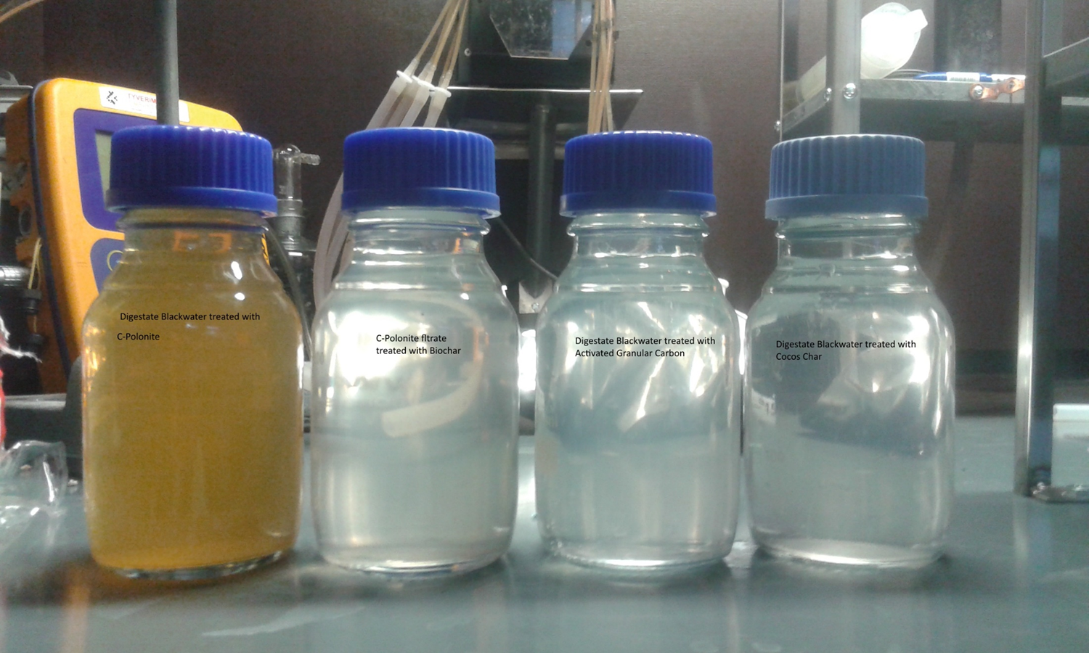
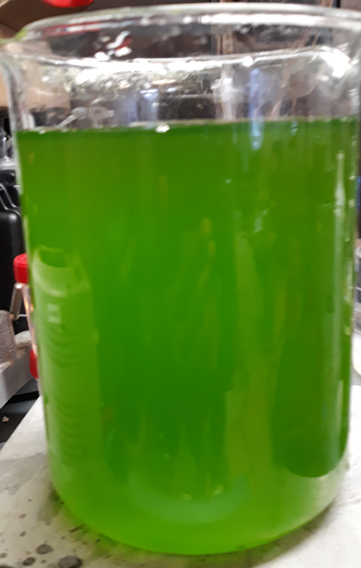
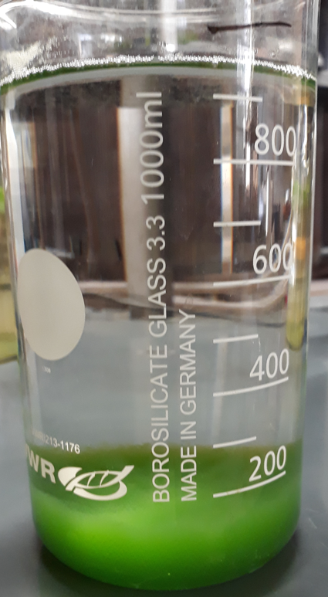
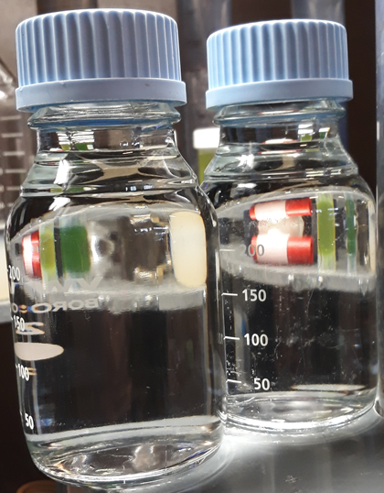
Filtration of Anaerobic effluent
R2C2
UV
Up to 7 log Cummulaive reduction.
E. coli ND
Anaerobic Treatment
Nutrient Solution
500-886 mg/L NH₄-N & 50-68 mg/L PO₄-P
Greywater
UV
Safe Discharge

Slide 25
Anaerobic filtration
  Activated granular carbon, biochar, clay
Sorption – depends on Chemical properties of specific compounds
  Acid and lipophilic compounds (e.g. hormones, anti-inflammatories, fluoroquinolones) can be efficiently removed than
  Neutral (diazepam, phenazone, and carbamazepine), and polar compounds (beta-lactam antibiotics)
Photocatalysis /photodegradation (Solar based or UV

Slide 26
New technologies that combine resource recovery and complete removal of organic/synthetic micro pollutants from WW effluents needs to be encouraged
Awearness creation - another important tool that need to be addressed
Thank You
.

Slide 27
References
Bardal, Stan K., Jason E. Waechter, and Douglas S. Martin. "Chapter 2 - Pharmacokinetics." In Applied Pharmacology, 17-34. Philadelphia: Content Repository Only!, 2011.
Beausse J. Selected drugs in solid matrices: a review of environmental determination, occurrence and properties of principal substances. Trends Anal Chem 23:(2004) 753–761
Gavrilescu, Maria, Kateřina Demnerová, Jens Aamand, Spiros Agathos, and Fabio Fava. "Emerging Pollutants in the Environment: Present and Future Challenges in Biomonitoring, Ecological Risks and Bioremediation." New Biotechnology 32, no. 1 (2015): 147-56.
Geissen, Violette, Hans Mol, Erwin Klumpp, Günter Umlauf, Marti Nadal, Martine van der Ploeg, Sjoerd E. A. T. M. van de Zee, and Coen J. Ritsema. "Emerging Pollutants in the Environment: A Challenge for Water Resource Management." International Soil and Water Conservation Research 3, no. 1 (2015): 57-65.
Gibson, R, MD Smith, CJ Spary, CR Tyler, and EM Hill. (2005) "Mixtures of Estrogenic Contaminants in Bile of Fish Exposed to Wastewater Treatment Works Effluents." Environmental science & technology 39, no. 8: 2461-71
Godfrey, E.; Woessner, W. W.; Benotti, M. J. Pharmaceuticals in on-site sewage effluent and ground water, Western Montana. Ground Water 2007, 45 (3), 263–271.
Joss A, Zabczynski S, Gobel A, Hoffman B, Lffler D, McArdell CS, Ternes TA, Thomsen A, Siegrist H Biological degradation of pharmaceuticals in municipal wastewater treatment: proposing a classification scheme. Water Res 40:(2006)1686–1696
Kallenborn, R., and Eva Brorstrom-Lunden. Pharmaceuticals and personal care products (PPCPs). In:AMAP Assessment 2016: Chemicals of Emerging Arctic Concern. Arctic Monitoring and Assessment Programme (AMAP), Oslo, Norway. (2017):141-151
Kapusta, Daniel. "Drug Excretion." In Xpharm: The Comprehensive Pharmacology Reference, 1-2. New York: Elsevier, 2007.
La Farré M, Pérez S, Kantiani L, Barcelo D (2008) Fate and toxicity of emerging pollutants, their metabolites and transformation products in the aquatic environment. Trends Anal Chem 27(11):991–1007
Lienert, J, T Bürki, and Beate I Escher. "Reducing Micropollutants with Source Control: Substance Flow Analysis of 212 Pharmaceuticals in Faeces and Urine." Water Science and Technology 56, no. 5 (2007): 87-96.
Snyder, Shane A, Paul Westerhoff, Yeomin Yoon, and David L Sedlak. "Pharmaceuticals, Personal Care Products, and Endocrine Disruptors in Water: Implications for the Water Industry." Environmental Engineering Science 20, no. 5 (2003): 449-69
Stumpf, M., Ternes, Th., Haberer, K., and Baumann, W. (1998). Isolation of ibuprofen metabolites and their importance as pollutants of the aquatic environment. Vom Wasser 91, 291–30
Suarez S, Lema JM, Omil F. “Removal of pharmaceutical and personal care products (PPCPs) under nitrifying and denitrifying conditions. Water Res 44:(2010) 3214–3224
Snyder, Shane A, Paul Westerhoff, Yeomin Yoon, and David L Sedlak. "Pharmaceuticals, Personal Care Products, and Endocrine Disruptors in Water: Implications for the Water Industry." Environmental Engineering Science 20, no. 5 (2003): 449-69.
Verstraeten, I. M.; Fetterman, G. S.; Meyer, M. T.; Bullen, T.; Sebree, S. K. Use of tracers and isotopes to evaluate vulnerability of water in domestic wells to septic waste. Ground Water Monit. Remed. 2005, 25, 107–117. (11)
.

