Slide 1

Introduction to QMRA and relevance to circumpolar household water uses
Nicholas J. ASHBOLT
(Ashbolt@UAlberta.ca)
Alberta Innovates Translational Research Chair in Water
Arctic WASH Summer School: Module 3 Health & Risk Assessment
UNIS Svalbard June 18th 2018

Slide 2
Learning objectives
Key steps in undertaking a quantitative microbial risk assessment (QMRA)
Selection of reference pathogens appropriate for circumpolar QMRAs of water service options
Linking QMRA within a broader sustainability system analysis to deliver sustainable water services
Practice in undertaking the key steps in a QMRA
2

Slide 3
What is risk & risk assessment?
Risk = likelihood (probability) x consequence
Generally described in two dimensions, and for qualitative assessments ranked, e.g.
Likelihood | Consequence
 | Negligible | Marginal | Critical | Catastrophic
Certain | Moderate | High | Extreme | Extreme
Likely | Moderate | Moderate | High | Extreme
Possible | Low | Moderate | High | Extreme
Unlikely | Low | Low | Moderate | High
Rare | Low | Low | Moderate | High
3

Slide 4
Better decisions though science
Key problem with qualitative risk ranking occurs when multiple players rank multiple aspects differently (i.e. often the case*)
Hence, quantitative risk assessment is generally the preferred approach, but is generally not accessible to most (hence WHO guidance)
*Cox (2008) What's wrong with risk matrices? Risk Analysis 28: 497-512
4

Slide 5
Context for QMRA Frameworks
QMRA applies risk assessment (RA) to quantify potential health consequence(s) from pathogen(s)
Primary framework used follows chemical RA described in 1970s: but some key differences.
  Haas (1983) first adapted single-hit dose-response models for waterborne pathogens, which
  Led to U.S. EPA being the first to use QMRA to consider pathogen #s for surface drinking water treatment rules (1989, 1991, 1998, 2006)
  USDA formalized QMRA in 1995
5

Slide 6
Risk assessment and the risk management framework
The process of risk management is well described in ISO 31000 and includes:
  communication and consultation;
  establishing the context;
  risk assessment (comprising risk identification, risk analysis and risk evaluation);
  risk treatment;
  monitoring and review.
6

Slide 7
Current Reactive versus evolving Proactive management based on risk assessment
For water quality, traditional coliform/E. coli treatment verification
  For last 100 years based on controlling bacterial diseases (cholera /typhoid) from raw sewage contamination of waters
  Problems include:
    Pathogens are acute hazards, outbreaks often from short-duration events
    Events can be missed with weekly or even daily sampling
    Enteric bacteria easiest to remove/kill, enteric viruses and protozoa largely the issue today
Solution, Proactive Management: Health Target of ‘tolerable’ risk to estimate reduction in enteric viruses, bacteria and parasitic protozoa
7

Slide 8
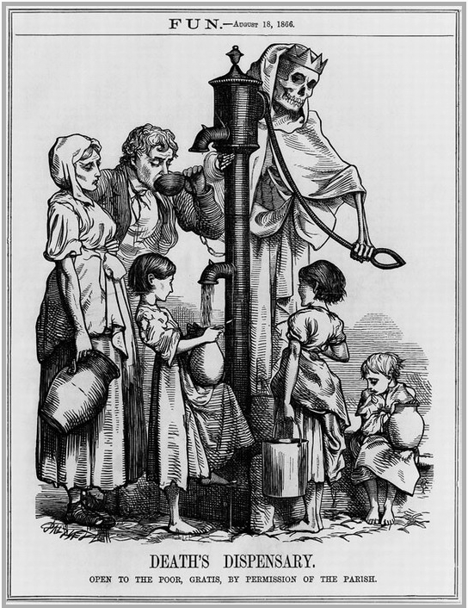
John Snow, cholera studies (1849-55):
Father of epidemiology – but ‘stink’ led to London’s sewers
Cholera introduced from Asia around 1831 to London, 1832 to New York and elsewhere
English epidemics: in 1832 killed 23,000, 1848-9 (53,000), 1853-4 (23,000) & the last 1866 (14,000)
  Sir Edwin Chadwick
  19th century sanitary revolution: Public Good
    Poor Law reform 1834
    Public Health Act of 1848
  Still drives water service decisions & E. coli assessment in the Arctic/sub-Arctic today
http://fx.damasgate.com/john-snow-and-cholera/
Black & Fawcett (2008) The Last Taboo
Earthscan Publications, London
8
Notes:
Pacini F. "Osservazioni microscopiche e deduzioni patologiche sul cholera asiatico" [Microscopic observations and pathological deductions on Asiatic cholera]. Gazzetta Medica Italiana. 1854;4,(51):405-412
20% from waterborne viruses in Mark B EHP 2012 paper
Sir Joseph Bazalgette led the sewering campaign, but did not solve typhoid fever, e.g. 1873 described by William Budd. Chadwick led it for Public Good, Poor Law reform of 1834; not financial or other reasons, 1934 Commissioner to the Poor Law, Commission of Sewers in London from 1848-49.

Slide 9
Health-based risk targets: tolerable risk in practice
Risk-based targets (also provide target/goal for treatment needs)
Non voluntary (e.g. Drinking water)
  Not current EPA policy: Drinking water < 1 infection per 10,000.y⁻¹ (10⁻⁴ infection risk per year)
    e.g. US-EPA & Health Canada 3 & 4 log treatment requirements for surface water enteric parasites & viruses respectively for drinking
  WHO & Health Canada; disability adjusted life year (10⁻⁶ DALY per year)
Voluntary (e.g. Recreational water exposures)
  EPA epidemiology-based risk target < 30 illness/1000.d (10⁻² per y)
9

Slide 10
WHO & Australian guidelines based on risk assessment / management
Provide greater justification for targets based on levels of tolerable risk
Definition of tolerable risk
Targets for enteric viruses, bacteria & protozoa (and how to calculate these from first principles)
Discussion of preventive measures (treatment and on-site controls) and their impact
Look-up tables of typical schemes & safe uses
10

Slide 11

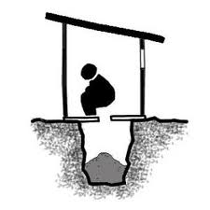



Current WHO Guidelines – (based on Quantitative Microbial Risk Assessment - QMRA)
Sanitation guidelines
Community
disease burden
Guidelines for safe recreational
environments
Guidelines for the safe use of wastewater, excreta, greywater
Groundwater
Surface water
Guidelines for drinking water quality
11

Slide 12
Traditional focus has been on enteric pathogens from excreta, with various modes of transmission:
Excreta from humans and animals
Land
Runoff
Sewage
Solid Waste
Landfills
Oceans and
Estuaries
Lagoons, Rivers and
Lakes
Groundwater
Irrigation
Shellfish
Recreation
Water
Supply
Crops
Aerosols
From Gerba et al. 1975 Environ Sci Technol 9, 1122-1126
Human
12

Slide 13
Epi surveillance & outbreak data plays a supportive role, not for reactive management
[Total:reported case 10 to 500:1]
Outbreak detected
Threshold for detection for an outbreak
Number of Cases
Undetected outbreak
Sporadic
Endemic rate
Hyperendemic
Time
Frost et al. (1996) J AWWA 88(9): 66-75
13

Slide 14
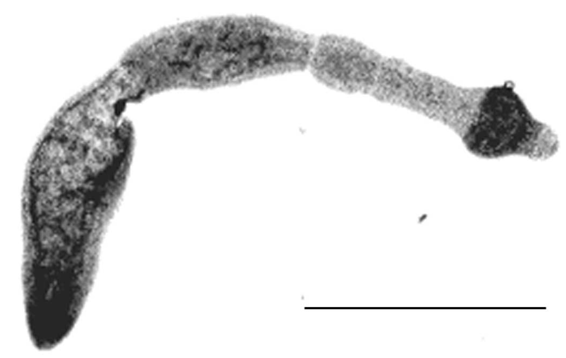
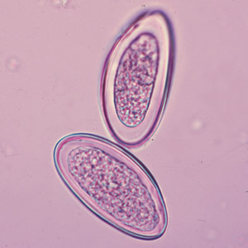
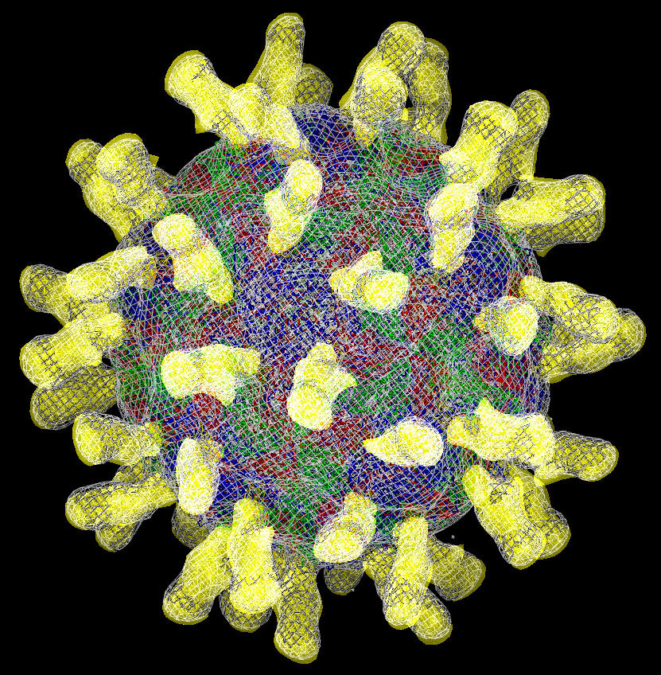
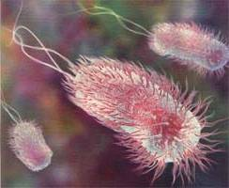
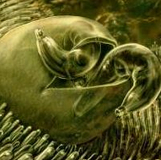
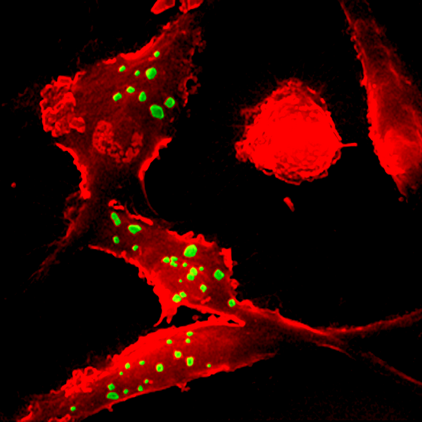
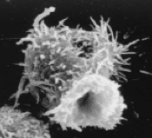
Enteric/Zoonotic & Saprozoic pathogens
Enteric / Zoonotic pathogens¹
wikipedia.org
0.5 mm
Viruses
(20-100 nm)
Bacteria
(0.5-2.5 µm)
Parasitic protozoa
(4-18 µm)
Helminth ova (20-50 µm)
Saprozoic (environmental) pathogens²
Echinococcus multilocularis
hydatid cysts
2 hosts needed
Alveolar echinococcosis
Amoeba
Legionella & mycobacteria in human
lung macrophages
Free-living protozoa – natural host to environ pathogens
¹Ashbolt (2015) Cur Environ Health Rep 2, 95-106
²Ashbolt (2015) Pathogens 4, 390-405
14

Slide 15
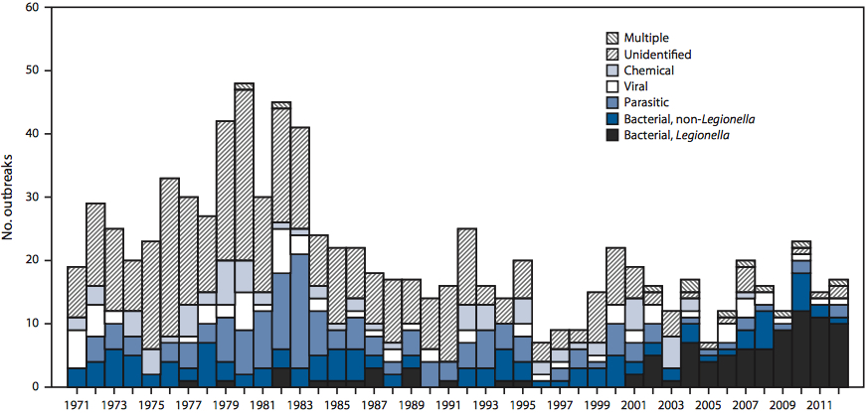
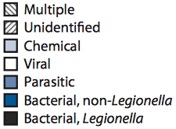
Etiologic agents & percentages for 885 drinking water outbreaks, 1971-2012 USA
Number of Outbreaks
>80 % not reported & sporadic
2001
2012
Beer et al. (2015) Morbidity & Mortality Wk Rep 64:842-8
2017, MMWR 66: 1216-1221
15

Slide 16
Key Points
Remote & Arctic community water services (not central water & sewage):
  One-Health and climate adaptive approach also needed
  Greater focus on decentralized (household) services
    Given the pathogen & chemical pathways of concern
  Management of microbial issues within a system’s approach to address more sustainable services
≅
16

Slide 17
Our common goals
Critical to address human health, but also
Climate change (threatening all systems)
Engineering issues (fit-for-purpose)
Operational needs (training/maintenance) &
Regulations (how, what, why); and
How to integrate within waterscape narrative driven by local community’s needs?
17

Slide 18
Sustainable systems achieved by trade-offs between key criteria with stakeholders
To meet the intent of regulations
i.e. systems may not meet current prescriptive regulations
Hygiene
QMRA
Environ
LCA
5 Primary Criteria
Economic
LCC
Social
MCDA
Technical
Robustness
Schoen et al. (2017) Water Res 109: 186-195
18

Slide 19

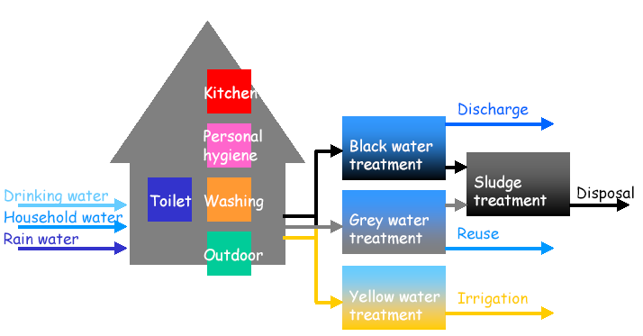
Water services within broader sustainability assessments
Water fit-for-purpose
Resource-recovery systems not waste disposal
www.urbanwater.org
Irrigation
Combined
Heat & Power
Fertilizer (NPK)
Reuse
Fertilizer (NPK)
Harder et al. (2017) Microbial Risk Assess 5: 71-77; Schoen et al. (2017) Water Res 109: 186-195
19

Slide 20
Cape Cod: Relative best estimates
Centralized
Urine diversion/ septic
Energy recovery/ greywater reuse
Energy recovery/ grey, rainwater reuse
Composting toilet/septic
Human Health | 0.0017 | 0.015 | 0.0072 | 1.00 | 0.056
Eutrophication | 0.045 | 1.00 | 0.34 | 0.061 | 0.061
Cost | 0.38 | 0.81 | 1.00 | 1.00 | 0.52
Global Warming | 0.20 | 0.22 | 0.22 | 1.00 | 0.92
Energy | 0.55 | 0.90 | 0.83 | 1.00 | 0.93
Ref: Schoen et al. (2017) Water Research 109(1): 186–195
Better Worse
20
Notes:
Score : best/option
Resilience cut

Slide 21
Climate change: loss of permafrost
Resulting in serious erosion, flooding, and destruction of homes, buildings, and roads from differential settlement, slumping, and/or collapse of underlying base sediments
Loss of clean lake water for drinking and hygiene, saltwater intrusion, and sewage contamination that could cause respiratory, gastrointestinal and skin infections
Need more adaptive infrastructure, not just resilient
– i.e. most infrastructure only within homes
21

Slide 22
Understanding microbial/water health issues
Community diseases result from:
  Inadequate water and sanitation
    waterborne & water-based pathogens
  Lack of body and clothes washing
    Water-wash skin infections (primarily bacterial/fungal)
  Respiratory infections
    person-to-person in group settings + water-based
    such as reduced with Kivalina washeteria closures ¹
Solutions must address indigenous societal needs ²
4 village study* rates
Pre & Post intervention
GI illnesses
2% & down 38%
skin illnesses
17% & down 20%
Resp’y illnesses
83% & down 16%
*Thomas et al. (2016) J Wat Health 14(1): 132-141
¹Thomas et al. (2013) Int J Circumpolar Health 72: 480-483
²Daley et al. (2015) Social Sci & Med 135: 124-132
22

Slide 23
Circumpolar-relevant water pathogens
Enteric waterborne (human & zoonotic) diseases
  Hepatitis A liver disease, Norovirus gastro, Shigella dysentery
  Giardia giardiasis, enteritis Yersinia & Campylobacter spp.
  Echinococcus multilocularis (lung disease) via foxes/voles
Water-based (saprozoic) diseases
  Non-tuberculous mycobacteria (wound/lung), Helicobacter pylori?
  V. parahemolyticus/vulnificus gastro via seafood if seawater > 15 °C
Person-to-person spread & Water-Washed infections:
  Norovirus, Cryptosporidium, Staph aureus, P. aeruginosa & helminths
  TB, Strep. pneumoniae, Haemophilus influenzae along with various multi-drug resistant bacterial and fungal pathogens
Parkinson & Evengård (2009) Glob Health Action 2: 1-3
Dudarev et al. (2013) Int J Circumpolar Health 72: 1-10
23

Slide 24
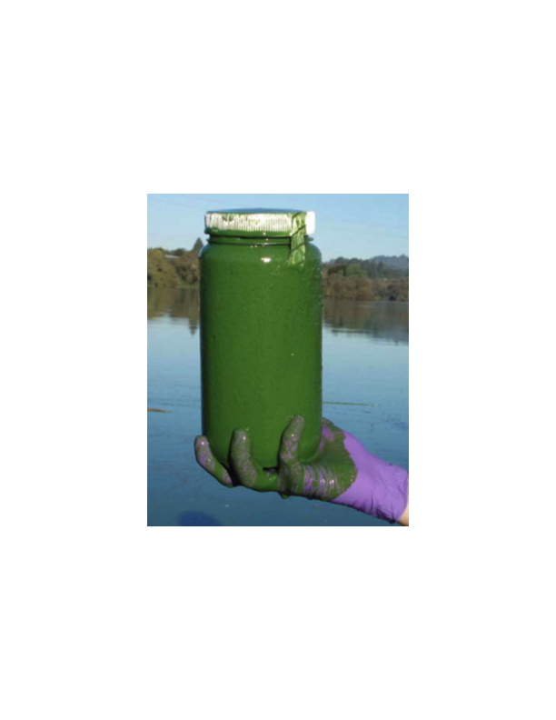
Waterborne sequelae – poorly understood
Auto-immune diseases
    Diabetes, Heart disease, Liver damage, & Reactive arthritis (enteric viruses, campylobacters)
Carcinogens
    Helicobacter pylori, cyanotoxins
Renal disease
    E. coli O157:H7, Microsporidium spp.
Nervous system disorders
    Campylobacter jejuni, various Enterovirus spp.
  Heart and liver disease
    Adenovirus, Coxsackievirus, cyanotoxins
Cyanobacteria that produce cyanotoxins
24

Slide 25
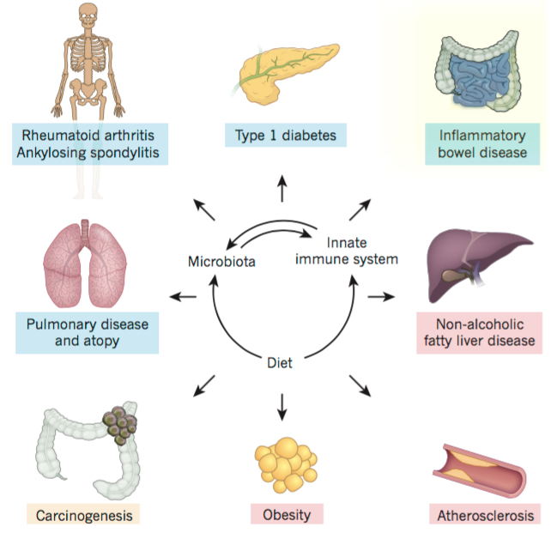
Human microbiome – innate-immune system interactions
Many inflammatory disorders are influenced by alterations in the crosstalk between innate immunity and our microbiome
These include metabolic (red boxes), neoplastic (orange box) and autoimmune or autoinflammatory (blue boxes) disorders
Thiass et al. (2016) Nature 535(7610): 65-74
25

Slide 26
WHO Risk-based water safety plans
Basis of water regulations in many countries
Origin NASA food & HACCP used in food industry
Health target
Tolerable
Risk
Risk Management
(water safety plan)
Risk assessment
(QMRA)
Exposure assessment
Public health status
Fewtrell & Bartram (2001) Water Quality: Guidelines, Standards and Health. Risk Assessment and Management for Water Related Infectious Diseases, WHO
26

Slide 27
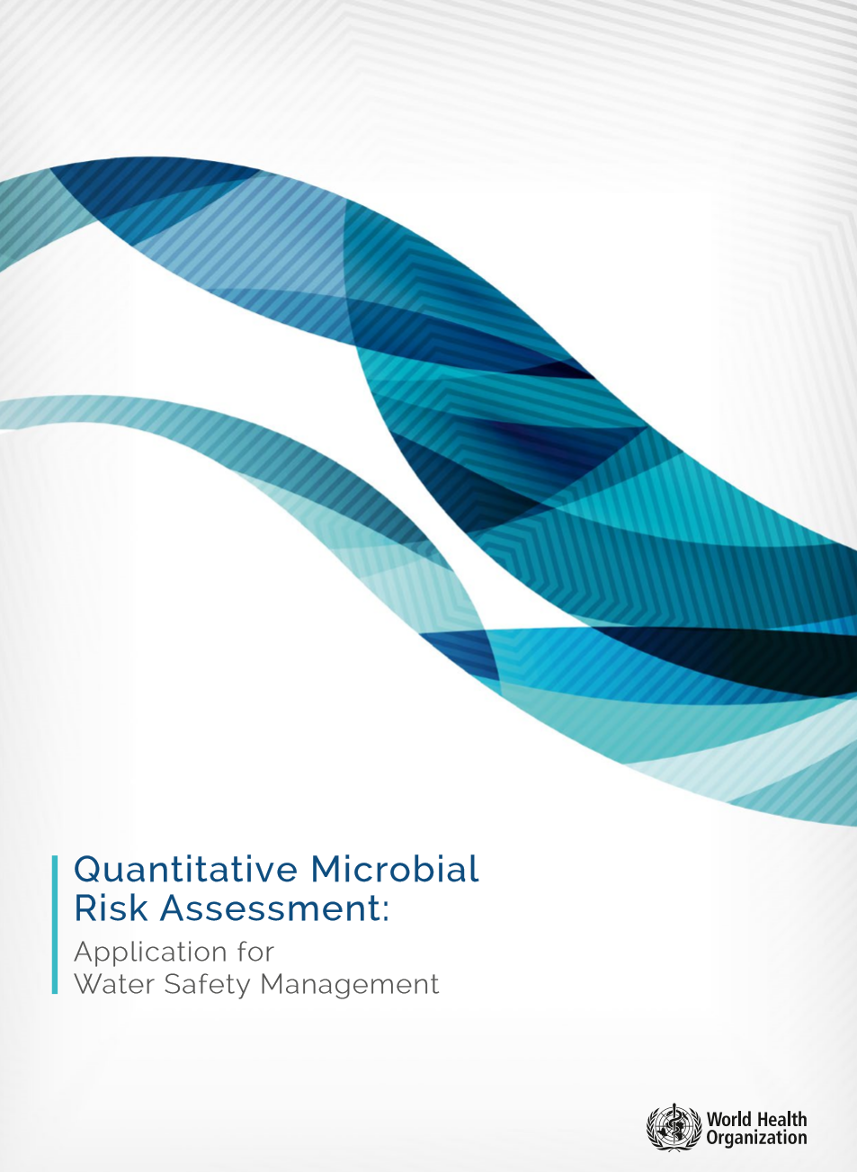
WHO - QMRA guidebook
Application for water safety management
Updated November 2016
www.who.int/water_sanitation_health/publications/qmra/en/
27

Slide 28
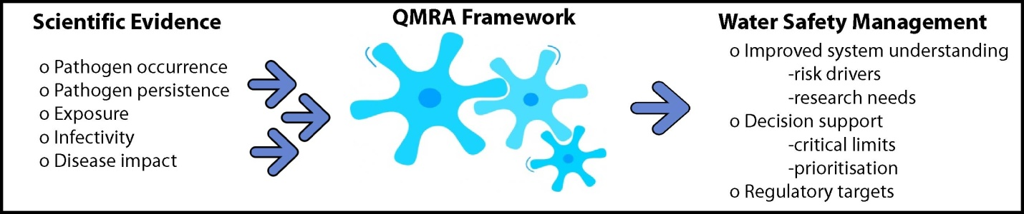
WHO QMRA document overview
28

Slide 29
Quantitative microbial risk assessment
(QMRA)
STEP 1
SETTING
Problem formulation & Hazard identification
Describe physical system, selection of reference
pathogens and identification of hazardous events
Source water
Ref pathogen densities
Treatment
Surrogate removals
STEP 2
EXPOSURE
Environ Pathogen growth in pipes & Ingress of faecal pathogens
Distribution
Pathogen loss
(biofilm/death)
(P_{env-path})
Human exposures
Vol water intake
STEP 3
HEALTH EFFECTS
Dose-Response (P_{inf} )
Selection of appropriate models for each ref pathogen and groups exposed
STEP 4
RISK
Risk Characterisation
Simulations for each pathogen baseline and event
infection risks with variability & uncertainty identified
29

Slide 30
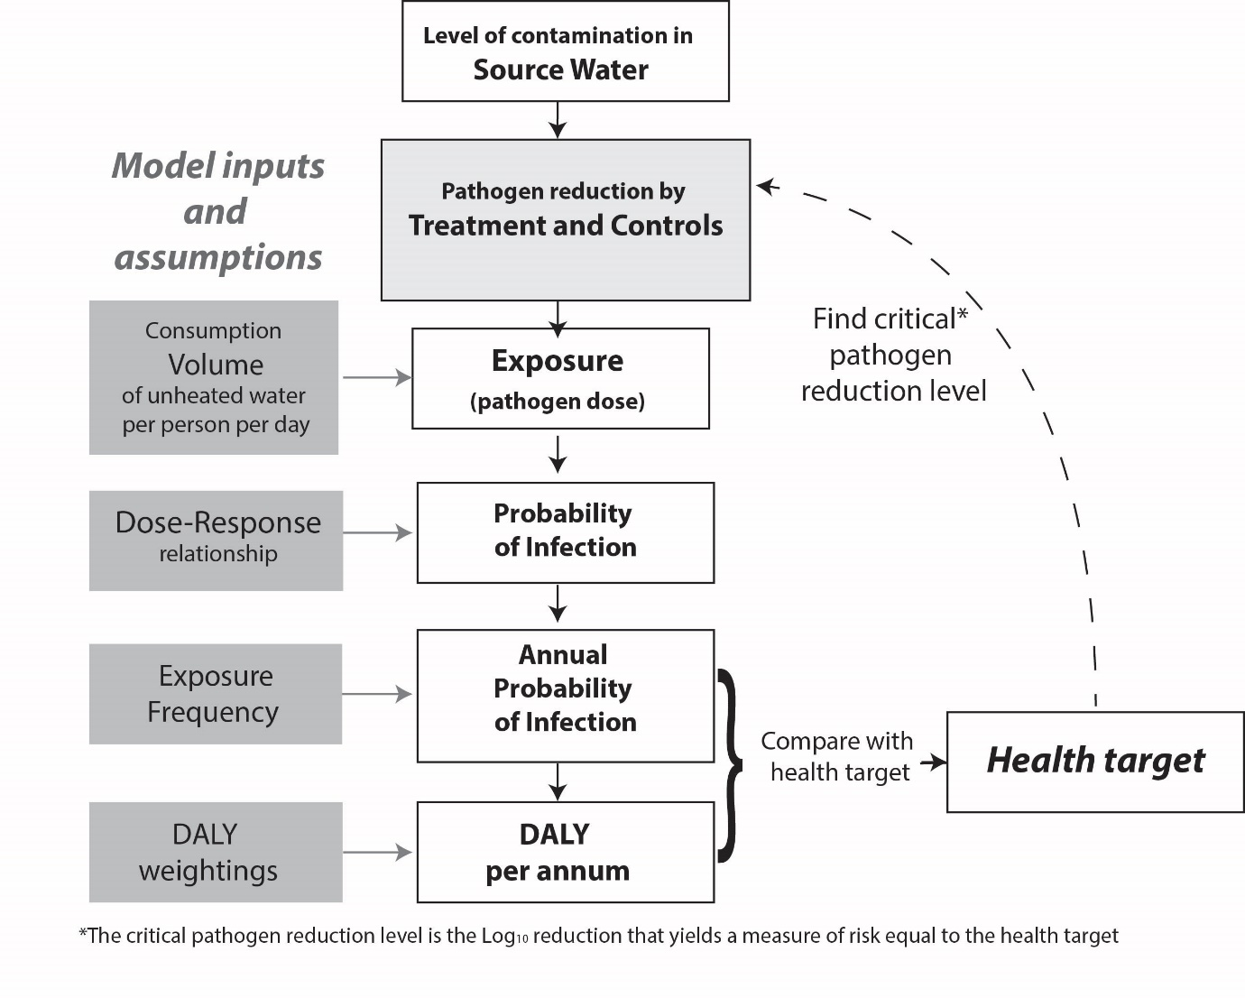
Risk-defined treatment requirements
Defines safe viral, bacterial & protozoan levels for any source water & end use combination:
Drives regulations
Needs for surrogates to demonstrate pathogen reductions at control points (barriers)
Identifies mitigation needs
10⁻⁴ or 10⁻²
10⁻⁶ or 10⁻⁴
Petterson & Ashbolt (2016) J Wat Health 4(4): 571-589
WHO (2016) Quantitative Microbial Risk Assessment, Geneva
30

Slide 31
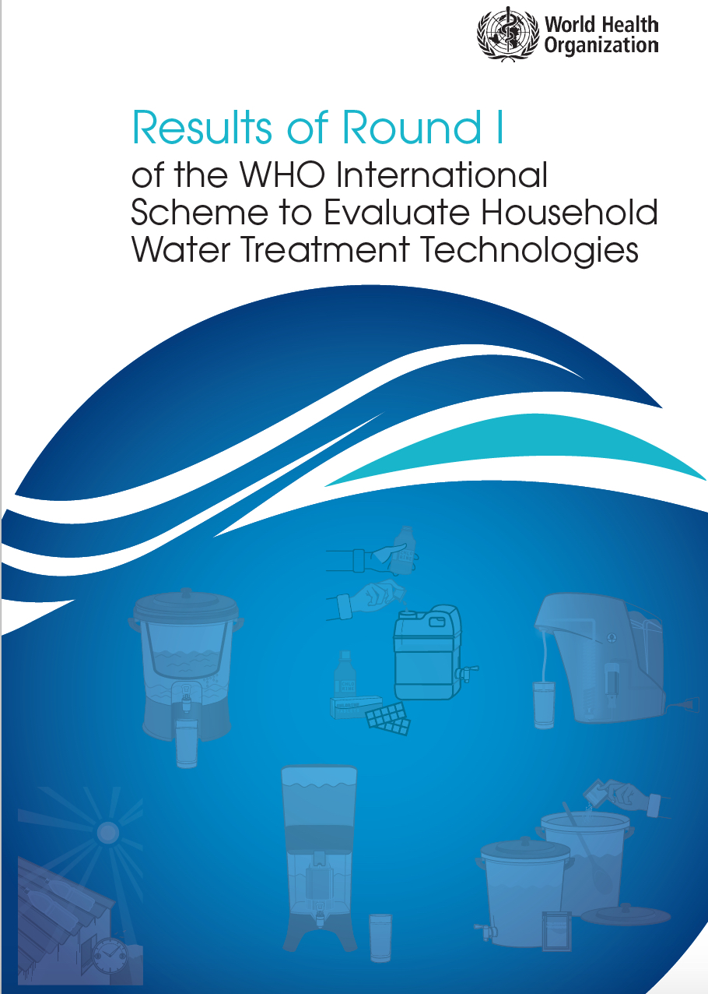
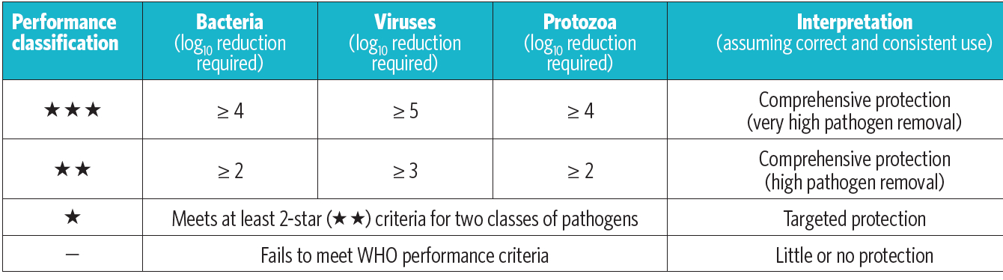
http://apps.who.int/iris/bitstream/10665/204284/1/9789241509947_eng.pdf
Criteria based on quantitative microbial risk assessment of surface drinking waters
31

Slide 32
95th percentile Log₁₀ pathogen Reductions Targets (LRT₉₅) for annual 10⁻⁴ infection risk: non-potable
Source & Scenario | Norovirus (gc) | Cryptosporidium (oocysts) | Campylobacter (CFU)
Sewage
Municipal | 8.0 | 7.0 | 6.0
Home useª | 8.5 | 7.0 | 6.0
Greywater for 1000 people (5 people)
Municipal | 5.5 (4.9) | 4.5 (~0^{b} ) | 3.5 (~0^{b} )
Home use | 6.0 (5.0) | 4.5 (~0^{b} ) | 3.5 (~0^{b} )
ª Assumes 10% of population is exposed to a cross-connection event lasting one day each year
^{b} The 99th percentile log₁₀ reduction is greater than zero and approximately equal to the 1000 population 95th percentile target log₁₀ reductions; Saprozoic pathogens managed by chlorine residual
Jahne et al. (2017) Microbial Risk Analysis 5: 44-52
Schoen et al. (2017) Microbial Risk Analysis 5: 32-43
32

Slide 33
Managing pathogens also needs a one-health approach, 2 examples:
  Containment of sewage/stormwater runoff to native animals: for Toxoplasma gondii, Giardia, Echinococcus, etc. yet
  Antimicrobial resistance (AMR) genes/bacteria & CEC not necessarily adequately controlled by sewage treatment and disinfection
Antimicrobial treatment for Helicobacter pylori infection: 58% people positive to below 9% by treatment (Aklavik NWT study) ¹ however..
One Health approach include interactions between and among humans, animals, plants, parasites, microbes, and chemical contaminants in terrestrial, aquatic, & marine ecosystems
¹Carraher et al. (2013) Int J Circumpolar Health 72:21594
Cheung et al. (2014) BMJ Open 4:e003689
33

Slide 34
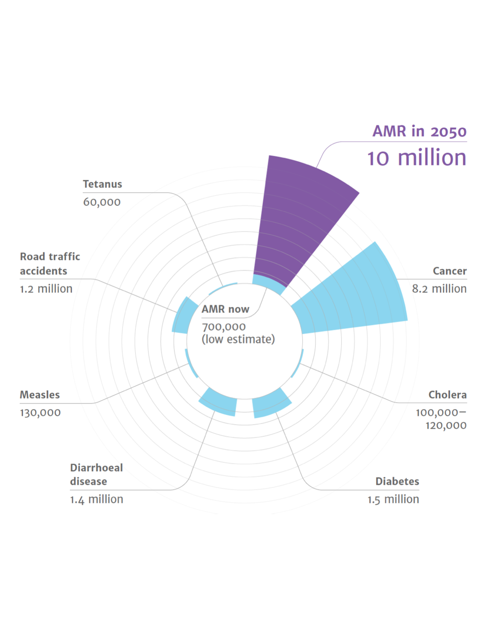
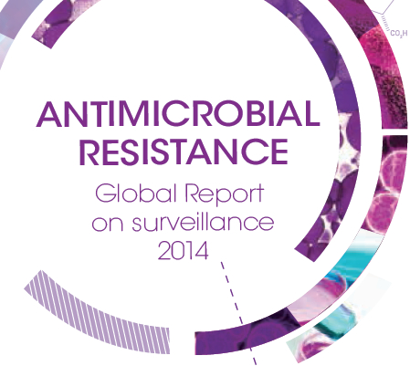

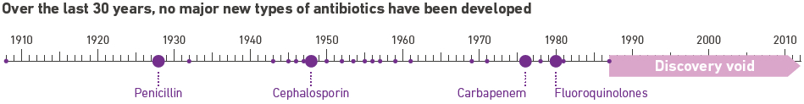
WHO’s 4th top issue: Antimicrobial Resistance (AMR)
3rd gen cephalosporin-resistant E. coli & MRSA estimated deaths 3.3 per 100,000 in EU in 2015*
Globally 700,000 AMR-deaths, some 10 million by 2050*
23,000 AMR-deaths/y in U.S.**
Unclear fraction due to water***
*Hoffman et al. (2015) Bull WHO 3(2), 66
**CDC: http://www.cdc.gov/drugresistance/pdf/arthreats-2013-508.pdf
O’Neill (2016)
***Ashbolt et al. (2013) Env Health Perspect 121(9), 993-1001
O'Neill (2016) Review on Antimicrobial Resistance, Welcome Trust and HM Government: London, England
34
34
Notes:
WWTP removes many antibiotics, but not sulfamethoxazole, but β-lactam antibiotics are degraded to undetectable levels in humans or the sanitation system before reaching the WWTP

Slide 35
WHO Global priority list of antibiotic-resistant bacteria¹
Purple highlighted are (facultative) saprozoic bacteria
Priority #1 – Critical
  Acinetobacter baumannii, carbapenem-resistant
  Pseudomonas aeruginosa, carbapenem-resistant (res)
  Enterobacteriaceae, carbapenem-res, 3rd gen cephalosporin-resistant
Priority #2 – High
  Enterococcus faecium, vancomycin-resistant
  Staphylococcus aureus, methicillin-resistant, vancomycin intermediate and resistant
  Helicobacter pylori, clarithromycin-resistant
  Campylobacter, fluoroquinolone-resistant
  Salmonella, fluoroquinolone-resistant
¹WHO (2017). Global priority list of antibiotic-resistant bacteria to guide research, discovery, and development of new antibiotics; World Health Organization: Geneva
35

Slide 36
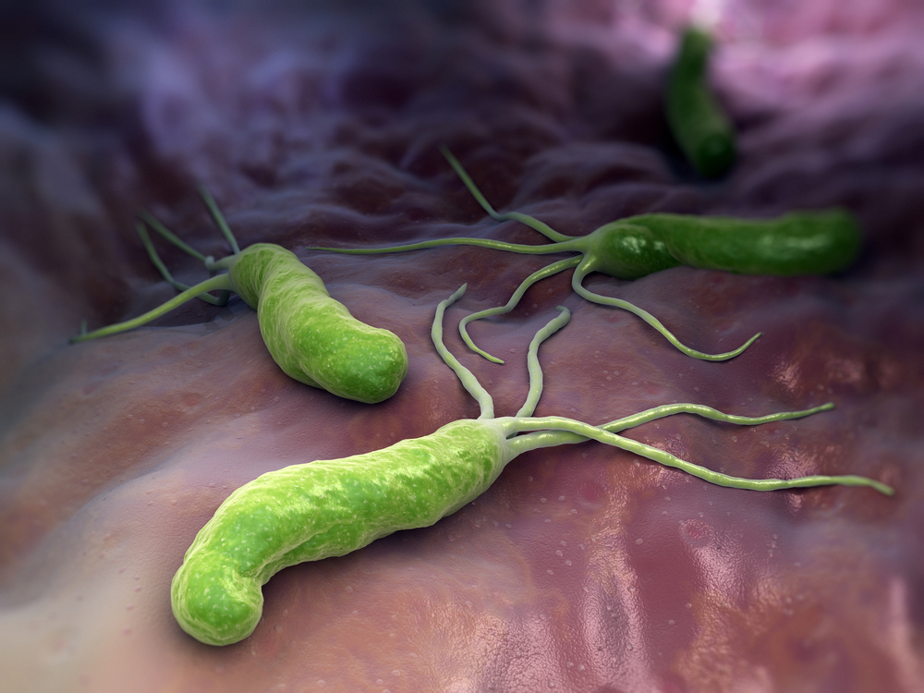
Helicobacter pylori, ulcer & cancer bug, is it waterborne?
CDC estimate 2/3 of all humans harbor H. pylori
  < 20% in developed regions, e.g. generally in USA
  50-80% in Indigenous Peoples of Arctic regions
Most infections do not cause illness, but
  Major risk factor for peptic ulcer disease
  1994 H. pylori classified as a carcinogen (mucosa-associated lymphoid tissue [MALT] lymphoma)
  But also reduces risk of esophageal adenocarcinoma
36

Slide 37
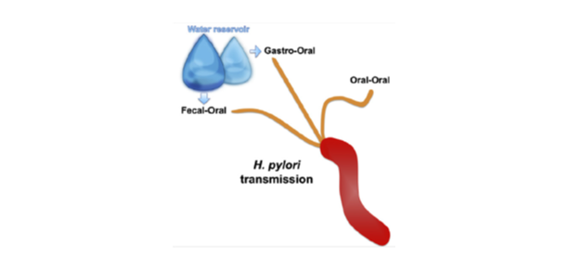
Waterborne H. pylori?
Water reservoir
Contaminated water may provide a reservoir
H. pylori survives in a viable but non-culturable (VBNC) state in water
  Traditional culture does not detect presence
Rafik Dey in my group has demonstrated intracellular growth within free-living amoebae
  Hence detect infectious VBNC forms & natural site for growth within biofilms (of chlorinated drinking water) and location for antibiotic-resistance development and spread
Aziz (2016) J Adv Res 6, 539-547
37

Slide 38
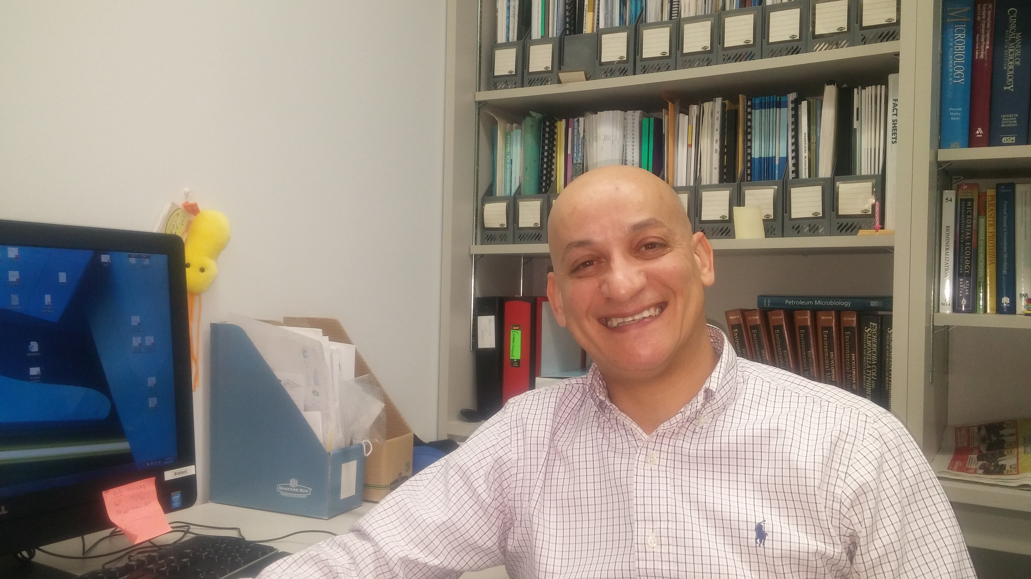
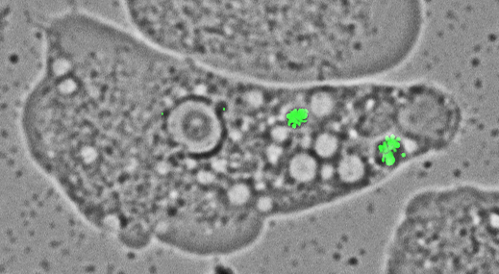
Waterborne H. pylori*
Free-living amoeba, Willaertia magna infected with green fluorescent protein-labelled H. pylori G27
and treated with pHrodo GreenTM (green at pH 4-5) to show local pH in infected W. magna food vacuole where it grows
Photos: Dr. Rafik Dey
*Aziz (2016) J Adv Res 6, 539-547
38

Slide 39
However, not necessarily good to treat all Helicobacter pylori cases
Based on an international experts’ review of evidenced-based benefits and harms for screening & treatment of H. pylori in high-prevalence countries
  In Arctic countries where H. pylori prevalence exceeds 60%, treating H. pylori infection should be limited to peptic ulcer disease and mucosa-associated lymphoid tissue lymphoma and
  test-and-treat strategy may not be beneficial for those with dyspepsia*
*McMahon et al. (2015) Epi Inf 144: 225-233
39

Slide 40
Key take home points
‘Traditional’ centralized water services should not be our aspirational goal for most small Arctic communities (nor elsewhere)
  Manage system within a proactive water safety plan based on QMRA
    coliform free does not mean pathogen free!
  Need a system’s & community view to identify alternatives
    Including energy, heat, fertilizers + water fit-for-purpose
  Demonstration at scale (e.g. Alaskan water/san challenge) to identify sustainable/adaptable water service options
    goal zero discharge
40

