Slide 1
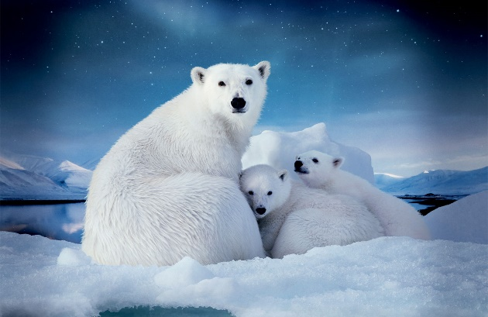
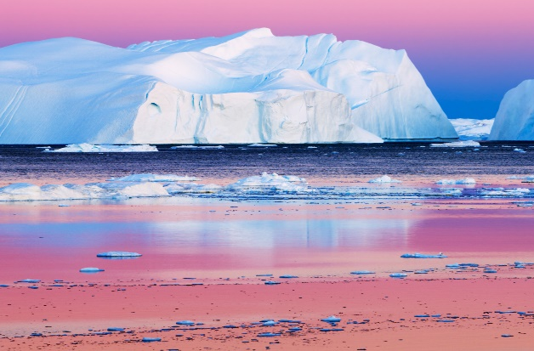
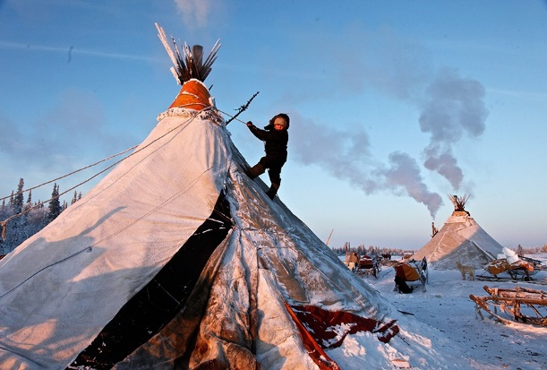
Impact of climate change and environmental pollution on population health in the Arctic
Tatiana Unguryanu
Northern State Medical University
Arkhangelsk, Russia
Notes:
My next topic is about impact of climate change and environmental pollution on population health in the Arctic.

Slide 2
Major human-health implications of climate change
Impact on health
Diseases and mortality
dependable on
temperature
Related to extreme
weather
Related to air pollution
Related to water and food
Allergic diseases
Diseases related to
vectors and rodents
Related to shortage of
water and food
Related to displacement
(Psychological breakdown)
Modulative
influences
Impact on a human
Regional
weather changes
Warm waves
Extreme weather
Temperature
Precipitation
Infection
Dynamics
Hydrology of
agro-ecosystem
Socioeconomics
and demography
Adaptive
strategies
Climate
change
Adaptation
Notes:
First of all I would like to discuss human-health implications of climate change. Climate change affects human health in a number of ways. There are direct and indirect impacts. For example, cold climate can cause body cooling. It is a direct impact. On the other hand, climate change can influence on the environment. For instance, warming climate can increase infectious and parasitic diseases due to the spread of infectious agents from southern to northern territories. It is indirect impact.

Slide 3
Interaction between temperature and health
COLD
Hyporeactions
Normal responses
Hyperreactions
COOLING
Frostbite
Hypothermia
Functional disturbance
Disease
Accident
Notes:
In the first part of the lecture let’s discuss direct impact of climate change. The interactions between temperature (in this case cold) and health, and the various health consequences are summarized in the slide. Responses to cold may be normal, exaggerated (hyperreactions), or damped (hyporeactions).
These result in body cooling and other outcomes, such as functional disturbance, frostbite, accident, hypothermia and different diseases. Cold is a key environmental risk factor for health in the Arctic regions.

Slide 4
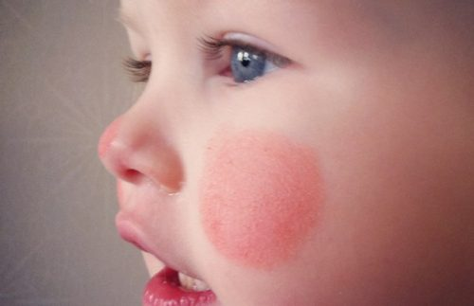

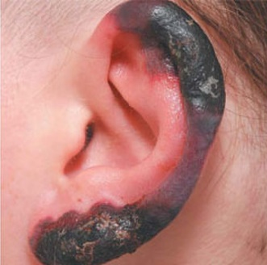
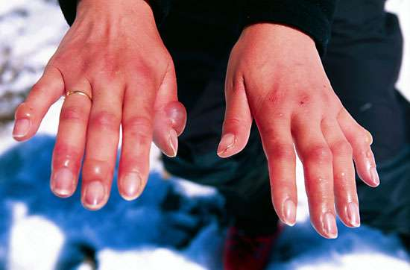
Cold injuries
Cold-related injuries are immediate pathological consequences of cold exposure
Cold exposure: coldest winter days and high wind speed (risk of frostbite is low at > -10°C; risk of frostbite is high at < -25°C)
The rate of slip and fall injuries increases with decreasing temperature
(0 ºC and below)
Injuries (frostbite, hypothermia) are linked to body cooling
In the Russian Arctic is 11 000 of hospitalizations due to cold injuries and
4 000 of deaths from hypothermia per year
Notes:
Cold-related injuries are direct pathological consequences of cold exposure. The main outcome of cold exposure is injuries. The rate of slip and fall injuries, for example, increases with decreasing temperature below zero degree. Injuries such as frostbite, hypothermia, and others are linked to body cooling. Cooling injuries occur during winter months, when there is a combination of the cold temperature and wind. The most common body parts that are affected by frostbite are head, hands, feet. Speaking about Russian statistics, as you can see on the slide, every year we have a lot of hospitalizations and deaths due to cold. injuries and 4 000 of deaths.

Slide 5
Cold-related diseases
Cardiovascular diseases
Cerebral vascular diseases
Respiratory diseases
Peripheral circulatory diseases
Cold urticaria
Musculoskeletal diseases
Cold-related immune effects
Deaths
Temperature °C
Notes:
This slide illustrates that cold is also a risk factor for diseases of different organs and systems. For example, the association of heart disease mortality and temperature has U-shape. It means that mortality decreases when the temperature is from 10 to 20 degrees and it increases when the temperature is below or higher these values. Deaths related to respiratory diseases, primarily pneumonia, increase significantly during the winter months.
Cold temperature causes a constriction of blood vessels that is why the most common abnormal skin reaction related to cold exposure is cold urticaria. Other popular outcomes of cold exposure are musculoskeletal diseases and decreasing of immune system function.

Slide 6
WHO project “Impact of climate change on human health and assessment of adaptation in the north of the Russian Federation”
Relative risk of mortality in the period of cold temperature
waves (-21.5 C) in Arkhangelsk, 1999-2008 (Varakina, 2011)
Causes of death | Age groups | RR
Infarct | 30-64 | 1.44*
 | 65+ | 1.32*
Stroke | 30-64 | 1.29
 | 65+ | 1.37*
Respiratory diseases | 30-64 | 1.41
 | 65+ | 1.32
External causes | 30-64 | 1.47*
 | 65+ | 0.99
* - relative risk is statistically significant at 95% level
The decrease in the average daily temperature for every degree below -12.8°C is accompanied by increasing in the number of calls for external causes among the population in the age group of 60 years and older by 1.6%
Notes:
Several years ago I participated in the WHO project about the influence of climate change on population health in the Arkhangelsk region. This slide demonstrates a small part of the results that we got. As you can see, cold waves statistically significant increase a risk of mortality from heart attacks, strokes and external causes. It was calculated that damage from cold waves was 180 additional deaths. It is interesting to mention that every degree below minus 12.8 causes increasing in the number of calls to ambulance for external causes in 1.6% among the population in the age group of 60 years and older.

Slide 7
Indirect climate change consequences for human health in the Arctic region
Warming climate → southern plant, insect, animal species expand
their ranges further north → new zoonotic diseases
Higher winter temperatures in the Arctic → increase of winter survival
of infected animals → the risk of hunter / consumer exposure
Northward expansion of new species → new water-borne diseases,
such as tularaemia
Longer Arctic summers and warmer winters → increase use of
commercial shipping → new rat-born infection (tick-borne encephalitis)
Notes:
Let’s speak about indirect impacts of climate change. Not to go into details I can say that the main health care problem associated with climate change is infection. For example, higher winter temperatures in the Arctic create a good conditions for the spread and survival of some agents of infectious diseases, such as tularemia and tick-borne encephalitis.
7

Slide 8
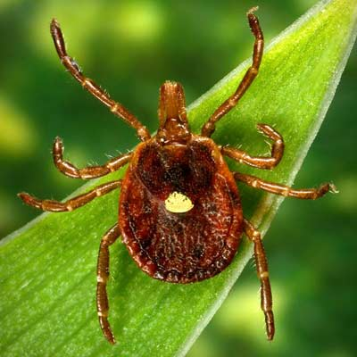
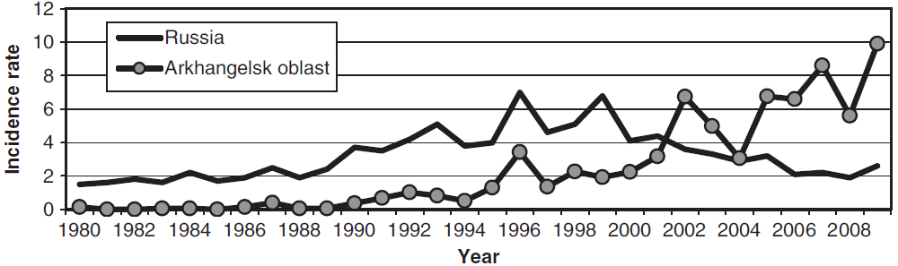
Tick-borne encephalitis (TBE) incidence
in the Arkhangelsk region and Russia
in 1980 – 2009
Ixodes tick
Warmer temperatures increase the length of seasonal periods of ixodic tick activity
9
Notes:
Now I would like to give you a bit more information about TBE. In recent decades tick-borne encephalitis (TBE) incidence has increased in some of Arctic countries. On the one hand a warming can lead to spreading of Ixodes ticks from the south to the north, and from the other hand, a warming weather may also change social behavioral. In a warmer climate people tend to spend more time outdoors in recreational activities, which increases their contacts with agents of zoonotic infectious diseases.
Let’s have a look on the first figure. It demonstrates the TBE incidence in the Arkhangelsk region and Russia. From 1980 to 1999 national TBE incidence was significantly higher compared to the Arkhangelsk region. But from 2000 the TBE incidence started to increase in the Arkhangelsk region. In 2009, it was in AO three times higher than in Russia as a whole.

Slide 9
Tick-borne encephalitis incidence rate in the Arkhangelsk region in 1980 – 2009
(averaged over each decade), per 100 000
1980 – 1989
1990 – 1999
2000 – 2009
1: 0.0 – 0.1 cases; 2: 0.1 – 1 cases; 3: 1 – 10 cases; 4: 10 – 100 cases
The number of TBE cases increased 40-fold in 30 years: from 162 in 1980 to 6,450 in 2009
10
Notes:
These three maps demonstrates the dynamics of spreading of ticks from the south to the north of the Arkhangelsk region.The number of TBE cases increased 40 times in 30 years: from 162 to 6,450.

Slide 10
Water related diseases
“any significant adverse effects on human health, such as death, disability, illness or disorders, caused directly or indirectly by the condition, or changes in the quantity or quality, of any waters” (WHO, 2012)
Water-borne diseases
(bad quality water)
Water-washed diseases
(inadequate water quantity)
Campylobacteriosis
Cryptosporidium infection
E.Coli infection
Giardiaosis
Hepatitis A
Hepatitis E
Tularemia
Yersiniaosis
Paratyphoid fever
Shigellosis
Typhoid fever
Trachoma (ocular blindness caused by Chlamydia trachomatis)
Bacterial skin infections (Staphylococcus aureus furunculitis)
Respiratory infections (respiratory syncytial virus bronchiolitis)
Notes:
Another indirect impact of climate change is connected to water related diseases. According to WHO, water-related disease means “any significant adverse effects on human health, such as death, disability, illness or disorders, caused directly or indirectly by the condition, or changes in the quantity or quality, of any waters” . Water-borne diseases is associated with bad quality drinking water. Water-washed diseases is associated with inadequate water quantity. In contrast to waterborne infectious diseases, water-washed infectious diseases are typically not reported and tracked. So, it is difficult to collect and analyze rates of water washed infectious.

Slide 11
Compulsorily registered waterborne diseases in Sweden 2011 (Nilsson, 2013)
Diseases | Arctic Sweden | Sweden
Campylobacteriosis | 57.8 | 86.6
Cryptosporidium infection | 31.6 | 3.9
Enterohaemorragic E coli infection | 2.1 | 5.0
Giardiaiosis | 12.8 | 11.0
Hepatitis A | 1.1 | 0.5
Hepatitis E | 0 | 0.1
Paratyphoid fever | 0.2 | 0.1
Shigellosis | 2.3 | 4.7
Typhoid fever | 0.5 | 0.1
Vibrio infection exkl. cholerae | 0 | 0.2
Yersiniaosis | 4.1 | 3.6
Entamoeba histolytica Infection | 0.2 | 1.7
Legionellaosis | 2.7 | 1.3
Tularaemia | 13.9 | 3.6
Total | 129.7 | 123.0
Notes:
This table shows incidence rate of waterborne diseases in Arctic Sweden (counties Vasterbotten and Norbotten) and Sweden in whole. In 2011 the levels of Cryptosporidium infection and Tularaemia were 8 and 4 times higher compare to Sweden. In general we can say that the statistics of the Arctic Sweden is not very different from Sweden.

Slide 12
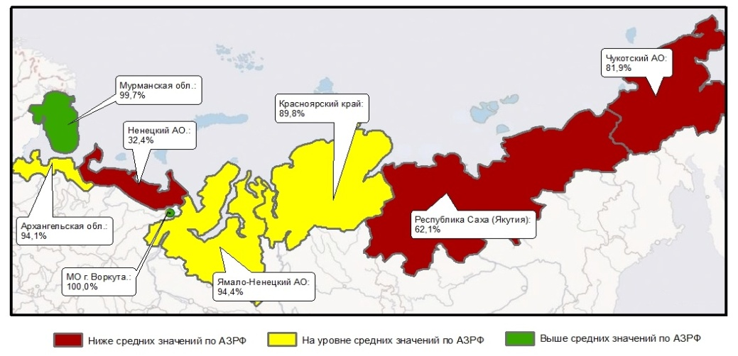
Drinking water related contaminants
Provision of the population (%) with centralized household
and drinking water supply in the Russian Arctic in 2017
Population (%) provided with quality drinking water in 2017
Regions | Urban | Rural
Murmansk Oblast | 100 | 97
Komi Republic | 99 | 87
Krasnoyarsk Krai | 99 | 62
Sakha Republic | 97 | 66
Yamalo-Nenets AO | 92 | 72
Chukotka AO | 94 | 58
Arkhangelsk Oblast | 85 | 47
Nenets AO | 84 | 50
Chukotka AO: 81.9
Murmansk
Oblast: 99.7
Krasnoyarsk
Krai: 89.8
Nenets AO: 32.4
Arkhangelsk Oblast: 94.1
Sakha
Republic: 62.1
Komi
Republic: 100
Yamalo-Nenets AO: 94.4
Potential water threats (WHO, 2005):
• naturally occurring chemicals
• chemicals from industrial sources and human dwellings
• chemicals from agriculture
• chemicals used in water treatment
Novikova Yu.A., 2017; Rospotrebnadzor, 2017
Notes:
Speaking about Russia, the problem of drinking water quality in the Russian Arctic is important. The map shows that not all the Arctic residents in Russia are provided with centralized household and drinking water supply. As you can see only the third part of Nenets population has an access to such kind of water supply. As for the water quality, almost all urban population in the Russian Arctic is provided with drinking water of high quality. But only 50% of rural residents in the Arkhangelsk and Nenets regions have the access to drinking water of good quality.

Slide 13
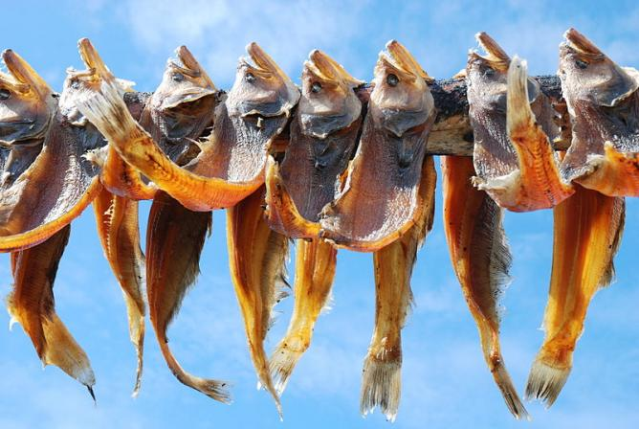
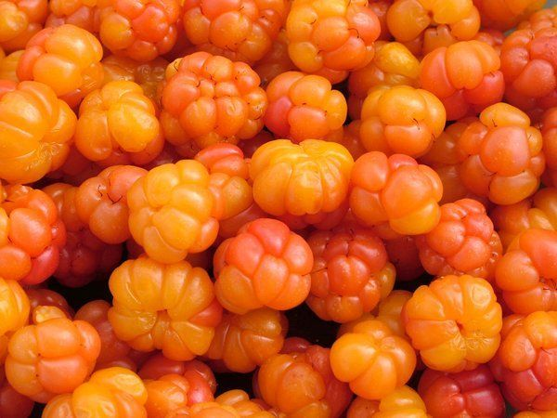
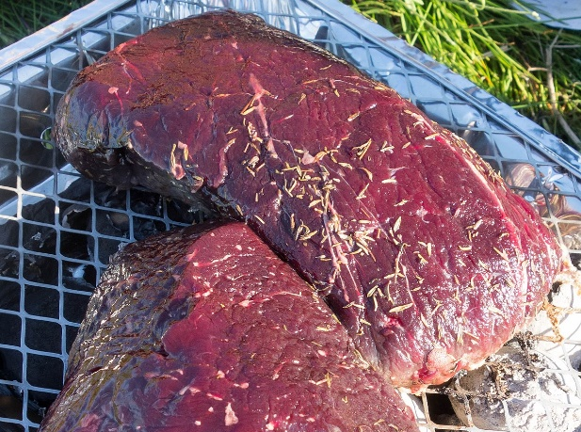
Sources of food contamination
Food storage / processing / preparation at home
Prolonged fermentation of meat and fish in ground pits
Pollution of soil and water around settlements
Use of toxic insecticides for the treatment of farmed animals
Use of technical oils and liquids for imbuing of wood and other construction materials
Second-hand use of waste technical containers and barrels for souring plants and vegetables
Notes:
The next factor connected to climate change and environmental pollution is food. There are a lot of ways of food contamination. Generally speaking we have chemical and microbiological contaminants of food.
The main pathways of food contamination include food storage and its preparation, fermentation of meat and fish in ground pits, use of toxic insecticides and pesticides and many others.

Slide 14
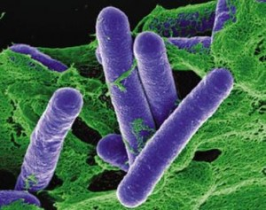
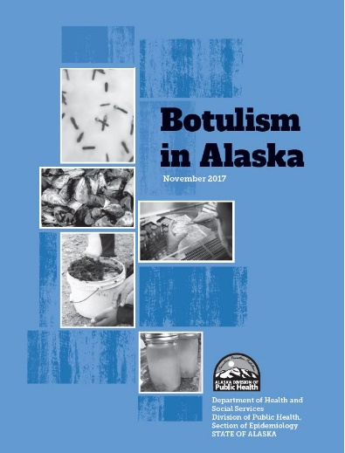
Foodborne botulism incidence,
1950 – 2016 per 100,000 Alaska Natives
In Alaska is 5.2 cases/100 000 inhabitants per year,
which is 836 times higher than the overall US rate
Clostridium botulinum
The main cause of the botulism is consumption of contaminated traditional fermented aquatic game foods such as fish and seal
Notes:
Let’s have a look at example of microbiological contamination of food. This slide illustrates foodborne botulism that has a health threat among northern indigenous populations. There is an opinion that it can increase in future in the circumpolar area as a result of increasing temperatures and climate change.
People suffer from botulism in Alaska in 800 times higher than the US in whole. The main cause of the disease is consumption of contaminated traditional fermented aquatic game foods such as fish and seal.
During 1950–2016 360 cases of botulism occuried Alaska Native people.

Slide 15
Interaction between climatic change and internal exposure to contaminants from seafood consumption
Brantsater and Knutsen, 2013
Notes:
The next slide demonstrates interaction between climatic change and internal exposure to contaminants from seafood consumption.
The impact of climate change on human exposure to POPs depends on the amount and type of fish consumed and other seafood. The most vulnerable groups to contamination are fetus and young children due to their physiological and anatomical characteristics. Biomonitoring studies allow to identify levels on these contaminants in human tissue and determine the extent of potential risks. I will give more information about biomonitoring a bit later.

Slide 16
Contribution of different traditional foods to dietary exposure to organochlorines in southwestern Greenland
AMAP, 2002
Notes:
As I have said before diet is the main source of human exposure to organic xenobiotic compounds.
These lipophilic chemical accumulate in the fatty tissues of all biota. They are prevalent in large Arctic mammals, and are concentrated in their fatty tissues and organs, such as blubber, liver, brain, and kidney.
This picture shows contributions of contaminated parts of mammals and birds by organoclorines in Greenland. The most contaminated saefood is seal blubber.

Slide 17
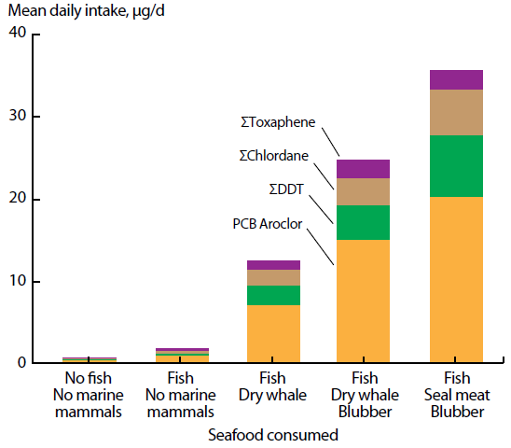
Daily intake of POPs in 90 daily food portion as a function of seafood types present in the diet (AMAP, 2009)
95% of mercury exposure due to seafood contamination
Notes:
Depending on diet type there are some differences in contributions of Pops exposure. For example, as you can see, if the diet doesn’t include fish and marine mammals, so there is no exposure to POPs. In case of consuming these products, especially seal meat and blubber there is a high risk of exposure of these contaminatns. However, seafood is also a rich source of nutrients such as marine omega-3 fatty acids, vitamin D, iodine and selenium. Thus, the risks associated with contaminant intake and the benefits of nutrient intake must be balanced acoording to dietary recommendations.
Apart from that seafood contributes on average 95% to the estimated dietary exposure to mercury..

Slide 18
Visual presentation of advice concerning consumption of traditional foods in the Far North of Russia
(Dudarev and Sychov, 2005)
Green: consumption unlimited
Ringed seal | Bearded seal | Walrus | Whale | Reindeer
Meat | Meat | Meat | Meat | Meat
Fat | Fat | Fat | Fat | Fat
Liver | Liver | Liver | Liver | Liver
Kidney | Kidney | Kidney | Kidney | Kidney
Yellow: recommended to limit consumption to 300 – 400 g/day
Pink: recommended to limit consumption to 100 g/day
Hare | Salmonoids | Marine fish | Ducks and grees | Tundra birds
Meat | Meat | Meat | Meat | Meat
Fat | Fat | Fat | Fat | Fat
Liver | Liver | Liver | Liver | Liver
Kidney
Red: recommended to replace with alternative food
Notes:
This slide provides visual presentation of advice concerning consumption of traditional foods in the Far North of Russia. These recommendations were prepared on the basis of the information about the concentrations of persistent toxic substances in local food products.
Let’s discuss these recomandations. Different colours show recommended amount of consumption. So, Green colour means that consumption is unlimited. Yellow colour recommends to limit consumption to 300 – 400 g/day. Pink colour recommends to limit consumption to 100 g/day. And finally Red colour says to change for alternative food.

Slide 19
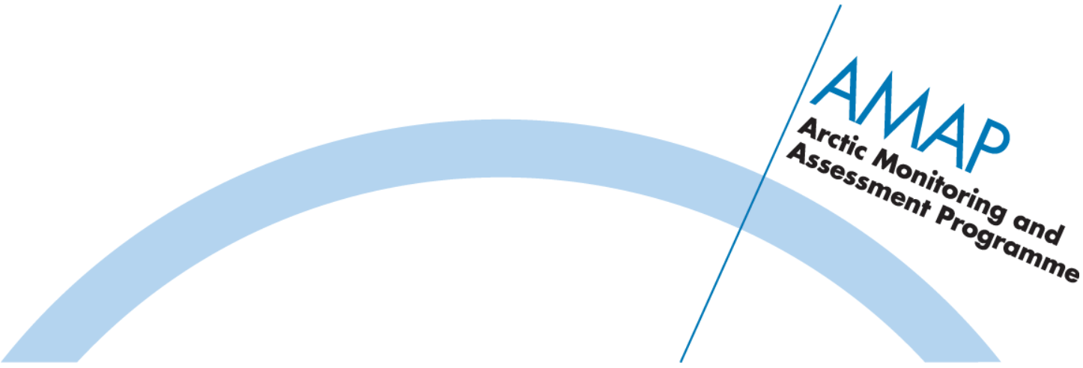
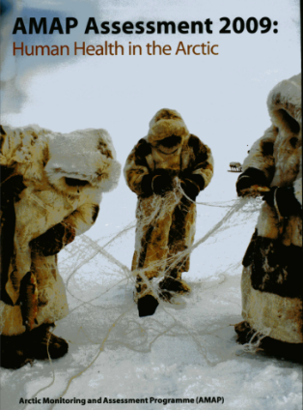
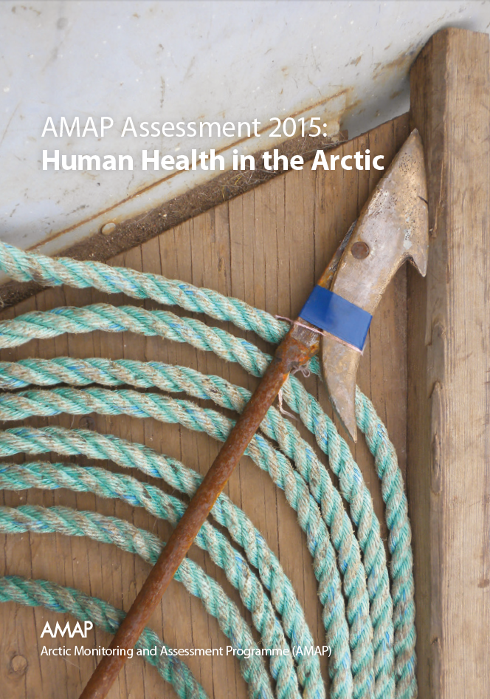
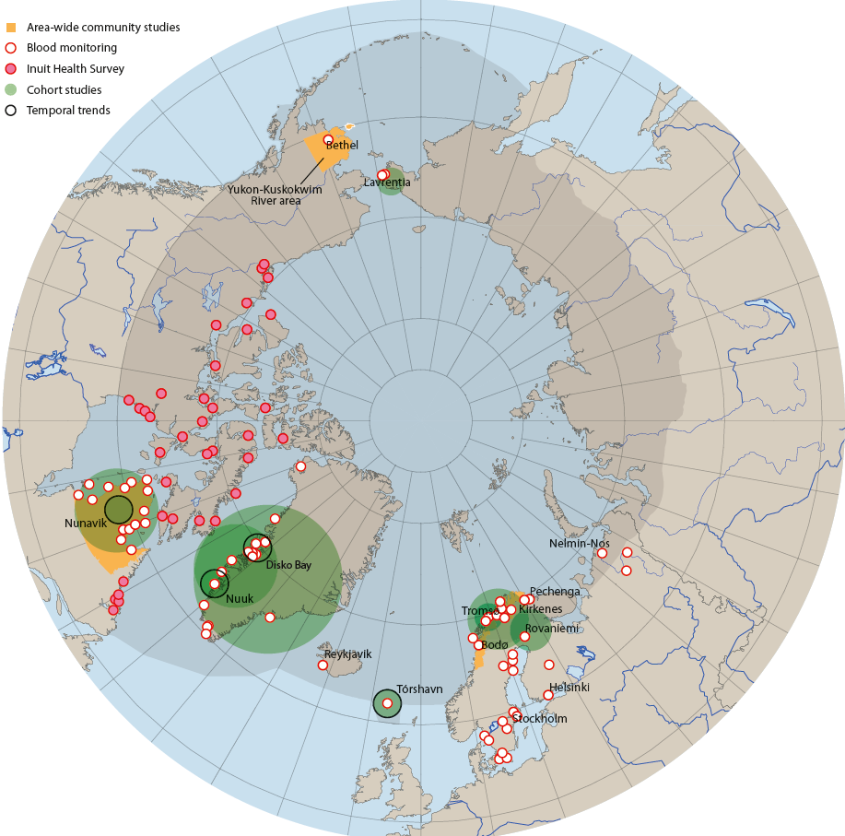
The Arctic Monitoring and Assessment Programme (AMAP) http://www.amap.no/
AMAP assessment 2009:
Human health in the Arctic
AMAP assessment 2015:
Human health in the Arctic
Scope of the AMAP biomonitoring: pesticides, polybrominated diphenyl
ethers (PBDEs), polychlorinated biphenyl (PCBs), perfluorinated compounds (PFCs), metals, total lipids, cholesterol, triglycerides
Human tissues for monitoring environmental contaminants are blood, breast milk, urine, hair
Location of recent and ongoing blood
monitoring, temporal trend and human health
cohort studies around the Arctic
Notes:
Threre is a programm that provides biomonitoring of persistent organic pollutants and heavy metals in human tissue in the Arctic regions. It is the Arctic Monitoring and Assessment Programme (AMAP). It was established in 1991.
The AMAP's studies provide 1) an update information of human exposure to environmental contaminants in the Arctic; 2) data to assess trends in human exposure over time, indicating whether contaminant concentrations are decreasing, remaining the same, or increasing; 3) the data collected provide important information on dietary habits and offer important insights into the relationship between contaminant exposure, traditional food consumption, and other lifestyle factors. Biomonitoring studies are useful for identifying adverse responses induced by exposure to environmental contaminants in small population in the Arctic region. The scope of the biomonitoring AMAP considers 37 analytes. Biomarkers of internal dose, biologically-effective dose, early biological effect can be measured from exposure to disease. In conclusion, blood, breast milk, urine, hair are useful and complementary media for monitoring environmental contaminants.

Slide 20
Change over time in pollutant levels in human blood within the Arctic region
Contaminant | Media | Region | Units | 1996 – 2004 | 2004 – 2009 | 2009 – 2013
PCB153 | Maternal blood | Northern Norway | μg/kg plasma lipid | 52 | 24.8 | -
p,p’-DDT | Child’s blood | Faroe Islands | μg/kg plasma lipid | 613 | - | 180
HCB | Maternal blood | Alaska | μg/kg plasma lipid | 14.0 | 22.0 | 15.9
Mirex | Child’s blood | Nunavik, Canada | μg/kg plasma lipid | 4.1 | 2.3 | −
Pb | Maternal blood | Chukotka, Russia | μg/L whole blood | 37.5 | 29.6 | −
Hg | Maternal blood | Greenland | μg/L whole blood | 6.3 | − | 4.0
Cd | Maternal blood | Alaska | μg/L whole blood | 0.57 | 0.44 | 0.20
PFOS | Maternal blood | Sweden | μg/L | 2.56 | 1.88 | 1.67
PFOS - Perfluorooctanesulfonic acid
AMAP, 2015
Notes:
This table provides data that human exposure to most persistent organic pollutants, mercury and other contaminants is decreasing in many Arctic populations. This reflects changes in diet and changing levels of environmental contamination. Besides this trend is connected to health advice concerning consumption of certain foods. However, exposure remains high in some populations.

Slide 21
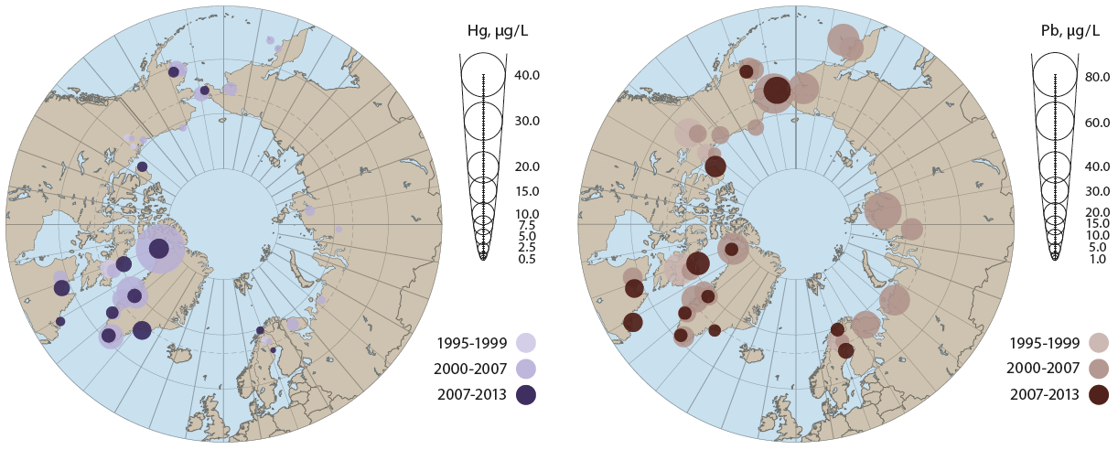
Circumpolar concentrations of Hg and Pb, μg/L whole maternal blood
Mercury
Lead
AMAP, 2015
Notes:
As an example this slide shows the differences in the levels of metals between countries. The highest levels of total Hg were observed in the blood of women of childbearing age from Nunavik in Canada. The lowest levels occurred in women from western Greenland, Sweden and Norway. Russian maternal blood from Chukotka taken in 2007 had the highest circumpolar levels of Pb.The lowest level of Pb was found in Alaska and Norwegian women.

Slide 22
Health outcomes in children related to exposure to organohalogens in utero and/or in early age
Compound | Exposure | Health end point
hexachlorobenzene (HCB) | In utero | Small length for gestational age Poor social behavior at 4 years Attention deficit hyperactivity disorder at 4 years Overweight at 6 years
DDE | In utero | Prematurity Delay in mental and psychomotor development at 1 year Asthma at 4 and 6 years
DDT | In utero 4 years | Decrease of cognitive skills at 4 years Alteration of thyroid hormones
β-hexachlorocyclohexane (β-HCH) | In utero 4 years | Alteration of thyroid hormones Alteration of thyroid hormones
PCBs | 4 years | Alteration of thyroid hormones
PBDEs | 4 years | Attention deficit hyperactivity disorder, poor social behavior
Other outcomes: neurobehavioral, immunological, reproductive, cardiovascular, endocrine and carcinogenic effects
AMAP, 2015
Notes:
This slide demonstrates the outcomes for children health in case of exposure of different POPs in utero and the first fore years of life.
Fetuses and newborns are most sensitive to POPs because their organs and metabolic functions are still under development.There are several adverse health effects related to exposure to organohalogens. For example, low birth size, low birth weight, low birth head circumference, poor social behavior, increased incidence of attention-deficit hyperactivity disorder (ADHD), decreased cognitive skills, overweight, and alterations of porphyrin, thyroid and liver metabolism. The health end points listed in slide are the results of several studies conducted in different cohorts. The associations between prenatal exposure to a particular contaminant and children’s social behavior or health outcomes should be considered when evaluating potential neurotoxicological effects.
Other effects: contaminants, diet and genetics are likely to be significant co-factors implicated in cardiovascular diseases and metabolic disturbances. Hg can affect circulatory parameters such as pulse pressure, heart rate and heart rate variability, blood pressure and hypertension. Prenatal exposures to MeHg may also affect the development of cardiovascular homeostasis.

Slide 23

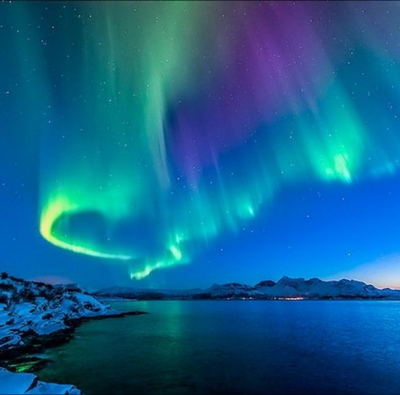
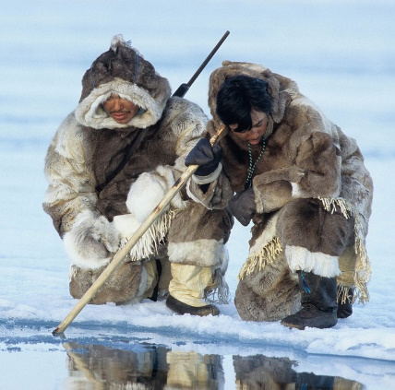
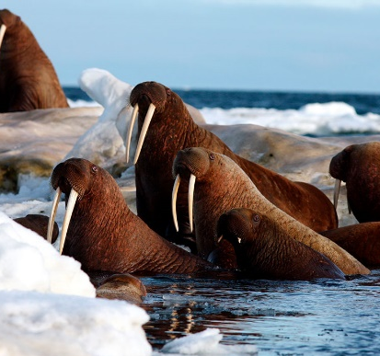
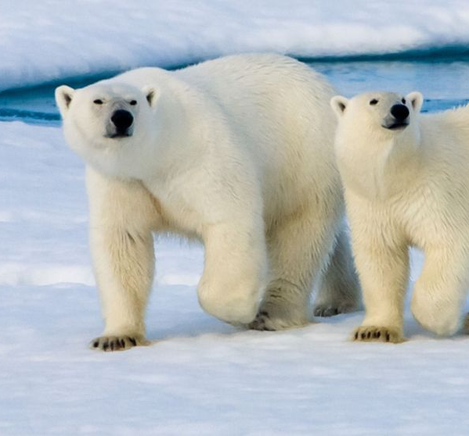
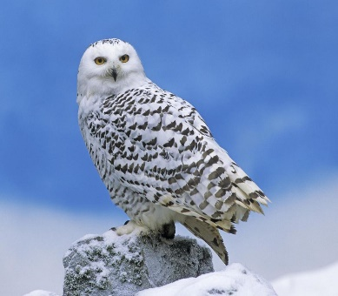
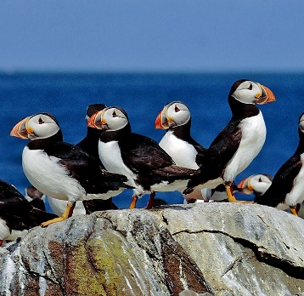
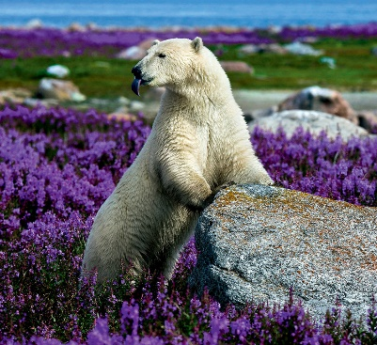
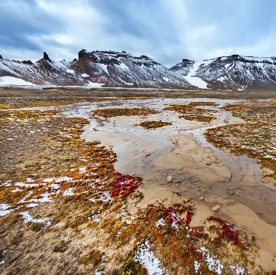

Thank you for your attention!
Notes:
So, climate change and environmental pollution have serious consiquences for human health in the Arctic regions. We should pay more attention to this problem and

