Slide 1
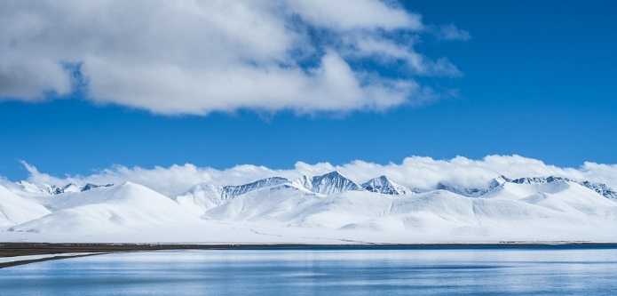
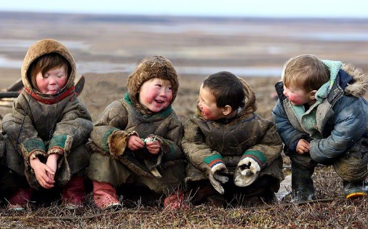
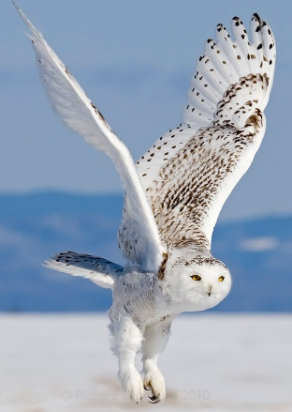
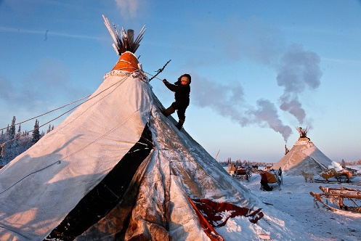
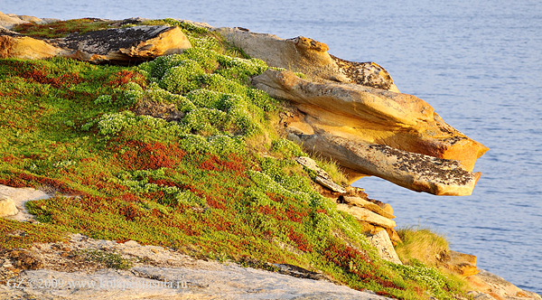
Demographics and health status of Arctic populations
Tatiana Unguryanu
Northern State Medical University
Arkhangelsk, Russia
Notes:
Dear colleagues, let me present the lecture about demographics and health status of Arctic populations.

Slide 2
Content
Arctic populations and migration:
Population density
Population change
Net migration
Demographics of Arctic populations:
Birth rate
Life expectancy
Mortality
Causes of death
Infant mortality
Morbidity of Arctic populations:
Infectious diseases
Noninfectious diseases
Notes:
My lecture covers the questions about characteristics of arctic populations and migration and also includes key indicators of its health status. Apart from that I will speak about morbidity in the Arctic regions.

Slide 3
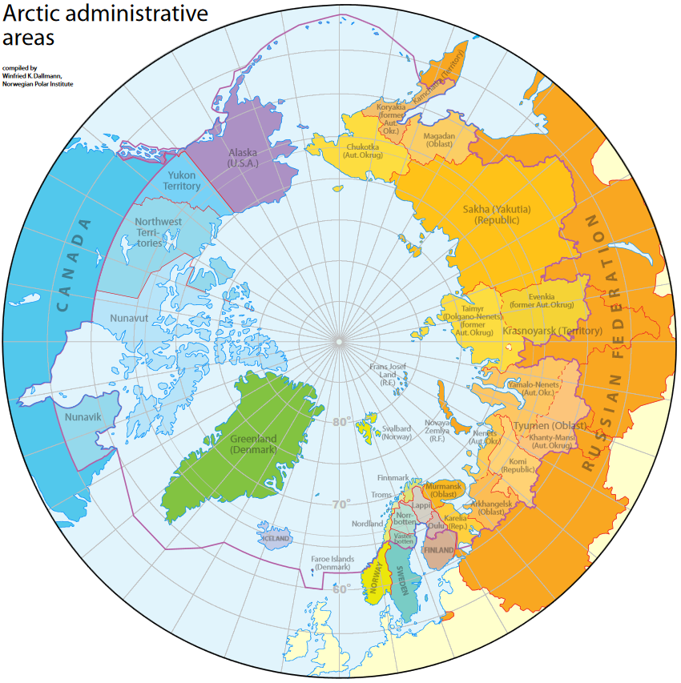
The Arctic region
United States: Alaska
Canada: Yukon, Nunavut, Northwest Territories
Denmark: Greenland, Faroe Islands
Iceland
Norway: Finnmark, Troms, Nordland
Sweden: Norrbotten, Västerbotten
Finland: Lapland, Oulu, Kainuu
The Russian Federation: Nenets Autonomous Okrug, Chukotka Autonomous Okrug, Yamalo-Nenets Autonomous Okrug, Komi Republic, Sakha Republic, Krasnoyarsk Krai, Arkhangelsk Oblast, Murmansk Oblast
Map of the Circumpolar Arctic region and
Arctic administrative areas (Compiled by Winfried
K. Dallmann, Norwegian Polar Institute)
Notes:
In the beginning of my lecture I would like to describe the Arctic regions for better understanding because during my lecture I will give some characteristics of population health of these territories.
Various sources give different information about total number of Arctic population. According to these data between 4 and 10 million people inhabit the Arctic.
The list shows eight countries that are included in the Arctic area. As you can see only the northern parts of every country belong to the Arctic except Iceland.

Slide 4
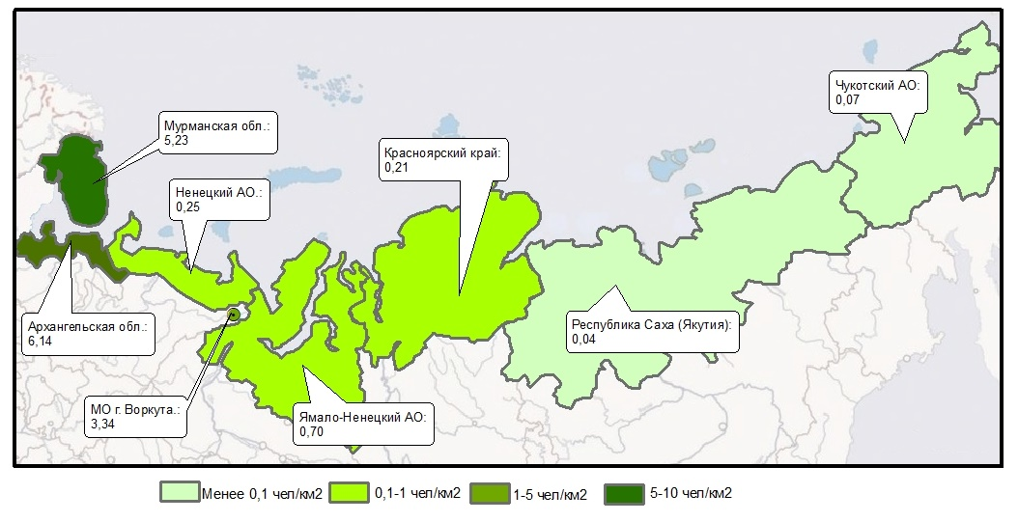
Russian Arctic
Chukotka Autonomous Okrug
Murmansk
Oblast
Krasnoyarsk
Krai
Nenets Autonomous Okrug
Arkhangelsk Oblast
Sakha
Republic
Komi
Republic
Yamalo-Nenets Autonomous Okrug
< 0.1 people
per km²
0.1 -1 people
per km²
1 - 5 people
per km²
5 – 10 people
per km²
Area of the RA is 3630296,82 km² (21% of area of the Russian Federation)
Population density is 0.65 people per km² (in the Russian Federation is 8.57 people per km²)
653 settlements: population of 106 settlements is more than 1000, 35 of them have more
10 000 people
Notes:
Now let me tell you a few words about the Russian Arctic. According to the decree of the President of the Russian Federation since 2014 the Russian Arctic includes 8 northern regions. Murmansk, Nenets and Chukotka regions are fully included in the Arctic zone of Russia. And speaking about the other regions, only some settlements belong to the Arctic zone. For example, in Komi republic only Vorkuta city is treated as Arctic territory. In the Arkhangelsk region three big cities Arkhangelsk, Severodvinsk, Novodvinsk and three rural districts are included in the Arctic zone. The Russian Arctic’s area occupies the fifth part of Russia and consists of 653 settlements.

Slide 5
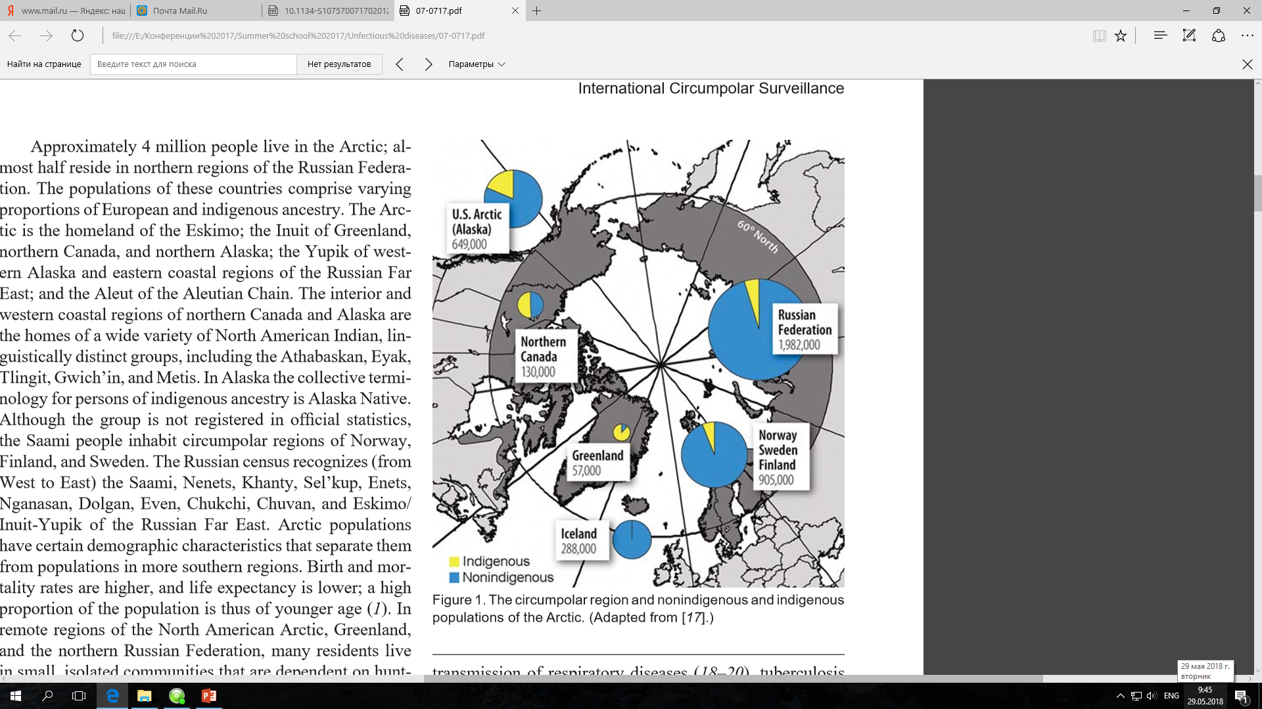
The circumpolar region and nonindigenous and indigenous populations of the Arctic
the Inuit (Greenland, northern Canada, and Alaska)
the Yupik (western Alaska)
the Athabaskan, Eyak, Tlingit, Gwich’in, Metis (northern Canada and Alaska)
Alaska Native (Alaska)
the Sami people (Norway, Finland, and Sweden)
the Sami, Nenets, Khanty, Sel’kup, Enets, Nganasan, Dolgan, Even, Chukchi, Chuvan, Mansi, Inuit, Yupik (the Russian Federation)
Alan J. Parkinson, Michael G. Bruce, Tammy Zulz, 2008
Notes:
The populations of the Arctic regions comprise varying proportions of European and indigenous populations. Between 400 000 and 1.3 million people belong to the indigenous populations. The Arctic is the homeland of the Eskimo; the Inuit; the Yupik; the Aleut; the Saami people and others. Arctic populations, especially indigenous people, have certain demographic characteristics. Birth and mortality rates are higher, and life expectancy is lower; a high proportion of the population is of younger age.

Slide 6
Population density of the Arctic territories
Regional level |  | National level
Regions | People per km² | Country | People per km²
Alaska | 0.47 | United States | 33,5
Yukon | 0.07 | Canada | 3,7
Northwest territories | 0.04
Nunavut | 0.02
Greenland | 0.03 | Denmark | 128,1
Faroe Islands | 34.7
Iceland | 3.1 | Iceland | 3,1
Nordland | 6.5 | Norway | 15,9
Troms | 6.3
Finnmark | 1.6
Vasterbotten | 4.7 | Sweden | 21,1
Norrbotten | 2.5
Oulu | 8.3 | Finland | 17,6
Lappi | 2.0
Murmansk oblast | 5.8 | Russia | 8,3
Arkhangelsk oblast | 2.1
Nenets autonomous okrug | 0.2
Komi Republic | 2.3
Yamal-Nenets autonomus okrug | 0.7
Sakha Republic | 0.3
Chukotka autonomous okrug | 0.1
A Comparative Review of Circumpolar Health Systems edited by Kue Young Gregory Marchildon, 2012
Notes:
Circumpolar regions differ from each other in the size of their population and population density. So, Alaska and the northern territories of Canada constitute less than 0.5% of the total population of the United States and Canada respectively. In contrast, a higher proportion of the population that reside in the northern regions in Norway (10%), Sweden (6%) Finland (12%), and Russia (5%). Due to the objective difficulties of living and infrastructure development, the Arctic territories are characterized by extremely low population densities. However, the population density differs significantly by region depending on the historical, geographical, and socioeconomic conditions. As shown in the slide the population density varies from 0.02 in Nunavut to 35 in the Faroe Islands. The highest density of the population of the territory is in Iceland, the region of Troms (Norway), and Murmansk oblast (Russia).

Slide 7
Population change in the Arctic, 2000 – 2010 (percent)
Alaska (United States)
Iceland
Canadian Arctic
World
Faroe Islands
Greenland
Norwegian Arctic
Arctic, total
Norrbotten (Sweden)
Lappi (Finland)
Russian Arctic
Arctic Human Development Report, 2014
Notes:
This slide demonstrates changing of the Arctic population. From 2000 to 2010 in the whole world (green colour in the slide) the population increased, however in the Arctic (black colour) population decreased. I would like to point your attention to the fact that the Arctic regions showed different changing. For example, the highest growth of population was in Alaska, Iceland and Canadian Arctic. In contrast the biggest decrease for this period was in the Russian Arctic. There are two demographic factors that influence on the population change: net migration and natural increase.

Slide 8
Net migration in the Arctic regions and countries in 2000 – 2014, number of persons
Country | Number of persons
United States | 14552509
Russia | 3424812
Canada | 3021246
Sweden | 676858
Norway | 438059
Denmark | 290418
Finland | 171015
Norrbotten
Iceland
Lapland
Alaska
Yukon
Nenets okrug
Nunavut
Northwest territories
Greenland
Yamal-Nenets okrug
Finnmark
Troms
Chukotka okrug
Murmansk oblast
Vylegzhanina AO, 2017
Notes:
Net migration means that people come to or leave the territory. There are positive and negative net migration. Positive net migration means that more people coming into a region than leaving. Negative net migration means that more people leaving the region than coming into it. So, net migration is the difference between the number of in-migrants and out-migrants. The greatest increase in population due to migration is observed in the Swedish county of Norrbotten over the last 15 years for 15000 people. The highest outflow rates in relation to the regional number of inhabitants were in Murmansk oblast, Finnmark, and Greenland. The highest negative migration was in Murmansk district in Russia. Negative migration is one of the general sociodemographic problems of the Arctic territories due to the bad conditions of living or lack of work places.

Slide 9
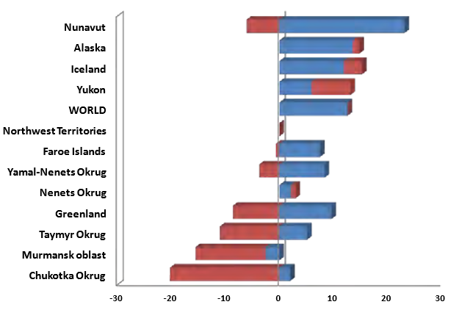
Population change from natural increase and net migration in selected Arctic regions, 2000 to 2014
Percent change
from natural increase
Percent change
from net migration
Arctic Human Development Report, 2014
Notes:
This slide demonstrates a proportion of net migration and natural increase. Natural increase is the difference between the number of births and the number of deaths. Let’s have a look on the slide. In Nunavut we can see on the one side there is a growth of population due to natural increase and from the other side there is a decrease of population because of net migration. The same situation we have in Greenland, Chukotka and Yamal-Nenets region. The second part of the Arctic territories, such as Alaska, Iceland, Yukon and Nenets region, have a growth of population due to both natural increase and net migration without any decrease.

Slide 10
Key indicators of health (Last, 2001)
Birth Rate is a summary rate based on the number of live births in a population over a given period, usually one year. The denominator is the average of midyear population in the area in that year.
Life Expectancy at birth is the average number of years a newborn baby can be expected to live if current mortality trends continue.
Death Rate is an estimate of the portion of the population that dies during a specified period. The numerator is the number of persons dying during the period; the denominator is the number in the population, usually estimated as the mid-year population.
Infant Mortality is a measure of the yearly rate of death in children less than one year old. The denominator is the number of live births in the same year.
Notes:
The next part of my lecture is about health of population in the Arctic. There are four key indicators of health outcomes. They include birth rate, life expectancy, death rate and infant mortality.
What does these indicators mean?
Birth Rate is a summary rate based on the number of live births in a population over a given period, usually one year. The denominator includes a number of population in this year.
Life Expectancy at birth is the average number of years a newborn baby can be expected to live if current mortality trends continue.
Death Rate is an estimate of the portion of the population that dies during a specified period. The numerator is the number of persons dying during the period; the denominator includes a number of population in this year.
Infant Mortality is a measure of the yearly rate of death in children less than one year old. The denominator is the number of live births in the same year.

Slide 11
Crude birth rates in 2000–2004, per 1000 population
AMAP, 2009
Notes:
You can see on this slide that the highest levels of birth rate were in Nunavut and Alaska among the natives. In these Arctic regions the birth rate was more than 20 cases of live birth per 1000 population. The lowest levels of birth rates (less than 10 cases of live birth per 1000 population) were shown in Northern Sweden, Lapland and Murmansk region.

Slide 12
Circumpolar life expectancy at birth
2000 – 2004
Country | Males | Females
Alaska (USA) | 74.5 | 80.1
Yukon (Canada) | 74.9 | 80.1
Nunavut (Canada) | 66.6 | 70.9
Greenland | 64.6 | 70.4
Iceland | 79.0 | 82.6
Faroe Islands | 77.0 | 81.3
Troms (Norway) | 76.5 | 81.5
Nordland (Norway) | 76.7 | 82.0
Finmark (Norway) | 74.6 | 80.6
Norbotten (Sweden) | 76.6 | 81.6
Vasterbotten (Sweden) | 77.6 | 82.1
Oulu (Finland) | 74.3 | 81.6
Lapland (Finland) | 73.7 | 81.1
AMAP, 2009
Notes:
Now let’s speak about life expectancy. There are substantial differences in life expectancy between the Arctic regions. As you can see the highest life expectancy among males and females have Iceland, Northern Norway and Northern Sweden. The lowest life expectancy has Greenland. Apart from that I would like to draw your attention to the difference in life expectancy between men and women. If in Iceland women live three years longer than men, so in Lapland, Finland women live 8 years longer than men.

Slide 13
Life expectancy at birth in the Russian Arctic (Rosstat)
Areas | 2000 year |  | 2016 year
 | Males | Females | Males | Females
Russian Federation | 59.0 | 72.3 | 66.5 | 77.0
Nenets AO | 54.0 | 68.3 | 63.9 | 78.4
Chukotka AO | 54.9 | 67.1 | 59.7 | 69.6
Kareliya Republic | 56.4 | 70.2 | 63.7 | 75.7
Krasnoyarsk Krai | 56.1 | 69.8 | 64.3 | 75.7
Arkhangelsk Oblast | 56.3 | 70.6 | 64.9 | 76.7
Komi Republic | 57.8 | 70.1 | 63.6 | 75.3
Sakha Republic | 57.9 | 70.3 | 65.8 | 75.9
Murmansk Oblast | 58.5 | 71.0 | 65.7 | 75.6
Yamalo-Nenets AO | 61.6 | 72.3 | 67.2 | 77.0
In rural area of the Chukotka AO life expectancy at birth is 53 years
(men is 47.5 years, women is 58,5 years)
Notes:
The northern regions of the Russian Federation have the lowest life expectancy among circumpolar countries. In average life expectancy in the Russian Arctic is 63 years for males and 75 years for females. Among the northern regions of Russia Chukotka AO has the lowest life expectancy. But the last 16 years life expectancy in the Arctic regions of Russia increased from 2 to 10 years. In Russia the difference in life expectancy between genders reaches from 10 to 15 years. In rural area of the Chukotka AO life expectancy at birth is 53 years (men is 47.5 years, women is 58,5 years).

Slide 14
Circumpolar age-standardized mortality rates (all causes) per 100 000
Young, 2008
Notes:
Let’s discuss the next indicator which is death rate. This slide demonstrates age-standardized mortality rates from all causes. Age-standardized mortality rate is more suitable to compare levels of death between countries with different age structures of populations. The chart on the slide shows that the mortality from all causes is not very different in the northern regions of most Scandinavian countries from the total age-standardized mortality rates of each country as a whole. However, there are obvious differences between Greenland and Denmark in two times. The age-standardized mortality of Alaska Natives is also much higher than in Alaska and the United States in general. Regions of Arctic Russia have the highest age-standardized mortality rates among all circumpolar regions and countries. The highest levels of mortality show Murmansk and Chukotka districts.

Slide 15
Common causes of death in some Arctic populations, 2000 – 2004
Age Standardized Mortality Rates (ASMR) per 100 000 persons
Young, 2008
Notes:
There are differences among circumpolar countries in the leading causes of death. This slide compares mortality rates for common causes of death. It is clear that circulatory diseases and cancers are the leading causes of death in Arctic populations. There is also a pattern of high mortality due to suicide and injuries.

Slide 16
Mortality rates (selected causes) per 100 000 in 2016 (Rosstat)
Causes of death | Russia | Chukotka AO | Arkhangelsk region | Murmansk region
Heart diseases | 616.4 | 406.1 | 785.2 | 613.5
Cancer | 204.3 | 156.0 | 239.4 | 202.5
External causes | 114.2 | 216.0 | 146.4 | 122.3
Respiratory diseases | 48.0 | 40.0 | 49.0 | 22.9
Infectious diseases | 24.1 | 32.0 | 11.0 | 14.5
Suicide | 15.8 | 62.0 | 30.6 | 5.0
Unintentional alcohol poisoning | 9.6 | 8.0 | 23.5 | 2.8
Homicide | 7.2 | 22.0 | 12.0 | 4.1
All causes | 1 289.3 | 996.2 | 1 370.9 | 1 150.0
Notes:
The causes of mortality in the Arctic are similar to those in Russia as a whole. The main causes of death (about 90% of all death cases) include diseases of the circulatory system, cancer and external causes. But there are substantial differences between the Arctic regions. For example, Arkhangelsk region has the highest level of death from heart diseases and unintentional alcohol poisoning. Mortality rates in Chukotka district from external causes, infectious diseases, suicide and homicide are many times higher compare to Arkhangelsk and Murmansk region.

Slide 17
Age-standardized cancer mortality rates per 100,000 in Chukotka AO, 1961 - 1990
Site | Male |  | Female
 | Chukotka | Russia | Chukotka | Russia
Pharynx | 3,0 | 6,9 | 8,1 | 0,3
Oesophagus | 110,9 | 8,4 | 82,7 | 2,4
Stomach | 58,3 | 51,3 | 64,5 | 22,8
Lung | 106,2 | 64,4 | 68,6 | 6,9
Breast | − | − | 11,2 | 11,6
All sites | 416,7 | 207,3 | 358,6 | 98,4
Alexey A. Dudarev, Valery S. Chupakhin, Jon Øyvind Odland, 2013
Notes:
Table present the mortality rates in Chukotska Okrug compared to the whole of Russia in the 1961-1990 period among men and women. In Chukotska Okrug among male the ASMR from all sites was two times higher than in Russia as a whole, among female the rate was 3.5 times higher. The most common sites in Chukotka district were oesophagus and lung cancer. Among men, the ASMR for cancer of the oesophagus was 13 timeshigher than the Russian rate and similarly among women, the ASMR for oesophagusl cancer in Chukotska Okrug was 35 times higher than in Russia.

Slide 18
Age-standardized mortality rates for select causes: Alaska Native and Alaska
Causes of death | Alaska Native | Alaska
Cancer | 247.4 | 186.0
Diabetes-related | 20.0 | 25.1
Heart diseases | 199.8 | 175.2
Stroke | 76.7 | 56.1
Influenza and pneumonia | 38.2 | 17.3
Chronic lower respiratory tract diseases | 54.0 | 43.1
Chronic liver disease and cirrhosis | 22.7 | 9.3
Unintentional injuries | 84.6 | 55.1
Suicide | 42.8 | 22.1
Homicide | 12.3 | 6.6
All causes | 1079.6 | 790.7
Berner, 2008
Notes:
The table presents age-standardized mortality rates for selected causes and illustrates differences in disease mortality between Alaska Native and the all-Alaska population. The age-standardised death rate from cancer, heart disease, respiratory tract diseases, injuries among Alaska Natives was higher compared to the all-Alaska population. Probably these differences are determined by various levels of such risk factors as smoking and alcohol consumption.
18

Slide 19
Infant mortality rate in 2000 – 2014 per 1000 live births
Arctic region | Regional rate | National rate
Troms (Norway) | 3.0 | 3.8
Lapland (Finland) | 3.2 | 2.7
Norrbotten (Sweden) | 3.5 | 2.7
Finnmark (Norway) | 3.6 | 3.8
Alaska (United States) | 4.7 | 5.6
Yukon (Canada) | 5.7 | 5.1
Northwest Territories (Canada) | 6.7 | 5.1
Murmansk region (Russia) | 9.3 | 10.2
Yamalo-Nenets autonomous okrug (Russia) | 12.1 | 10.2
Greenland (Denmark) | 13.0 | 4.1
Nenets autonomous okrug (Russia) | 13.0 | 10.2
Nunavut (Canada) | 16.1 | 5.1
Chukotka autonomous okrug (Russia) | 22.0 | 10.2
Vylegzhanina, 2016
Notes:
The last key health key indicator is infant mortality. Among the Arctic regions the lowest infant mortality rate is observed in the the Nordic countries, and in Alaska. In the Arctic regions of these countries the infant mortality rate was below than 7 cases of death per 1000 live births. Besides the differences between the regional and national rates in these countries are small. Speaking about Russia, the highest level of infant mortality has Chukotka district, where infant mortality is two times higher than the average in Russia.
19

Slide 20
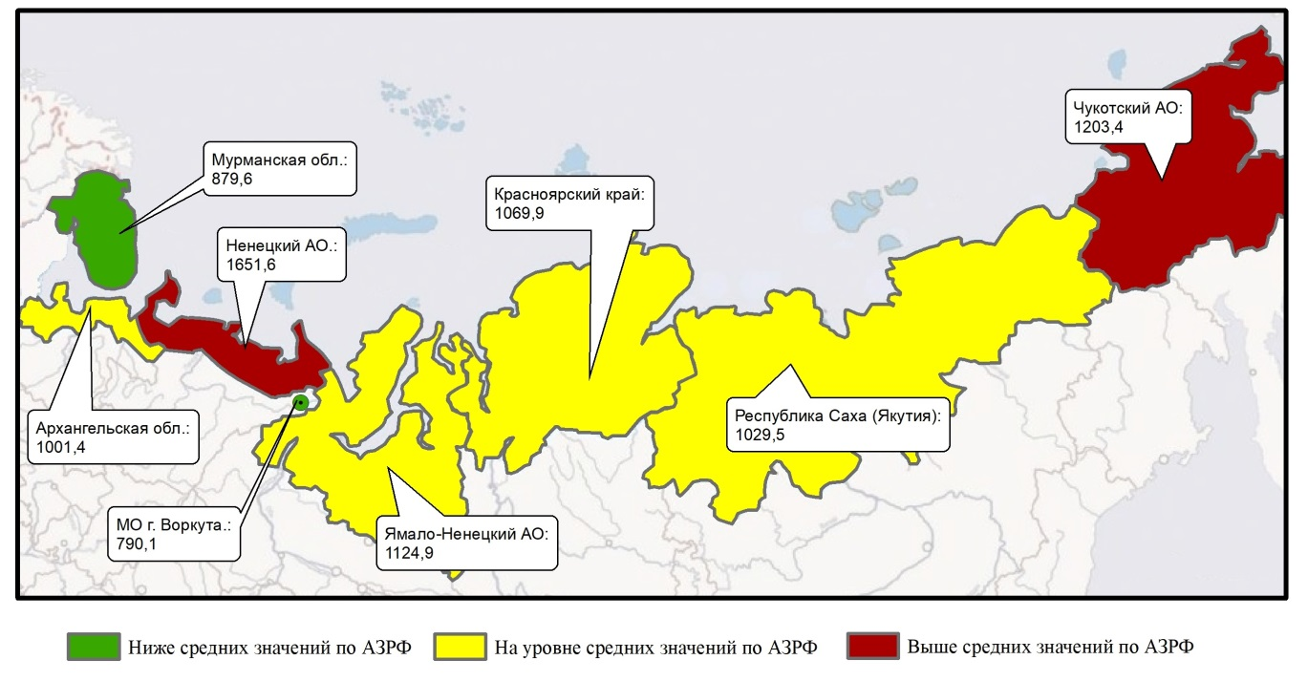
Morbidity in the Russian Arctic in 2016, per 1000 (all ages, both sex)
Chukotka AO: 1203.4
Murmansk
Oblast: 879.6
Krasnoyarsk
Krai: 1069.9
Nenets AO: 1651.6
Arkhangelsk Oblast: 1001.4
Sakha
Republic: 1029.5
Komi
Republic: 790.1
Yamalo-Nenets AO: 1124.9
< 1000 per 1000
1000 – 1200 per 1000
> 1200 per 1000
Level of morbidity: in the Russian Arctic is 1044.3 per 1000
in the Russian Federation is 778.2 per 1000
Novikova Yu.A, 2017
Notes:
At the end of my lecture I would like to say a few words about morbidity in Russia. Distribution of the morbidity levels in the Artic Russian regions is not equal. The highest level of morbidity among all population is in the Nenets and Chukotka regions. The lowest level of morbidity is in the Murmansk region.

Slide 21
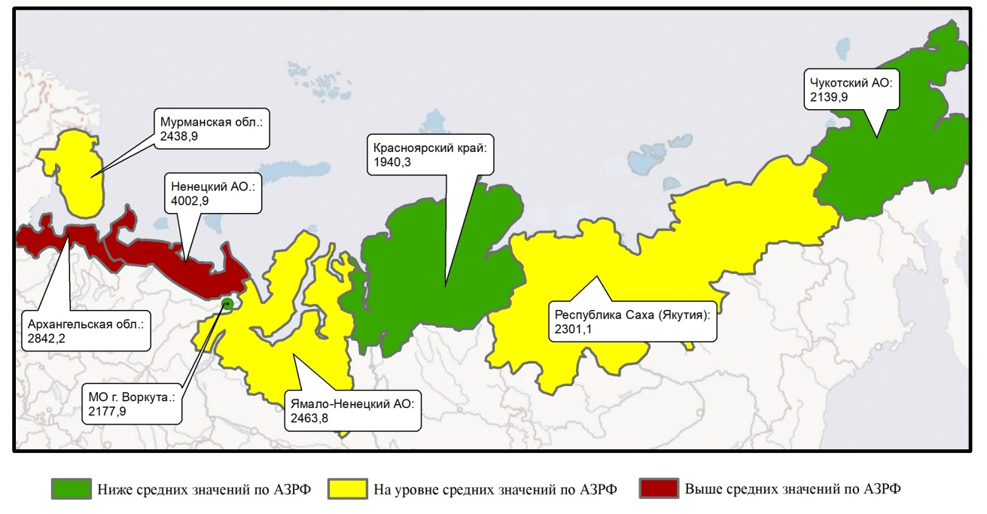
Morbidity in the Russian Arctic in 2016, per 1000 (children 0 - 17, both sex)
Chukotka AO: 2139.9
Murmansk
Oblast: 2438.9
Krasnoyarsk
Krai: 1940.3
Nenets AO: 4002.9
Arkhangelsk Oblast: 2842.2
Sakha
Republic: 2301.1
Komi
Republic: 2177.9
Yamalo-Nenets AO: 2463.8
< 2200 per 1000
2200 – 3000 per 1000
> 3000 per 1000
Level of morbidity: in the Russian Arctic is 2387.6 per 1000
in the Russian Federation is 1775.8 per 1000
Novikova Yu.A, 2017
Notes:
This slide demonstrates the distribution of morbidity among children. As you see the situation is different from whole population. Nenets region has the highest level of morbidity 4 000 cases per 1 000 children.
The risk territories of respiratory diseases including bronchial asthma are Nenets, Murmansk and Arkhangelsk regions.

Slide 22
Crude incidence rate of tuberculosis in 2006 – 2012, per 100 000
Bourgeois, 2016
Notes:
One of the most dangerous diseases is tuberculosis. Сertain circumpolar regions carry a significant burden of TB. Key risk factors that determine TB in the Arctic regions are physical environment (crowding and poor ventilation), poverty, poor access to health services and lifestyle behaviours (alcoholism, tobacco use, and malnutrition). Such Arctic Regions as Nunavut and Greenland have the highest crude TB incidence rate more than 100 cases per 100,000 population.

Slide 23
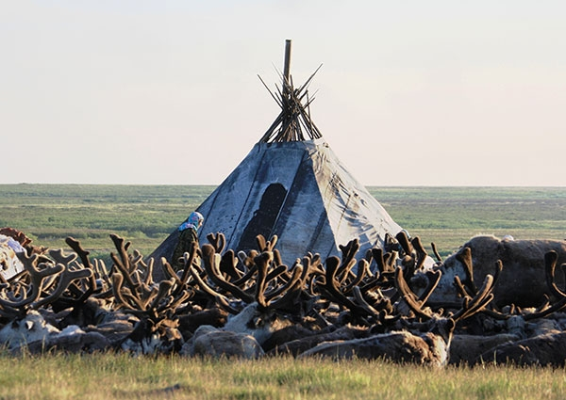
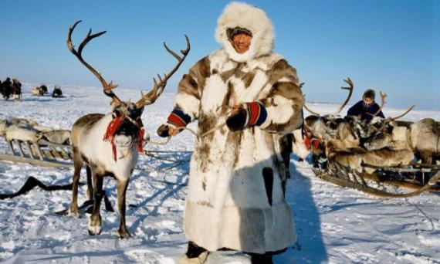
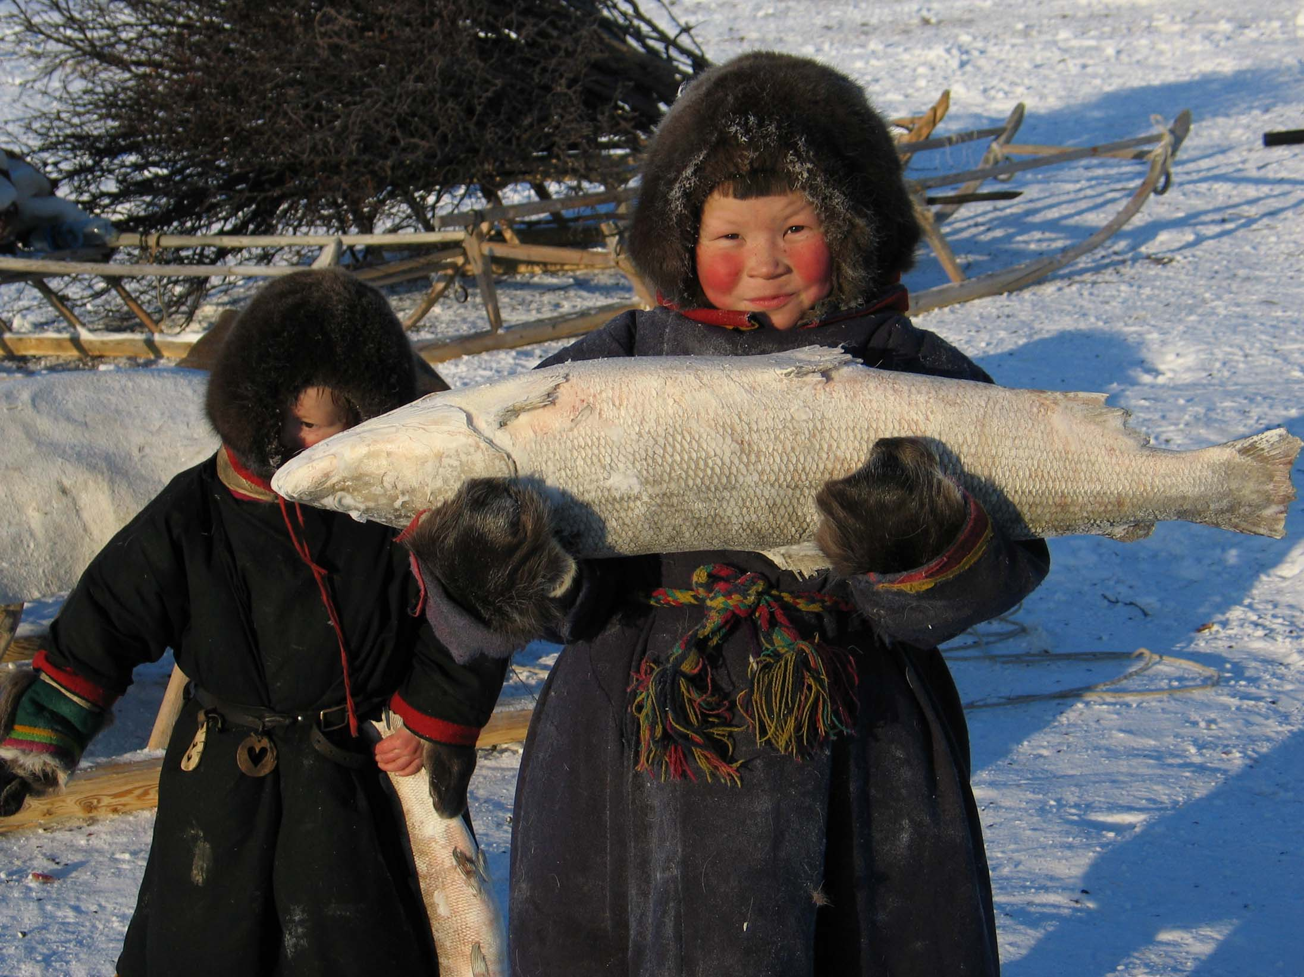
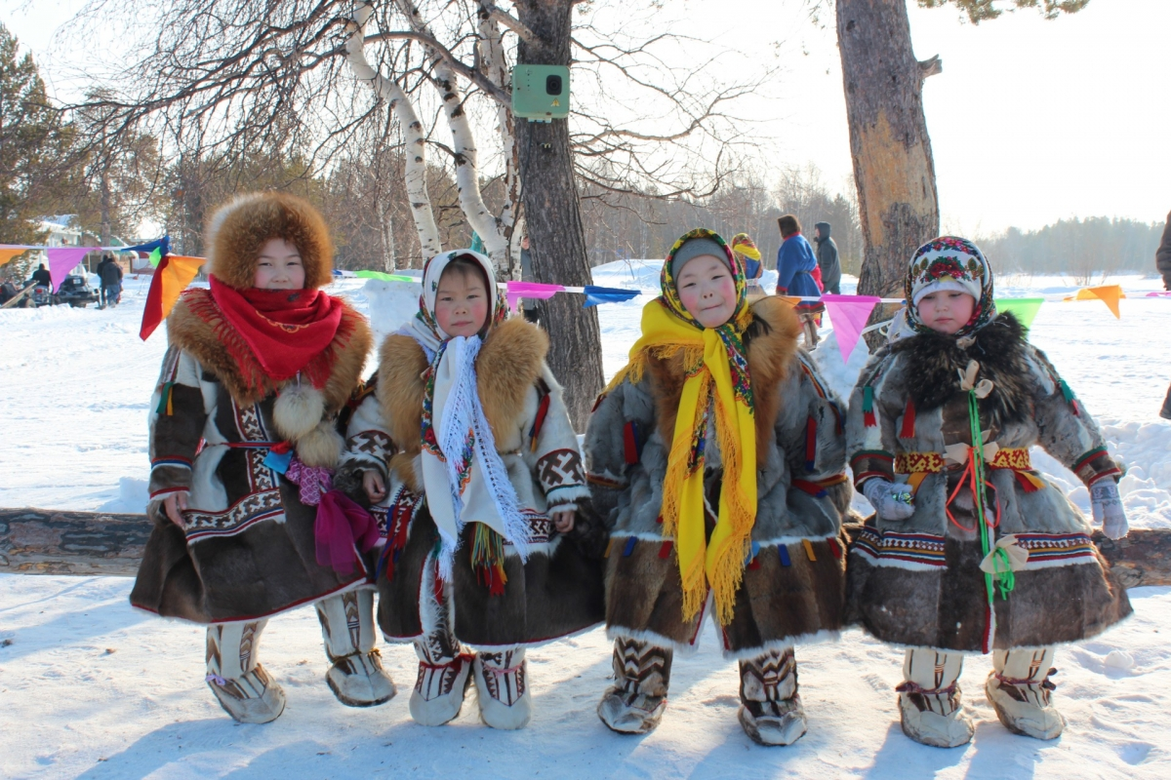
Thank you for your attention!
Notes:
To sum up, even though the Arctic regions have similar severe climate conditions, there are differences in levels of key health indicators, that is connected to local life characteristics in the Arctic communities such as traditional food, alcohol consumption and others.

