Slide 1
Sewage as important local pollutant source in the Arctic aqueous environments.
Roland Kallenborn
Norwegian University of Life Sciences (NMBU) & University Centre in Svalbard (UNIS)
Contact info: roland.kallenborn@nmbu.no; tel.: +47 67232497

Slide 2
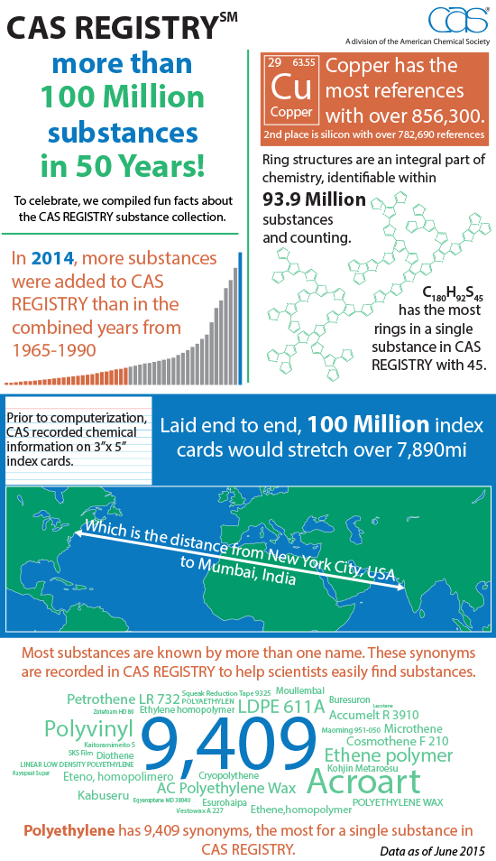
Todays Chemical Universe
According CAS (up-dated September 2017):
132 Million substances registered
387 225 substances regulated
200 000 substances identified as toxic
Estimated ca. 10 000 substances covered by current available analytical methods for quantitative analysis
CAS celebrates more than 100 Million registered chemicals in 2015

Slide 3
AMAP Chemicals of Emerging Concern (CEAS)
16 relevant compound groups identified.
Chemical of emerging concern (CEC): Either newly introduced substances or identified due to advancements in technology.
Chemicals of Emerging Arctic concern (CEAC): CECs found in the Arctic environment
Non-POPs like compounds included

Slide 4
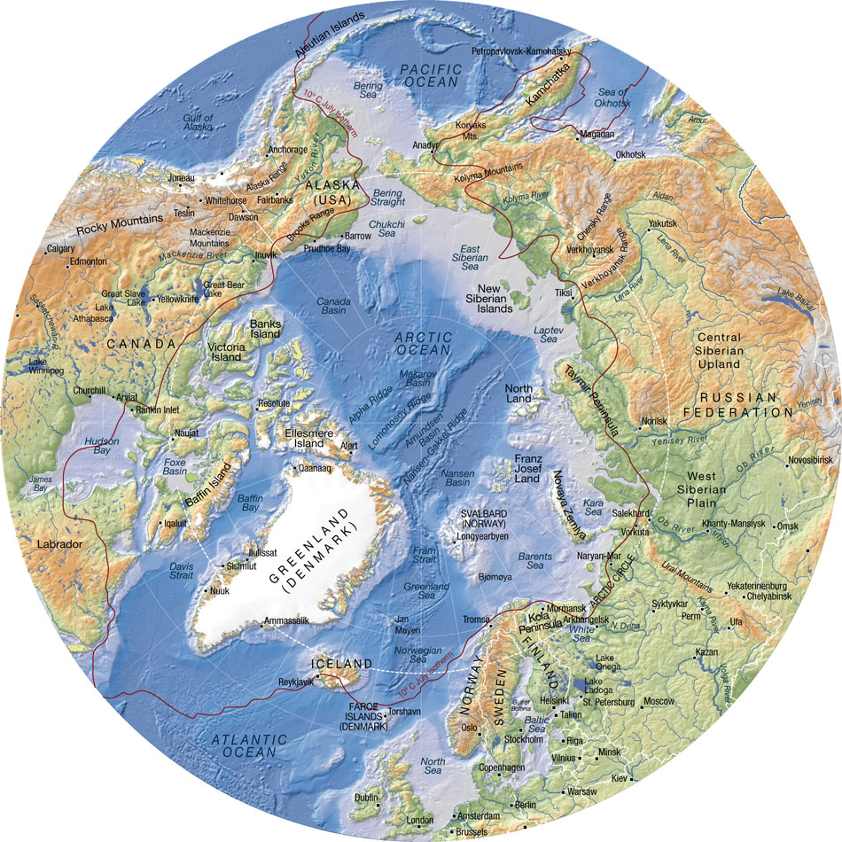
Background information
North of 66 º N (Polar Circle)
Average Temp. < 10 ºC (July)
Eight Arctic nations (Arctic Council)
14.5 mill. km² area (mainly marine)
Ca. 13.1 Mill. people are living in the Arctic
20% of the global water resources are found in the Arctic (ice caps, glaciers, cryosphere)

Slide 5
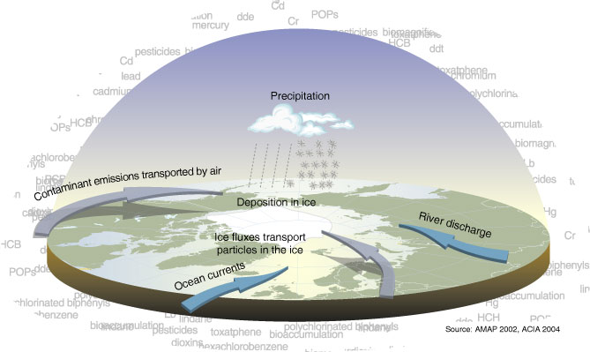
Arctic pollution
Global distribution processes
Remote sources
Bioaccumulation
Seasonal distribution patterns (photochemistry & microbiology)
Local sources ?
PBT: Persistent – Bioaccumulative - Toxic

Slide 6
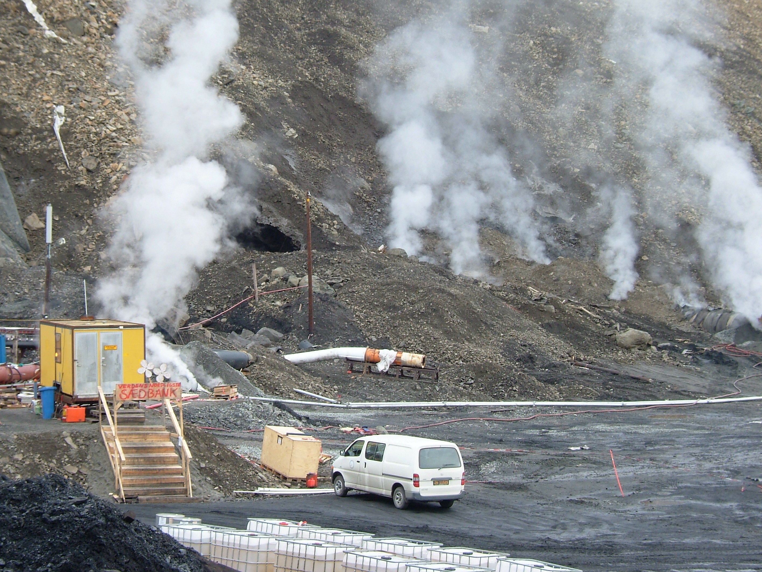
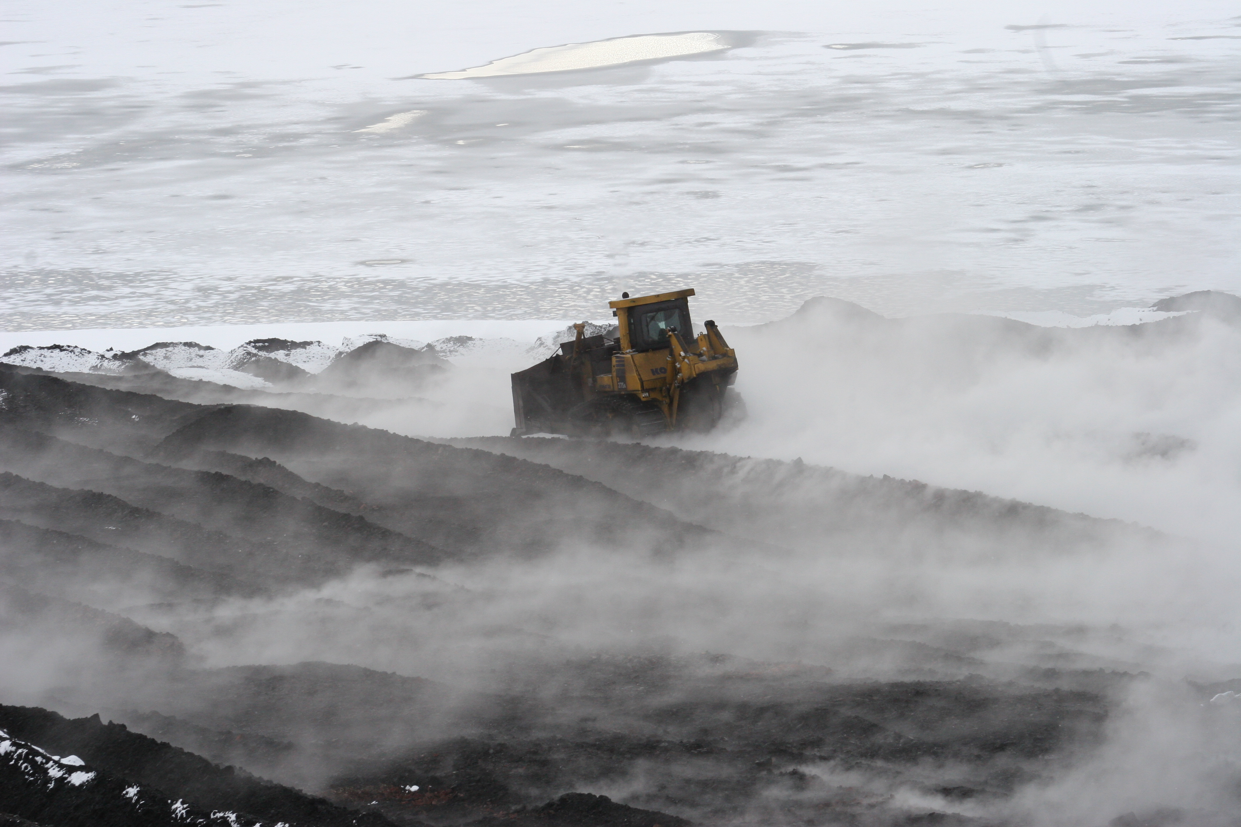
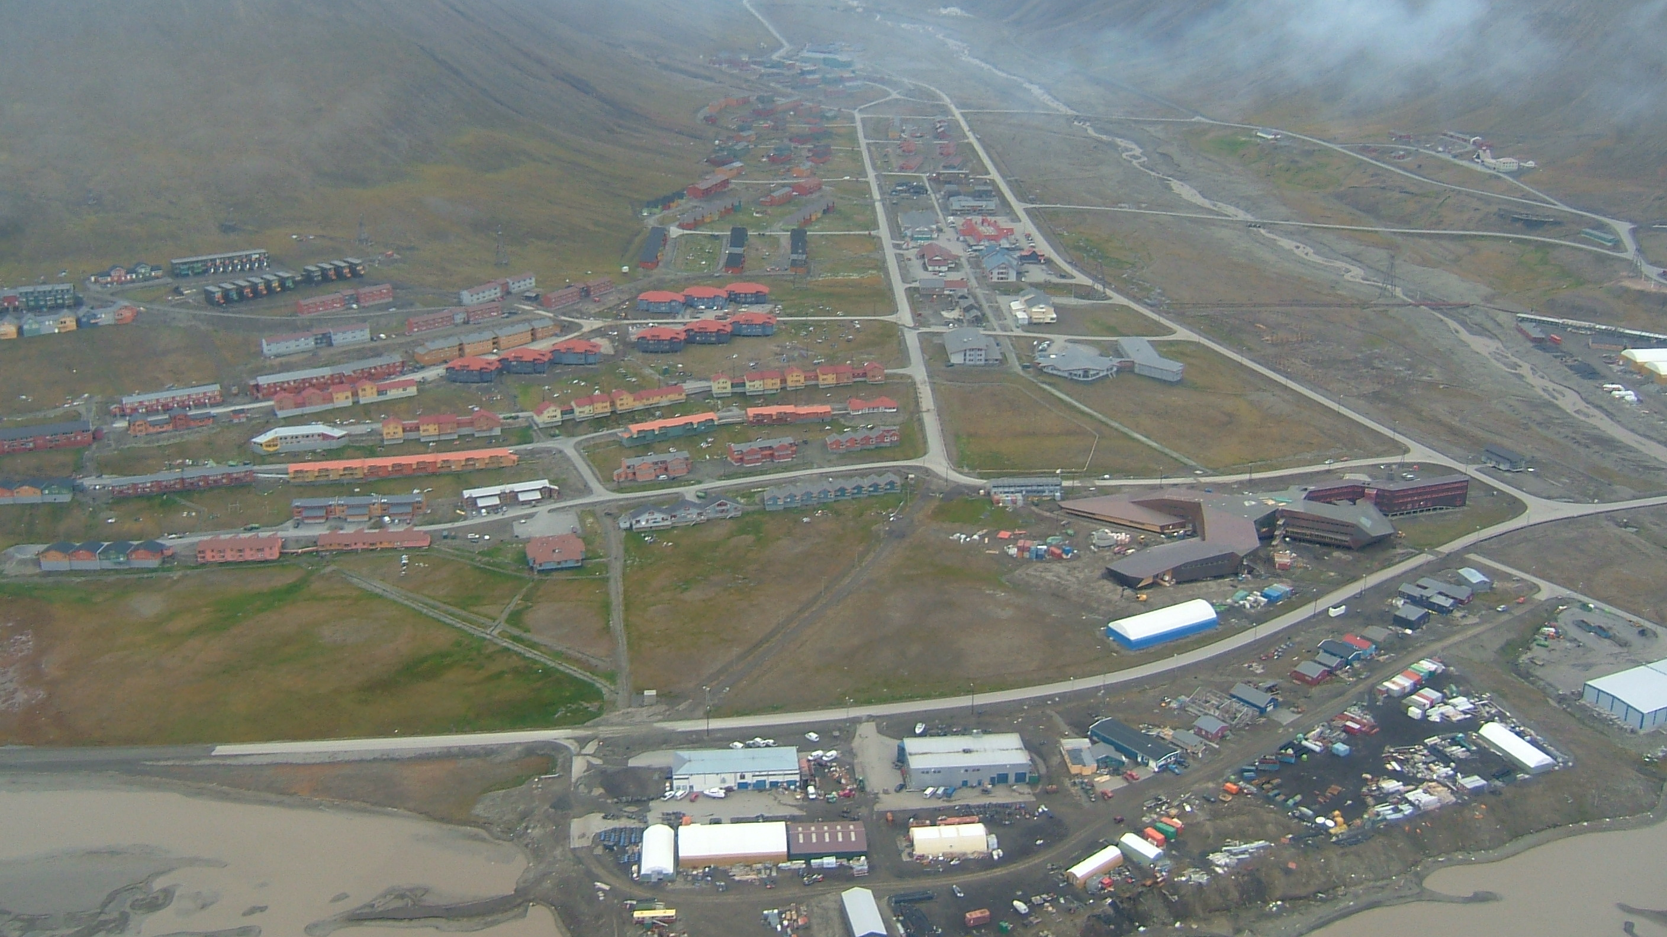
Local pollution issues
Anthropogenic activities: Industry – Households – Transportation – Energy production
“Human foot-print”
Arctic still considered as pristine environment
Significant local anthropogenic contamination sources

Slide 7
Sanitation and Sewage treatment in the Arctic
Direct release (veterinary, aquaculture, households), sanitation and sewage treatment identified as major sources
Decentralized or even absent
Low technological standards (absent, filtration, storage)
Direct release into ponds, local and coastal aqueous recipients or transported to storage/ treatment facilities.
Pictures: ARCUS/ NSF

Slide 8
Examples for local emission of pollutants
Power plants and domestic heating: Polycyclic aromatic hydrocarbons (PAH), metals (Hg, Cd, Pb etc.), volatile organic pollutants (VOCs)
Vehicles (fossile fuel combustion): PAHs, VOCs, aromatic compounds, metals
Local industry (mining, refining, fishery, off-shore): plastics, polymerrs, Metals, PAH, industrial chemicals (polychlorinated biphenyls (PCB), brominated flame retardants (BFR), perfluoroalkyl substances (PFASs) others, VOCs, anti corrosives, surfactants etc.
Agriculture (incl. infrastructures): Anticorrosives, plastics, pesticides, PFAS, PCB, BFR, pharmaceuticals and personal care products (PPCPs), surfactants, etc.
Municipale installations (Sewage treatment plants, others): Anticorrosives, pesticides, PFAS, PCB, BFR, pharmaceuticals and personal care products (PPCPs), surfactants, cosmetics, bioactive compounds, food preservation, plastics, polymers, additives, pesticides, …………..

Slide 9
1. Pharmaceuticals and personal care products (PPCPs)
Indicator chemicals for human activities
Sources: Hygiene products, Cosmetics, supplementary food, Veterinary & Human therapeutic applications etc.
Accessibility: PPCPs open available; vendors, stores; Medical therapy: Over the counter (uncontrolled) & Prescriptions (controlled)
Release: Introduction mainly via Sewage and sewage treatment (faces & urine), Direct (husbandry, aquaculture), uncontrolled disposal of outdated products via sewage/ manure and/or garbage dumps.
Photo: Wikipedia

Slide 10
Release pattern and distribution pathways
Sewage sludge and sewage effluents identified as main emission source in the Arctic
First studies from summer 2001/2002, Tromsø, Norway (Weigel et al. 2004):
Caffeine (upper) and Ibuprofen (lower) in Tromsøsund surface water samples [ng/L] in 2001

Slide 11
PPCPs in Norwegian Sewage effluents and recipients (2006): A first comparison
LOQ = Limit of quantification, n.a. = not analysed, n.d. = not detected

Slide 12
PPCPs in the Arctic: CEAC summary
110 PPCPs (including transformation products) identified
Conc. range: ppb – ppm
Environmental fate largely unknown

Slide 13
PPCPs in the Arctic environment
Metoprolol, Manitoba (ng/g dw)
Salicylic acid, Ontario (ng/L)
Paracetamol, Faroe islands (ng/L)
Lincomycin, Ontario (ng/L)
BAC, Faroe Islands (ng/g dw)
N-cresol, Faroe Islands (ng/g dw)
Citalopram, Tromsø (ng/L)
D4, D5 Svalbard (ng/m3)

Slide 14
Comparison with other regions
Conc. Unit | Compounds | Sample matrix | Levels Arctic [max] | Other regions | Non Arctic sampling location | Reference
ng/m³ | Siloxanes (D4, D5) | Air | 4 | 1100 | Chicago | Yucuis et al. (2013) Chemosphere 92: 905-910
ng/g | cresol | soil | 96 | 2000 | Russian soil | Korenman et al. (2001) J. Anal. Chem. 56/2: 166-169
ng/L | Ibuprofen | Sewage influent | 87400 | 3600 | Källby (SWE) | Bendz et al. (2005) J. Haz. Materials 122/3: 195-204
ng/g | Metoprolol | Sewage sludge | 680000 | 500 | WWTP Terrassa, Spain | Radjenovic et al. (2009) Water Res. 43: 831-841
ng/L | Paracetamol | Sewage effluent | 71000 | 150 | Källby (SWE) | Bendz et al. (2005) J. Haz. Materials 122/3: 195-204
ng/L | Lincomycin | Freshwater | 1413 | 40 | Biscayne Bay (Florida US) | Wang & Garinaldi(2012) Anal. Bioanal. Chem. 404: 2711-2720
ng/g | BAC | Freshwater Sediment | 1300 | 1500 | Long Island (NY) | Li & Brownawell (2010) Env. Sci. Technol 44: 7561-7568
ng/L | Citalopram | Sea water | 612 | 27 | San Francisco Bay | Nödler et al (2014) Marine Pol. Bull. 85: 50-59
ng/g | Bisphenol A | Marine sediment | 11 | 10500 | Taiwan | Huang et al (2012) Environ. International 42: 91-99
ng/g | Siloxanes (D5) | Marine biota | 10 | 36 | Walleye (Canada) | Goldrick et al. (2014) 186: 141-148

Slide 15
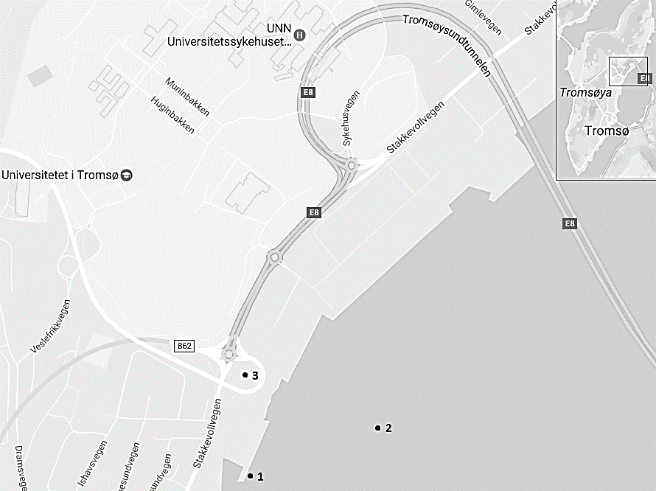
PPCPs in Tromsø (2016)
PPCPs in similar and in some cases even higher concentration ranges as reported in earlier studies were from the same area (Weigel et al. 2004).
Considerable variations reveal differences in consumption behavior and release patterns
Julie Strømberg, Masters thesis,NMBU,2016 (in collaboration with Terje Vasskog,UiT)

Slide 16
Tromsø studies (2002 versus 2016)
Increased overall emission rate reported for selected compounds
Additional PPCPs identified in 2016

Slide 17
2.) Poly- and perfluoroalkyl substances (PFAS)
Known as Arctic pollutants since the early 2000s
Many compounds are introduced via precursors and subsequent transformation into persistent compounds (PFOS, PFOA)
Identified as relevant pollutants in all environmental compartments in the Arctic
Local sources identified in the Arctic

Slide 18
PFASsource characterisation
Local sources in the Arctic
Firefighting training facilities (airfields, municipal, industrial facilities)
Sewage effluents and sewage storage ponds
Landfills
Outdoor equipment and clothing (Impregnation of surfaces)
Other recreational activities (skiing,skidoos etc.)

Slide 19
PFAS:Fluoros impact 2026
Local survey on PFAS sourcesand distribution pathways on Spitsbergen (collaboration, SLU; UNIS, NMBU)
Report available on the web-page of the Svalbard Miljøvernfond (SMF)

Slide 20
PFAS on Svalbard
Overall distribution (background)
Elevated levels found in snow melt
Snow melt and run-off from glaciers =major water resource for drinking water in the Arctic
FluorosImpact report 2016, SMF.

Slide 21
PFASs in Svalbard
Different PFASs patterns in coastal surface sea water, close to Barentsburg and Longyearbyen
Indication for local differences in PFASs emissions
FluorosImpact report 2016, SMF.

Slide 22
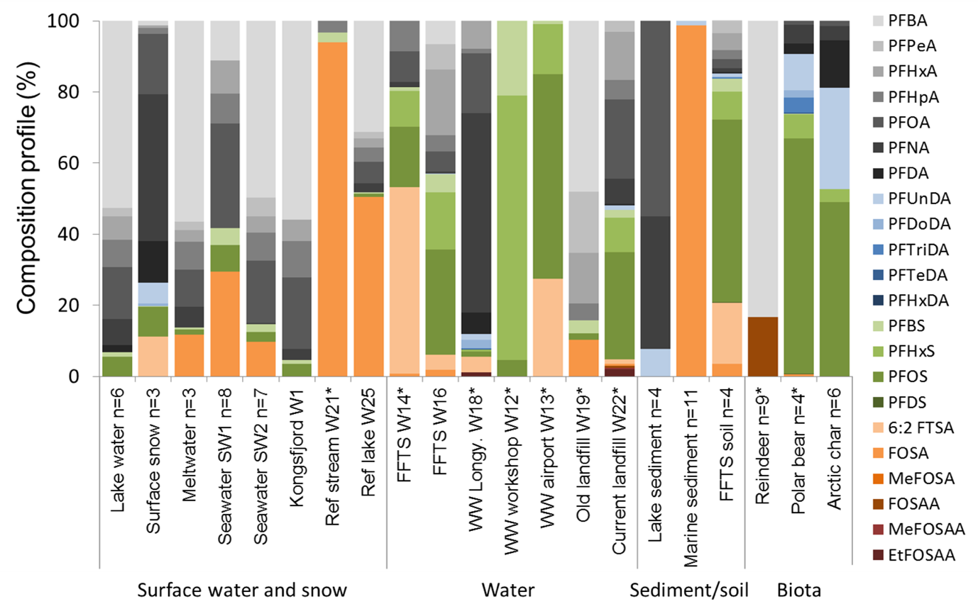
PFASs in Svalbard
PFASs emission profiles
Distinct emission profiles identified.
FFTS, landfills and Sewage emission identified as major sourse for PFAS

Slide 23
3. Trifluoroacetic acid (TFA)
Significant amounts of trifluoroacetate (TFA) are formed in the atmosphere by photochemical transformation of fluorinated refrigerants and subsequently introduced into the aquatic environment by wet deposition.
TFA is also a known transformation products of PFAS.
TFA is a High Production Volume Chemical and was identified as biodegradation product of different pesticides.
Reported concentrations of TFA in European surface waters are usually <1 μg/L (= 1000 ng/L).
Due to industrial discharge, high concentrations of TFA (up to 100 μg/L) were detected in a tributary of the River Rhine.

Slide 24
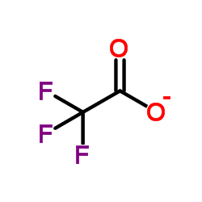
TFA in the Arctic
First screening in Oslo and Longyearbyen 2017:
Oslo drinking water = average 150 ng/L
Longyearbyen Drinking water: average 200 ng/L
Longyearbyen surface snow: average 60 ng/L
TFA is ubiquously found in surface waters
Various pathways into water are identified (industry, domestic, atmosphere)
Commonly applied techniques in waterworks do not remove TFA
Analysis conducted by Karsten Nødler, DVGW-Technologiezentrum Wasser in 2017

Slide 25
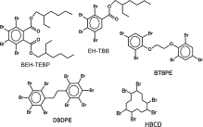
Novel brominated flame retardants (BFRs)4.)
Known as Arctic pollutants since 1990s
Additional CEAC compounds recently identified:
Deca-BDE, BEH-TEBP, BTBPE, DBDPE, DBE-DBCh, EH-TBB, HBBz, HBCDD, OBTMPI, PBB-Acr, PBBz, PBEB, PBT, TBBPA, TBBz, TBCT, TBP-AE, TBP-BAE, TBP-DBPE, TBX (name list available upon request)
Identified in air, water and biota (marine predominantly
Levels were found low with predominant occurence in the marine enviroment.
Released through ølocal sources included industry and sewage
Source: Olukunle et al. (2015) Waste Manag. 43: 300-306
Mean concentrations of bis(2-ethylhexyl)tetrabromopthalate (BEHTBP) (ng/g lw) in birds. Source: Sagerup et al (2010) New brominated flame retardants in Arctic biota. Norwegian EPA report 1070/2010 – TA2630

Slide 26
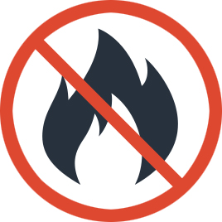
CEACs relevant as surface water contaminants
Chlorinated flame retardants: Dechlorane plus and others - 8 comp.; Identified in the terrestrial andmarine environment; Remote and local sources identified; ppt Concentration range in aqueous and solid samples
Organo-phosphate based flame retardants: Organophosphate esters (OPE) – 20 comp.; Confirmed in the Arctic atmosphere and biota mainly; conc. in low/medium ppt range (max. 2300 pg/m³ air).
Phthalates: Esters of phthalic acid – 11 comp.; Confirmed in air and mainly the marine Arctic enviroment; conc. In the low/ medium ppb range (Torshavn DINP: 17000 ng/g dw sed.)

Slide 27
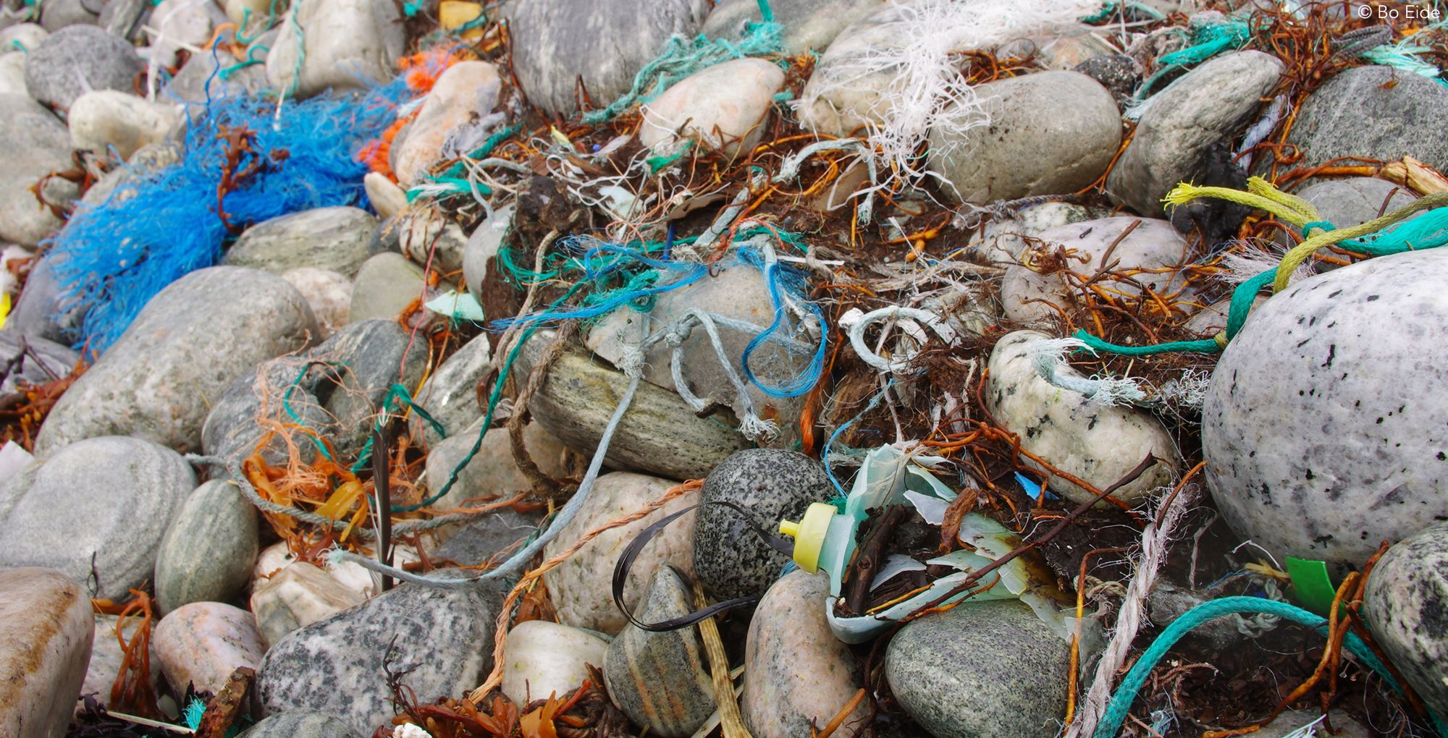
CEACs relevant as surface water contaminants
Marine plastics and microplastics: Strong focus on the marine environment incl. Sea ice. Up to 250 particles/m3 in sea ice cores. Plastic ingestion by Arctic biota confirmed
Unintenionally generated PCBs: Generated by thermal decomposition, pigment manufacture (impurities); 93 congeners: found in Arctic air and terrestrial samples; in low/ medium ppt range (Ny-Ålesund soil: 167 pg/g dw).

Slide 28
Potential adverse effects
Significant knowledge gaps evident for all CEAC groups
PFASs: Protein associated; immunotoxicity
nBFRs: Endocrine disrupting, neurotoxicity
Phthalates: Endocrine disrupting, reproductive effects, pre-birth development
TFA: Immunotoxicity,
PPCPs: Target effects, cytotoxicity, neurotoxicity, immuntoxicity

Slide 29
Remediation and mitigation strategies
Coordinated sanitation strategies required
High technological standards for Sewage treatment for decentralized systems
Community awareness: Disposal strategies and public awareness in the communities (i.e. pharmacies as return points for outdated pharmaceutical products)
Continuous communication of all critical aspects with the public
Development of sanitation technology for cold High North environments

Slide 30
Knowledge gaps
Medium and long term monitoring data need for source evaluation.
Time and spatial trend investigations for priority CEACs are needed.
Comprehensive information on source apportionment and assessment of source strength is missing
Research on mitigation and abatement strategies on CEACs in Arctic waters required.
The elucidation of transformation processes as an integrated part of fate assessment is not available.
Reliable environmental toxicology and effects studies for the Arctic environments are missing.
Joint Research & Development strategies for PPCP remediation and abatement in the Arctic

Slide 31
Conclusions
CEACs are present in Artic environments.
STP release into aquatic environments identified as major environmental source in the Arctic
Level can reach high μg range in contaminated sites
No spatial trends identified in the registered studies
Level can be higher than for middle latitude regions
Low Technological standards or even absence of Sewage treatment
Concentration range depends on usage patterns and sanitation treatment
Adequate remediation and mitigation strategies required.

Slide 32
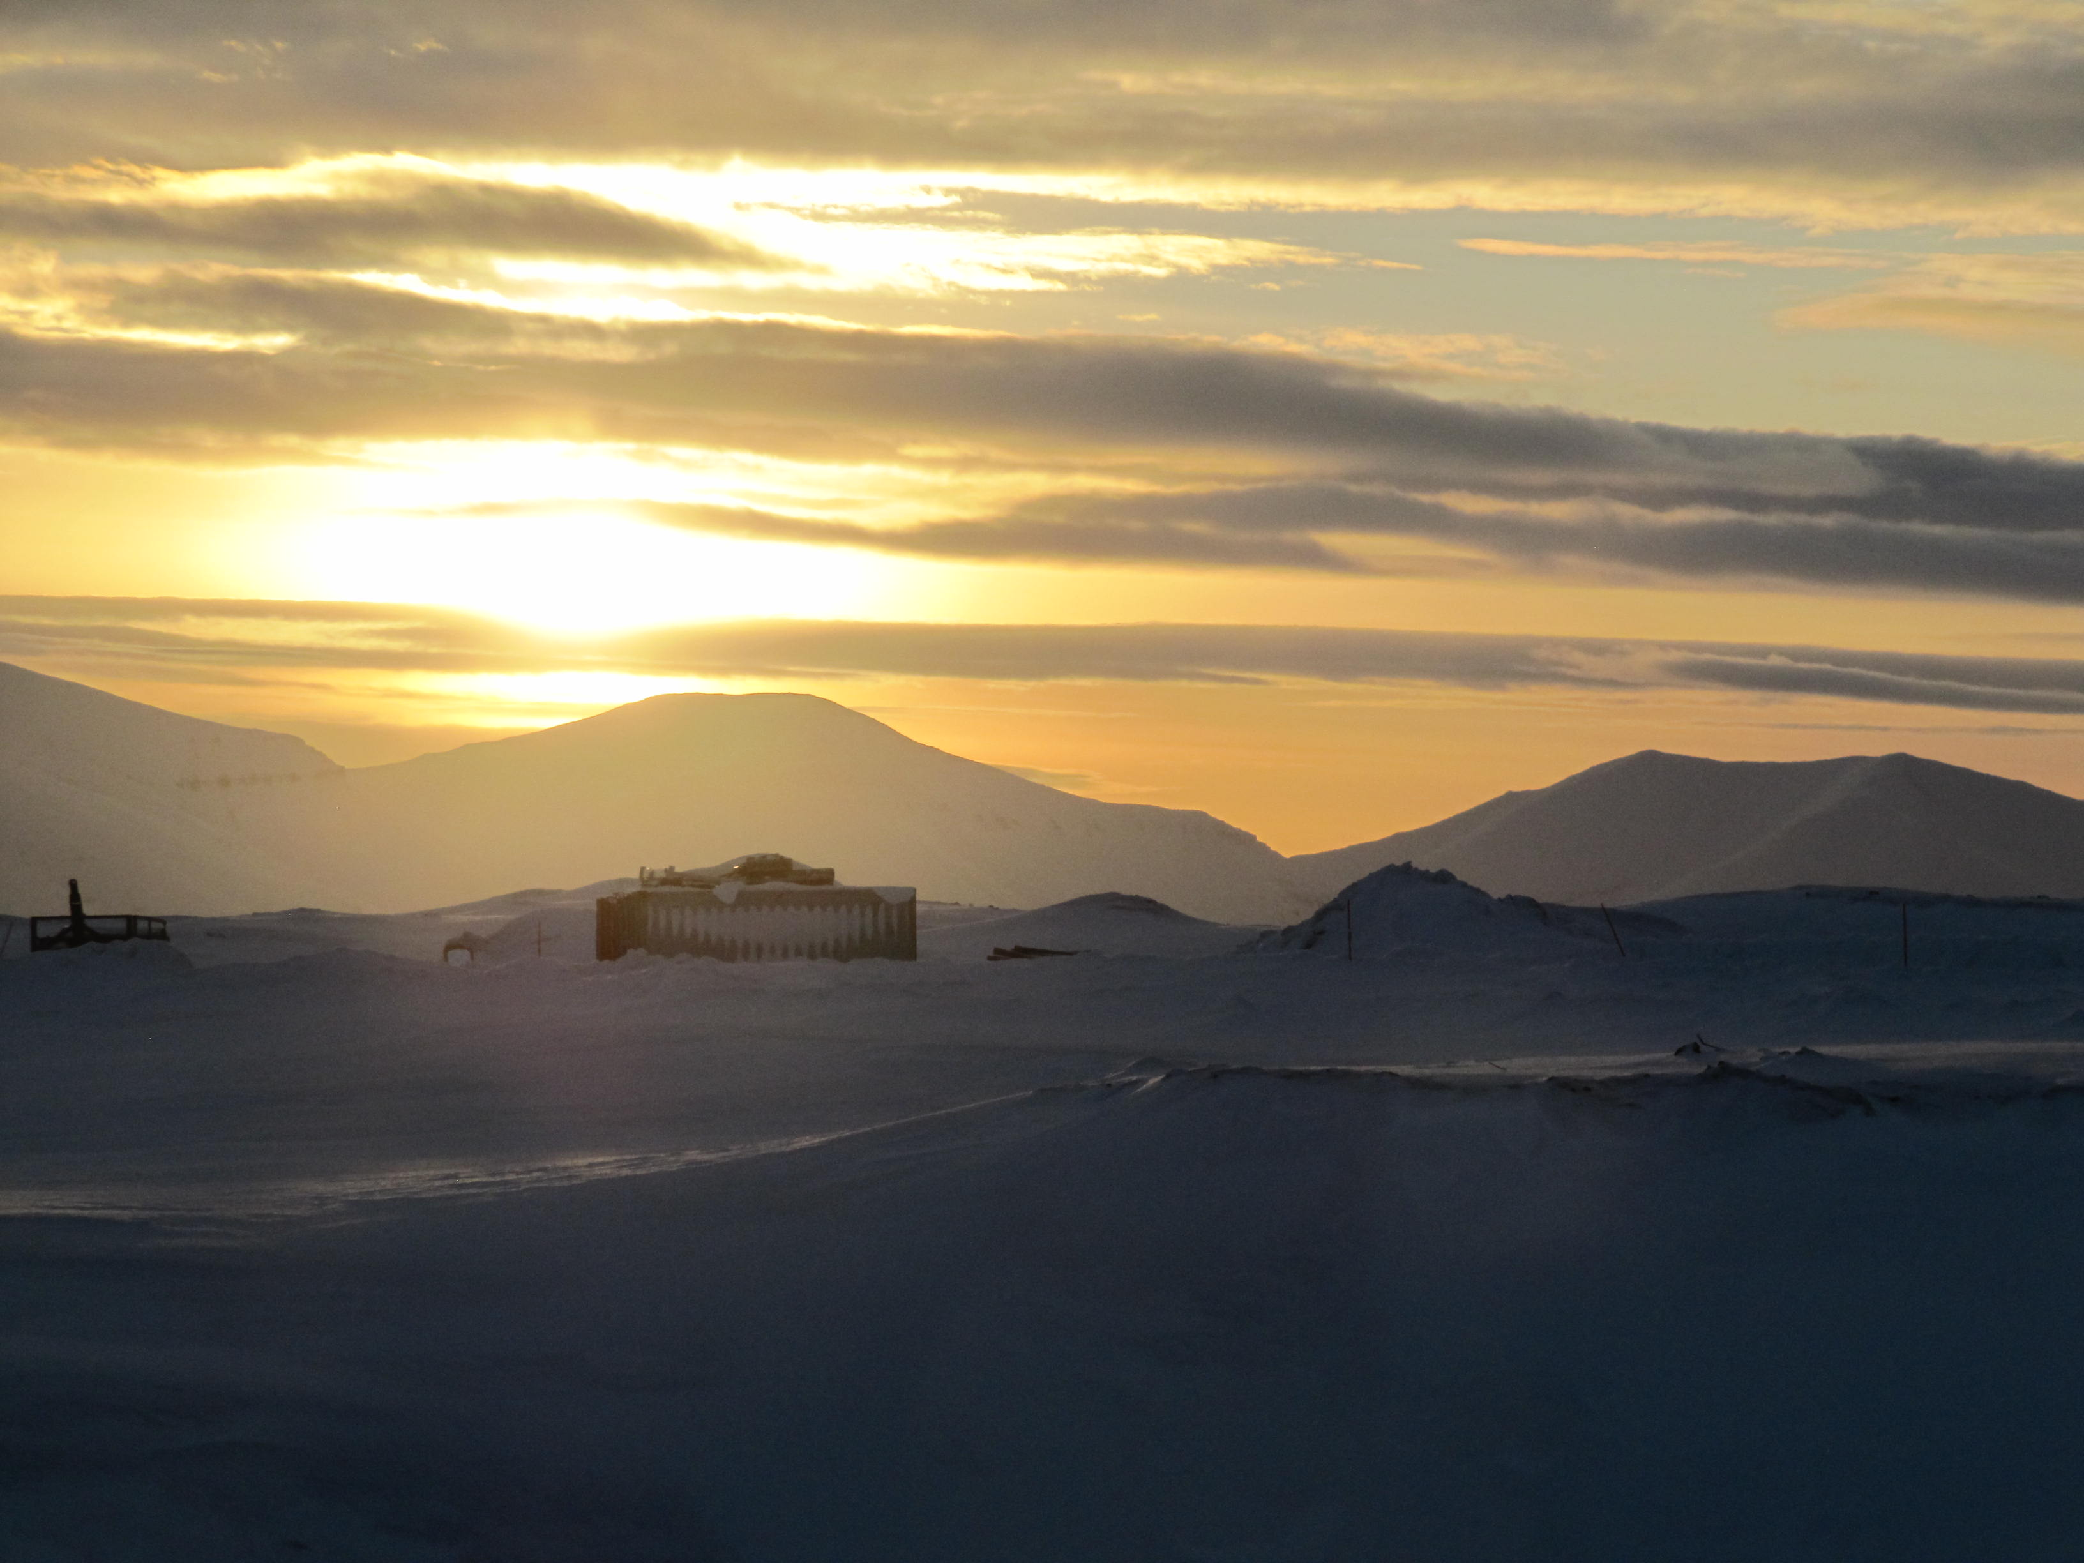
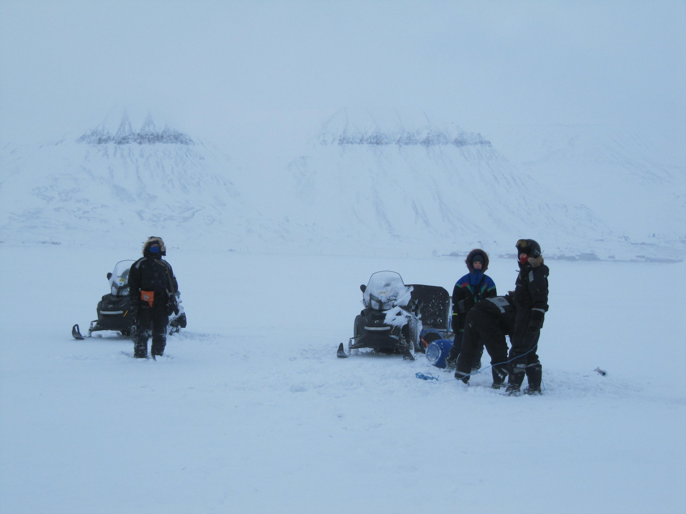
Acknowledgement
The Arctic Monitoring and Assessment Programme (AMAP) initiated the here presented survey of CEACs in the Arctic.
Lars-Otto Reiersen, Simon Wilson, Janet Pawlak (AMAP), Terje Vasskog (NORUT, Tromsø), Stefan Weigel (RIKILT, NL), Pernilla Carlsson (NIVA, Oslo) contributed with advise, data and discussions.
The AMAP/NCM project “Combined effects of Climate and Pollution” & and FP7 ArcRisk supported this study financially and with data.
NMBU, UNIS and DVGW-Technologiezentrum Wasser in 2017 for in-kind support

